Slide 1
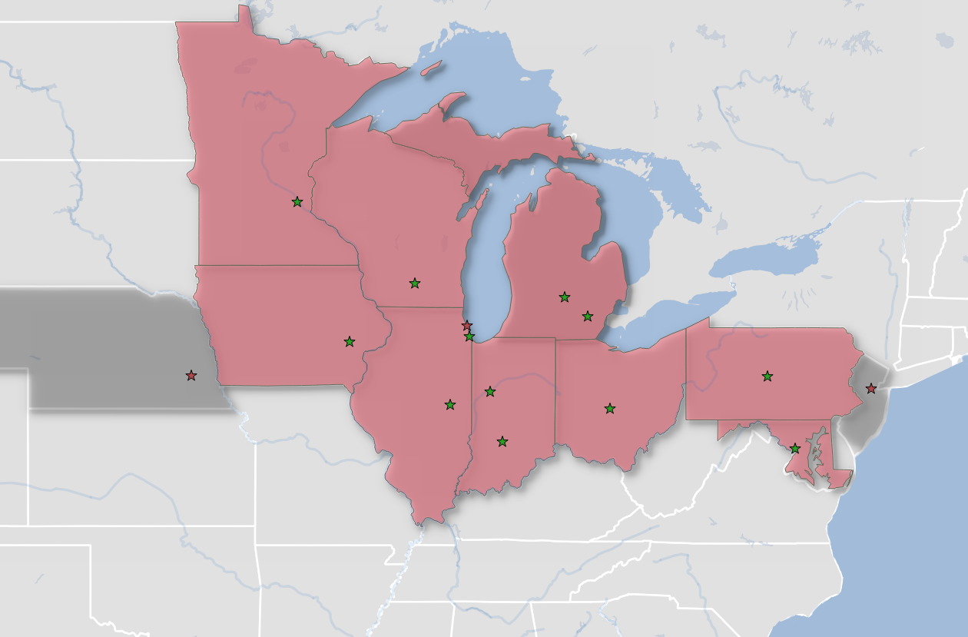
A Collaborative GeoPortal for the Big Ten Region
Kathleen W. Weessies
Tim Kiser
Nicole Smeltekop
Amanda Tickner

Slide 2
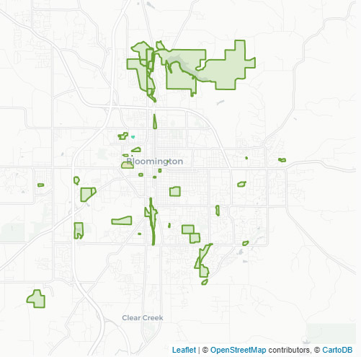
City parks in Bloomington, Indiana

Slide 3
1. Dumps
2. Go everywhere
3. Networking

Slide 4
1. Dumps
2. Go everywhere
3. Networking
404 Not Found

Slide 5
1. Dumps
2. Go everywhere
3. Networking

Slide 6
1. Dumps
2. Go everywhere
3. Networking
State GIS
County GIS
Local GIS
Local NGOs
Regional GIS

Slide 7
1. Dumps
2. Go everywhere
3. Networking

Slide 8
1. Dumps
2. Go everywhere
3. Networking
You as Bottleneck

Slide 9
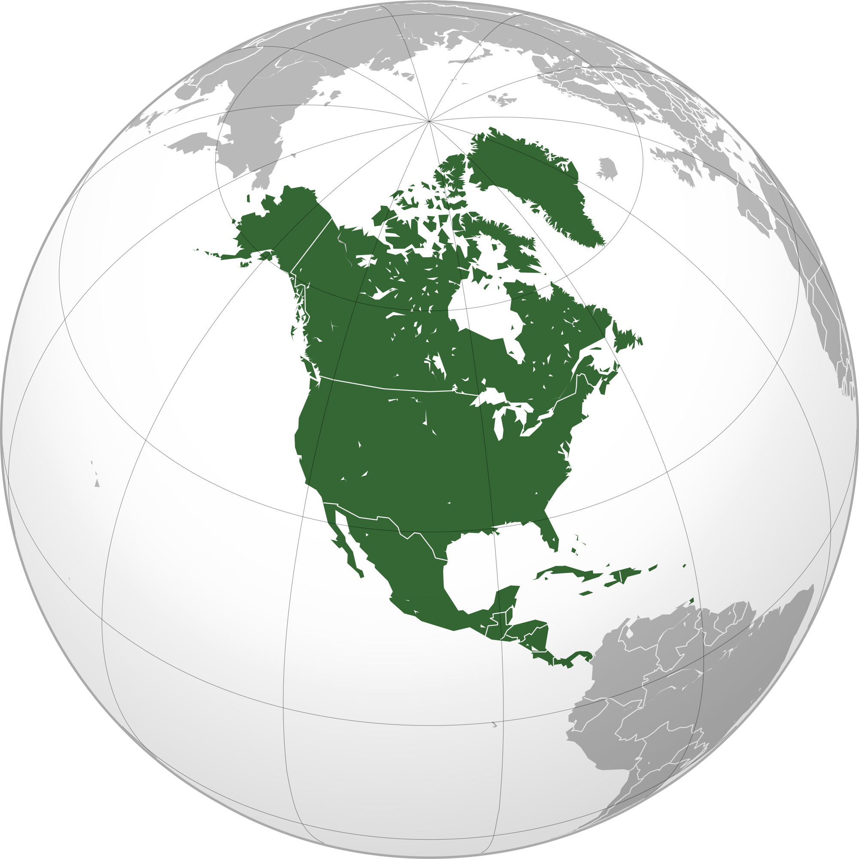

Slide 12
Map of north America with service regions
🍁

Slide 13
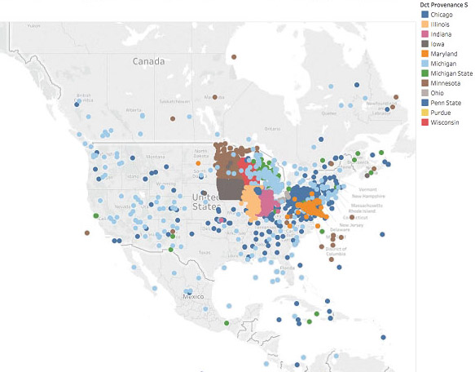

Slide 14
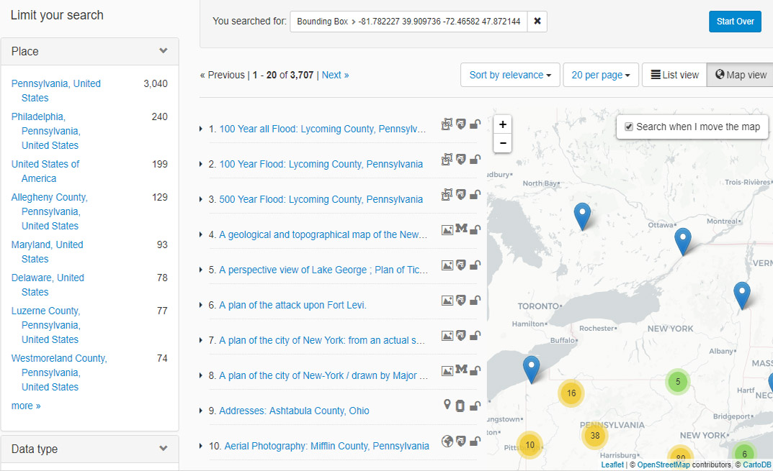

Slide 15
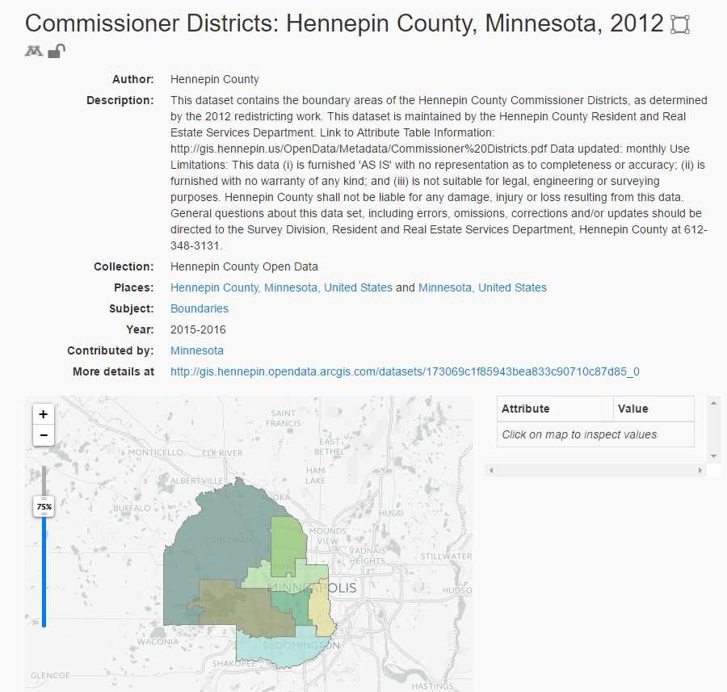

Slide 16
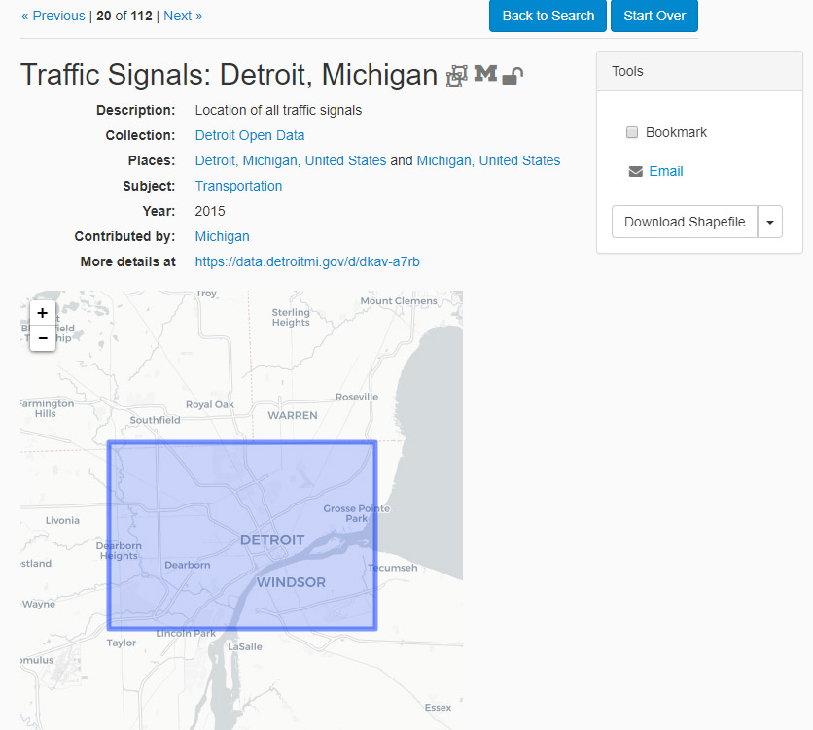

Slide 17
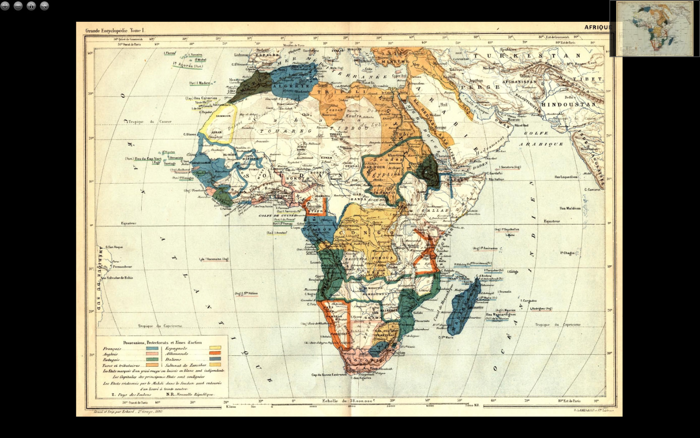
Change to Africa map

Slide 18
So Why do This?
Map librarians responding to an increased demand for geospatial data across a wide range of disciplines
Challenges to access and discovery

Slide 19
15 Research University Libraries
12 Participating

Slide 20
15 Research University Libraries
12 Participating
Change to new Big ten map – color in participating schools

Slide 21
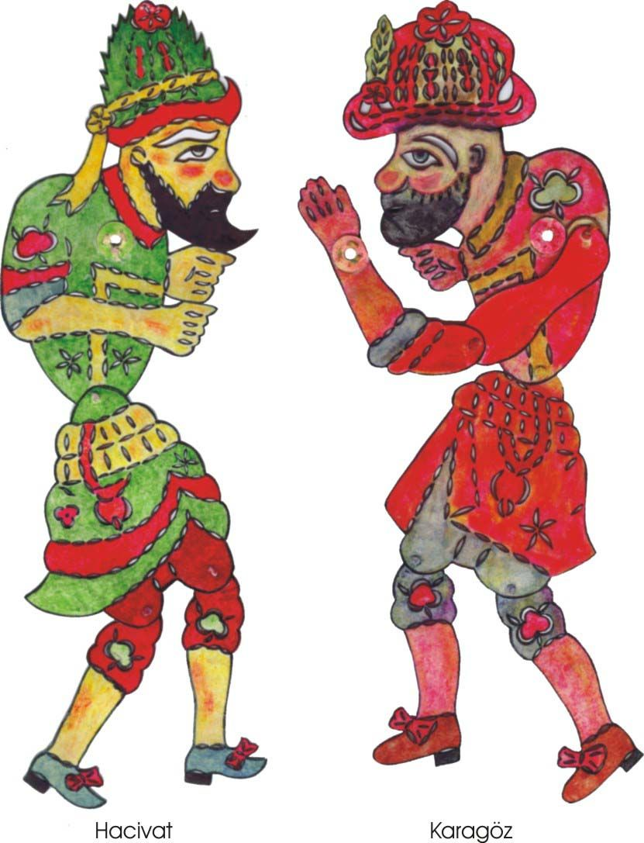
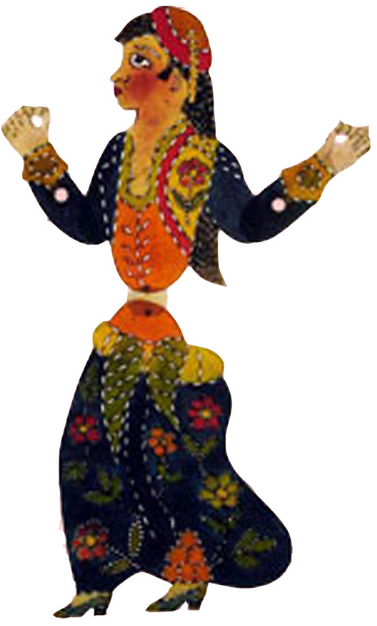
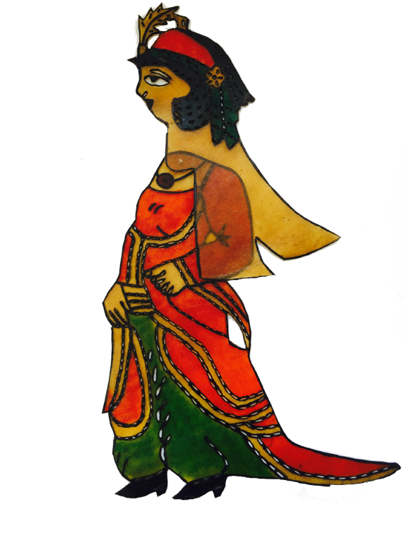
Ryan 10% Karen 100% Eric 25% Melinda 25%

Slide 22
1. Interface
2. Metadata
3. Learn & Share

Slide 23
Statewide Clearinghouses
Local Governments in our Region
Scanned historic maps or aerial photographs

Slide 24
Transforming Metadata
ISO
ISO
FGDC
Dublin Core / MARC
Geo Blacklight Schema
ISO
FGDC
Dublin Core / MARC

Slide 25
Strategic Leadership Group
Roles and Effort:
UMN BTAA:GDP Project Lead: Ryan Mattke
BTAA:GDP Task Force Members
Jaime Martindale - Wisconsin
Nicole Kong - Purdue
Senior-level representatives
Claire Stewart- Minnesota, SLG Chair
Jon Dunn - Indiana
Karen Estlund - Penn State
Karen Hogenboom - Illinois
Field specialists
Len Kne - Minnesota
Oya Rieger - Cornell (specialist in sustainability models)
Jack Reed - Stanford (GeoBlacklight)

Slide 26
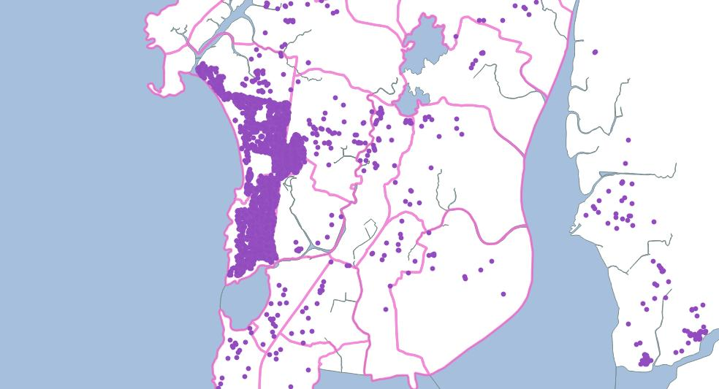
Shops in Mumbai, India (Vector File)

Slide 29
Usability and the BTAA Geoportal
Three institutions/individuals conducted 16 user tests:
Mara Blake, University of Michigan
Karen Majewicz, University of Minnesota
Amanda Tickner, Michigan State University
Notes:
First usability study of a geoportal/geoblacklight
With non-GIS users and GIS users recruited from list-servs, student employees, MI GIS user meeting, etc.
6 task questions, likert scale questions, follow up questions – participants encouraged to “think aloud” as they were completing tasks.

Slide 30
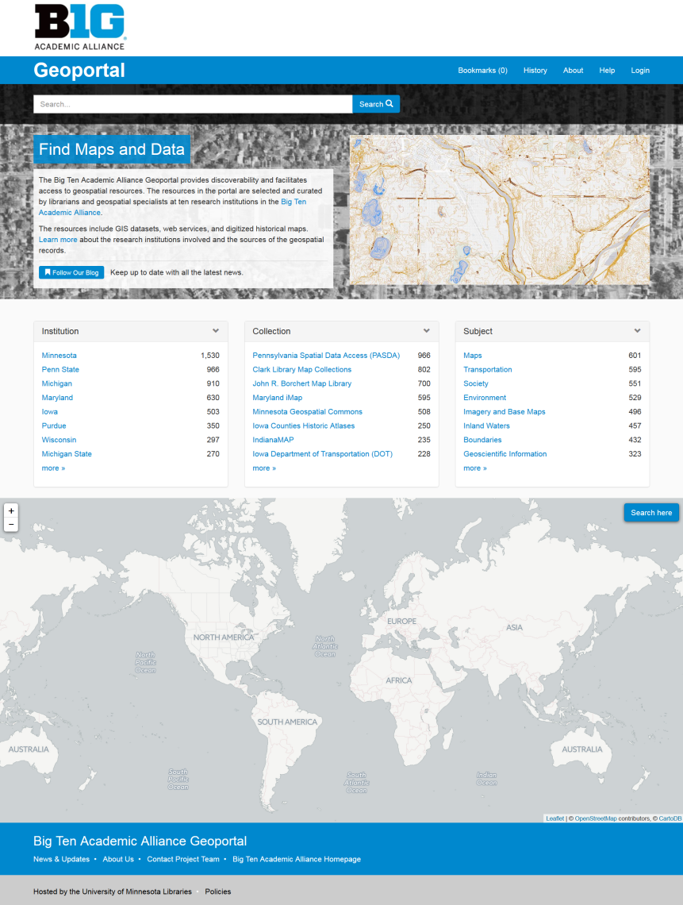
Overall Positive Response
There was praise for the colors, layout, and general aesthetics of the site
Notes:
There was unanimous praise for the visual design, color, and aesthetics of the site. Several users commented that the site was straightforward to use and that the simplicity of options made it easy to learn.
An ignored design feature was the use of icons for institution, access, and data type. Users did not know what these icons are supposed to represent, and none of the users discovered their explanatory hover labels.

Slide 31
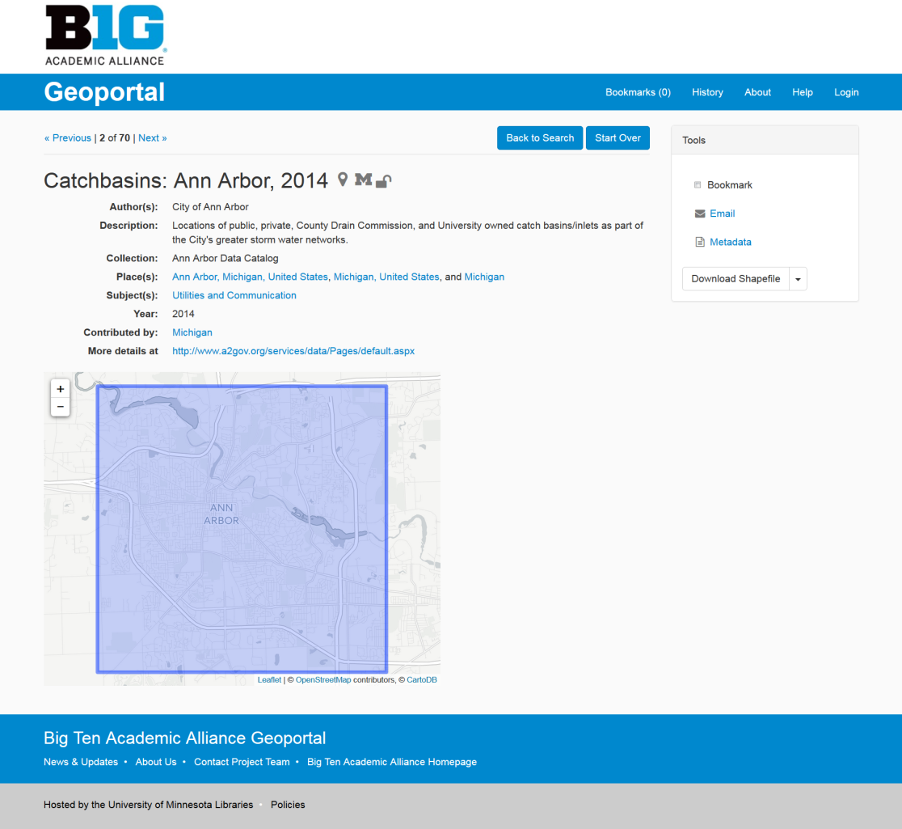
Differences between expert and novice GIS users
More minimal than anticipated
Notes:
Key differences:
Confusion over preview box
Confusion with file type being downloaded (scanned map versus shapefile)

Slide 32
How did people search?
Free text in search box (primary)
Typically the map search was ignored
Facets were used in addition to free text after initial search
Notes:
The geoportal has three main search functions: a text box, a map inset, and facets.

Slide 33
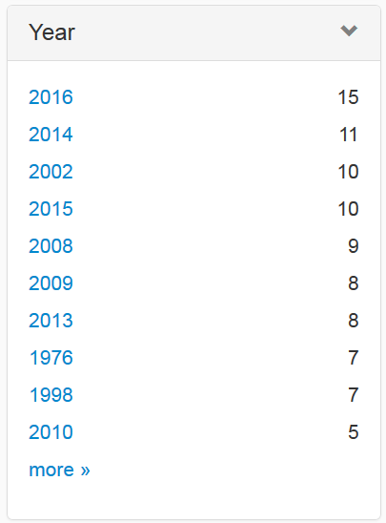
Recommendation 1: Clean and robust metadata/keywords
Problem w/Solr: MI and Michigan treated differently, abbreviations not recognized. Capital letters also.
Lack of chronological order and alphabetical order for topics within facets was problematic
Notes:
The most common cause of a failed text search was after typing in a place name or phrase that did not exist in any of the metadata records. When this occurred, users were often stymied and did not know how to proceed. For example, one user searched for “Ann Arbor, MI.” The state abbreviation “MI” did not appear in any metadata records, causing surprise on the user’s part that the Geoportal did not seem to include items for the city of Ann Arbor.
SUBJECT FACET USED: these keywords had not been standardized for capitalization, which negatively affected scrolling, since the same or similar keywords appeared multiple times. These duplicates and inconsistencies in keywords also eroded trust in the interface for some users.
The most obvious issue that arose is that users have been conditioned to expect higher quality results from using text searches than the geoportal can offer. Internet search engines have been calibrated to include massive synonym libraries, spatial indexes, timelines, and natural language inputs. The Solr engine for the geoportal has not been configured to incorporate this kind of functionality, and users were confused when their text searches failed. Several users also expressed impatience with the need to enhance their searches by selecting facets or repositioning the map.
Overall, users did not often take advantage of facets and were confused by the myriad of results when they did. GeoBlacklight is populated with records by loading individual flat files into Apache Solr. Solr indexes the records and enables querying and faceting by matching integers or text strings. A challenge of this method is that it strips out possible entity relationships that might be found in a database and groups values only if the text strings match exactly. For example, with our current Solr configuration, “Inland Waters” and “inland waters” would not be grouped together, nor would “Philadelphia, PA” and “Philadelphia, Pennsylvania.” Since the Big Ten project aggregates metadata records from dozens of clearinghouses, who may be using different best practices and standards, expecting normalized keyword or contact values is unrealistic. As a result, the unrefined metadata records created a long, unwieldy list of near duplicates in GeoBlacklight that made browsing confusing to users.
Solution: The BTAA team proposes mediating this problem by normalizing the metadata, adding synonyms, and making the adjacent search strategies of using the map and the facets more prominent, more understandable, and easier to use.

Slide 34
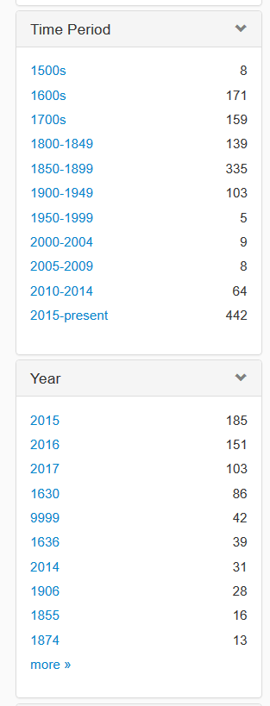
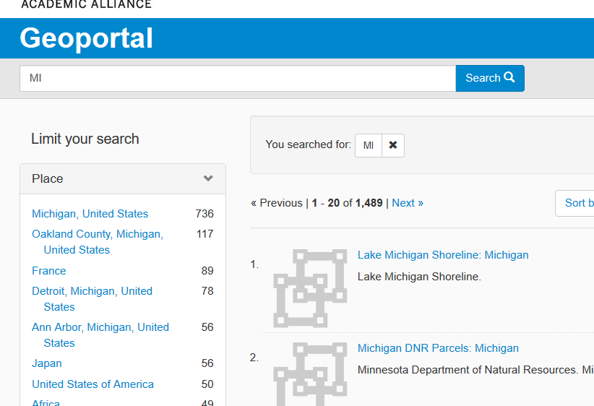
Updates to site: improved facets/keywords

Slide 35
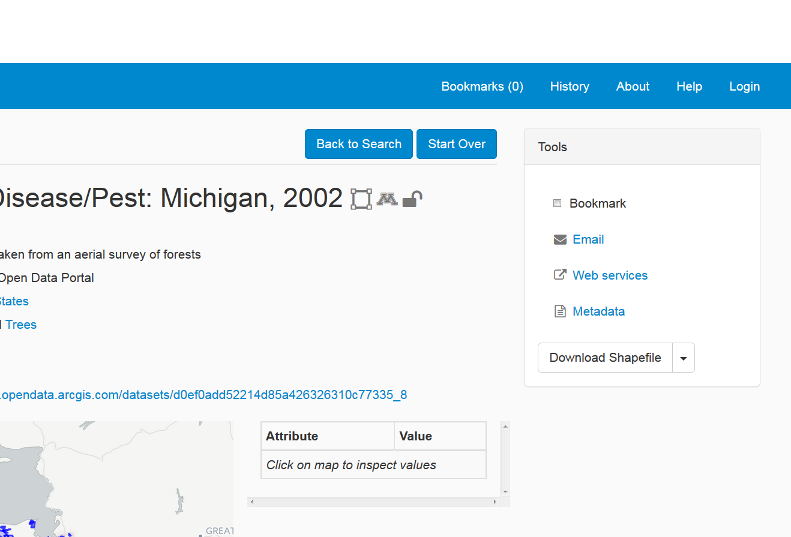
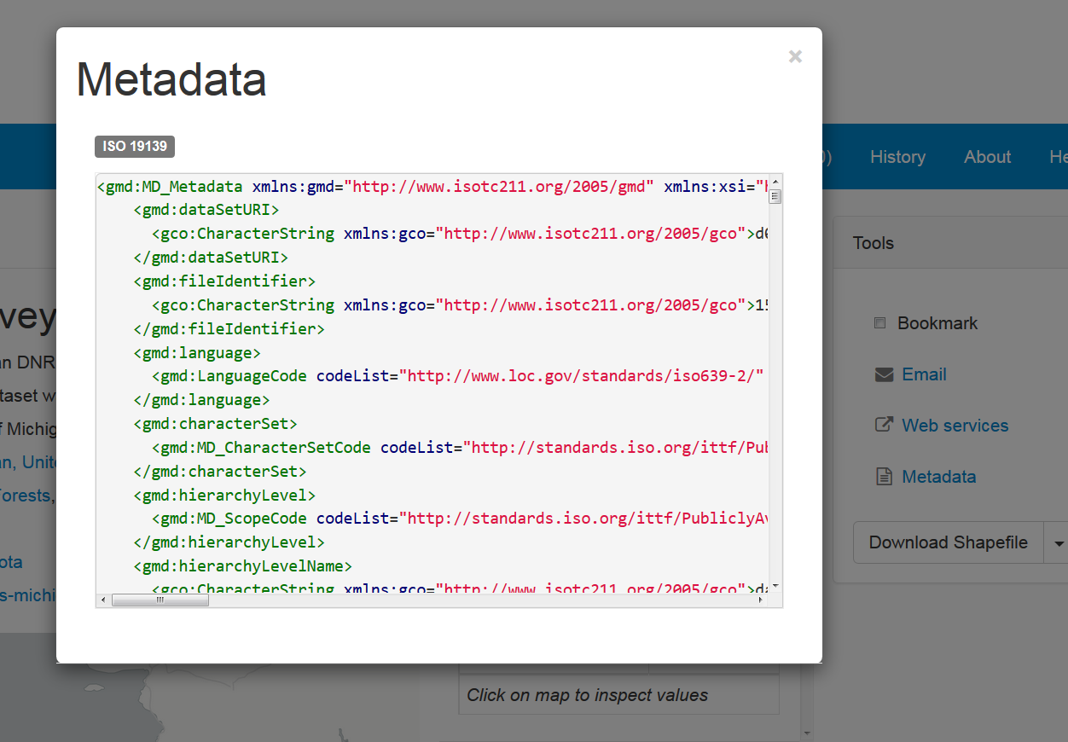
Recommendation 2: Improve the item page features
Metadata as XML = problematic
Notes:
Issue 2: Item page features
Users were challenged to understand what was being presented on the item page view, especially when some of the tools or map preview was missing. Some of the resources can only be downloaded by visiting an external website. This deviates from the norm, as most items can be downloaded from the item entry page.
Solution: Fill in missing features or provide explanatory text for unavailable. When the item is a scanned map, this should be clearly stated, and, ideally, the image should display. When there is no download button available, include explanation that the user must visit an external site to obtain the resource.

Slide 36
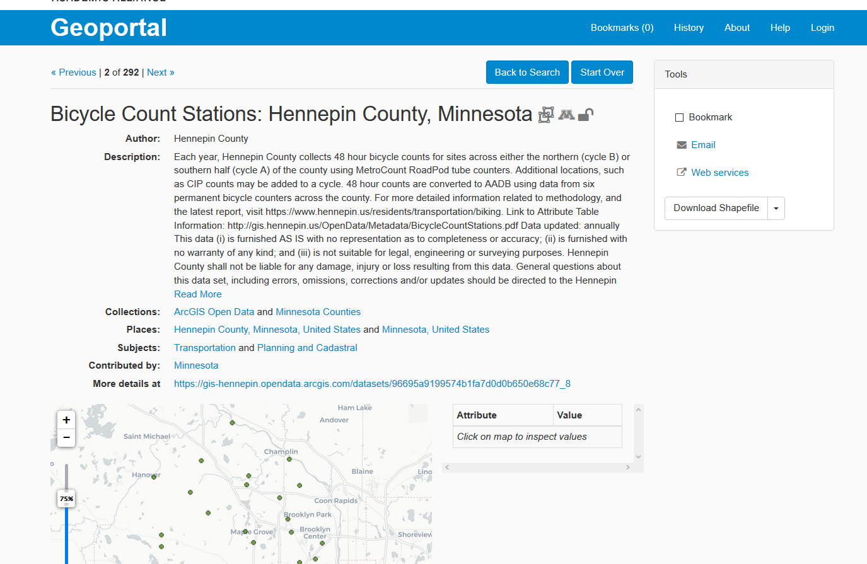
Removed Metadata Download Option

Slide 37
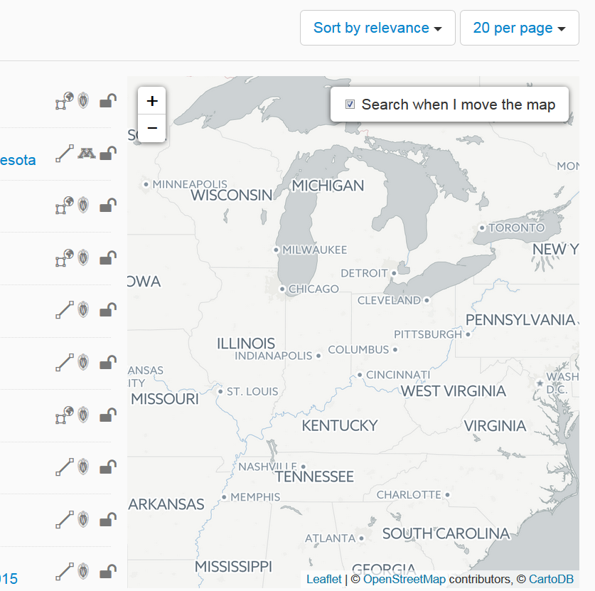
Recommendation 3: Change the Map Search
Under utilized
Notes:
Issue 3: The map search
An essential feature of a geoportal should be the ability to search for items via a map interface. Although this feature is functional in our geoportal, it is rarely used. On the homepage, its intended use is to zoom and focus the map and then click “Search here.” However, it is not clear to users how this works and for the BTAA geoportal, the map is positioned at the bottom of the homepage, beneath the fold. As a result, no users took advantage of the map as a potential first search step.
The map appears near the top of the screen on the search results page. Here, it can be used like a facet to filter results based upon whether or not their bounding boxes intersect the visible search area. If a user hovers over the text of the search results, the associated bounding boxes for each record will show up on the same map. This map inset has the potential to be very helpful, but was not intuitive to the users in the study. Only a few users took advantage of the map on the results page, and only after they had been using the geoportal for awhile.
Solution: Add explanatory text, experiment with repositioning it, and add a textbox for search for place name within the map.

Slide 38
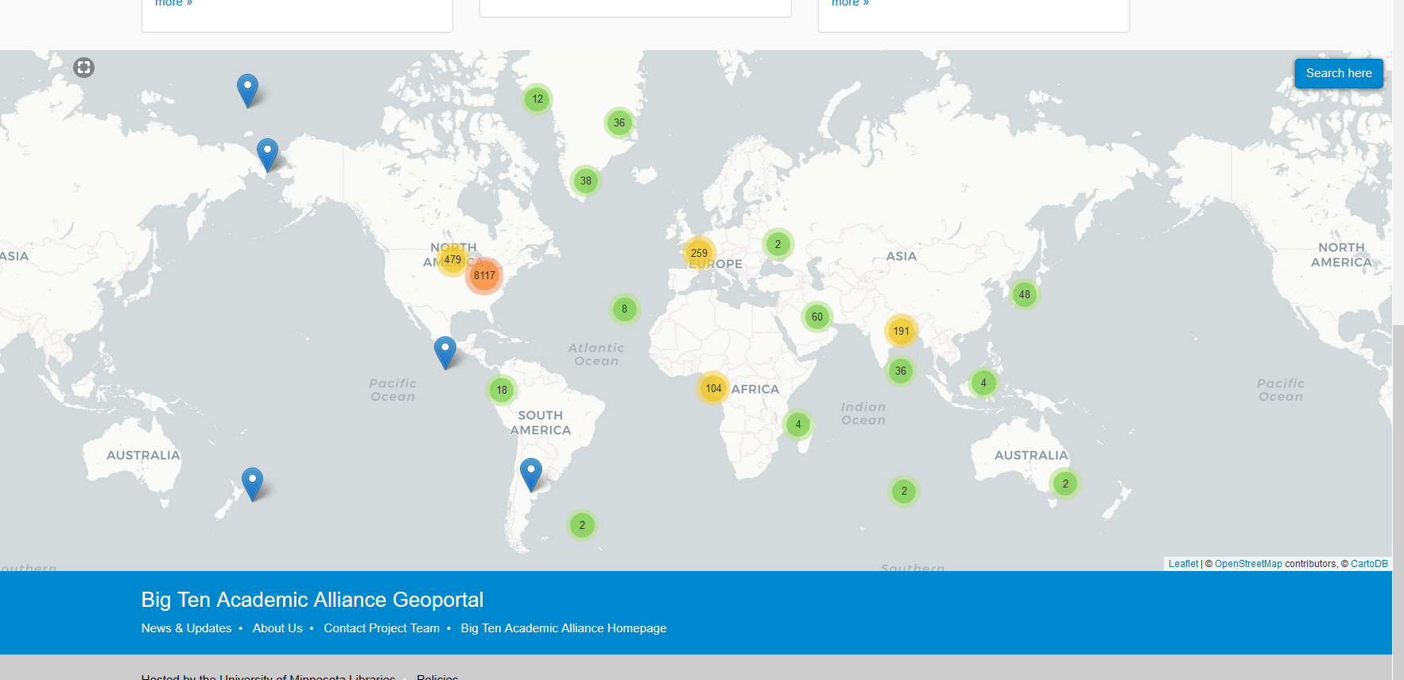
Somewhat Improved Map Search

Slide 39
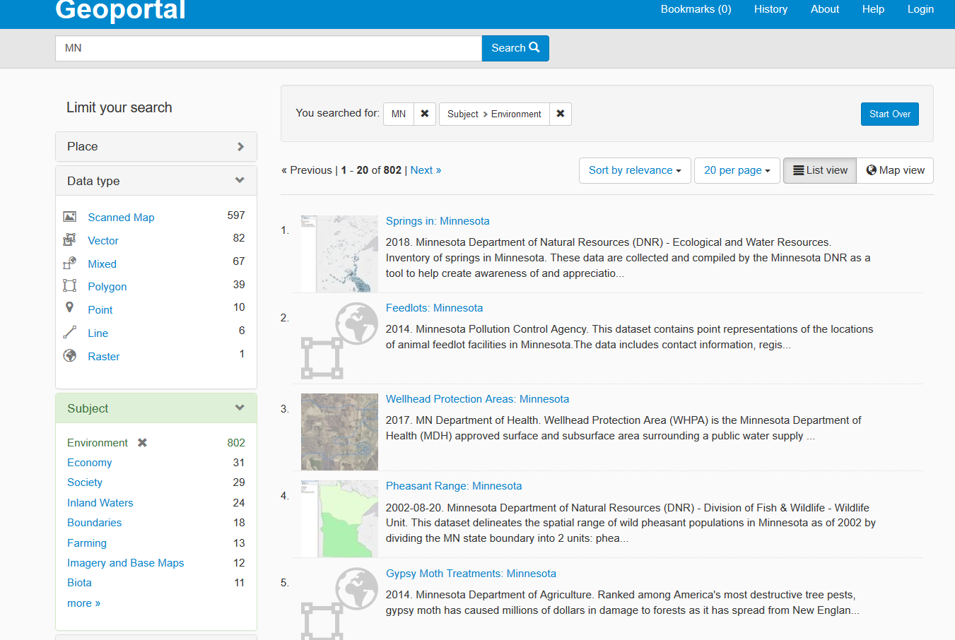
General Issue: Presence of Scanned Maps and Shapefiles
Notes:
Another point of confusion is that the BTAA geoportal is one of the few geospatial resource portals to combine both GIS datasets and scanned maps in the same application. As a result, some users were not sure if they had found a shapefile or a scanned map, nor did they realize there is a distinction. This was one time where having a discipline knowledge of geospatial resources was helpful.

Slide 40
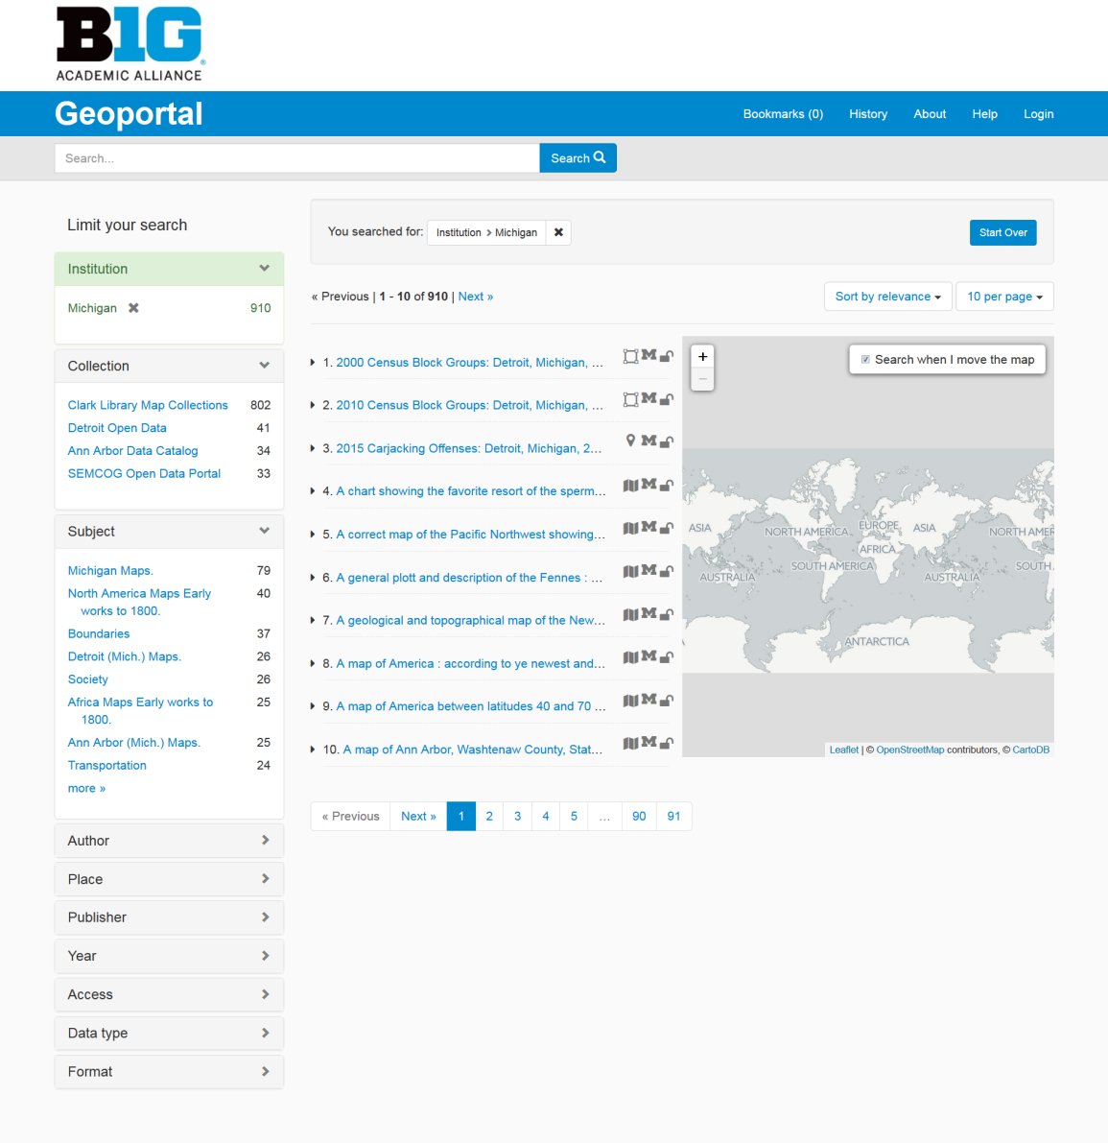
Recommendation 4: Reorder the search refining facets
Users found “Institution” and “Collection” very confusing
Notes:
Change highlighted facets to Subject, Place, Data Type. Users struggled with the categories Institution and Collection, those categories should be moved to the About page and replaced with Place and Data Type.
2) Reorder facets on the left facet menu, making the first four: Place; Subject; Data Type and Year. Users only click on the the facets listed first and ignore the ones lower down. Similar to observations from the homepage, users found Institution and Collection confusing. We recommended moving those facets to the top four spots because they were of interest to users and also the facets with the most cleaned up and standardized metadata.
3) Set year facet to chronological sort. Users found this facet difficult because it displayed in numeric instead of chronological order. Chronological order would make selection more intuitive.
4) Add time slider for year facet. This would further support searching by time period, allowing users to search within a timeframe instead of just selecting a particular year.

Slide 41
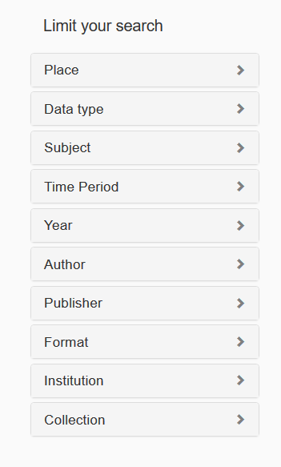
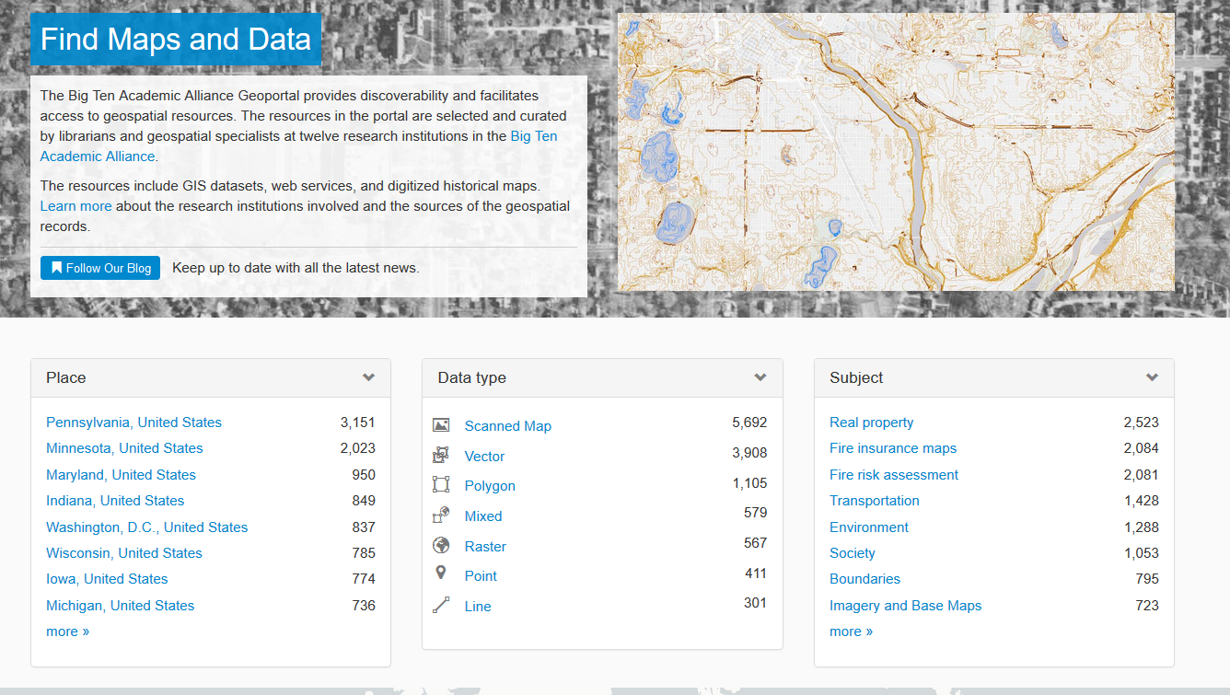
Reordered the facets on results page and on home page

Slide 42
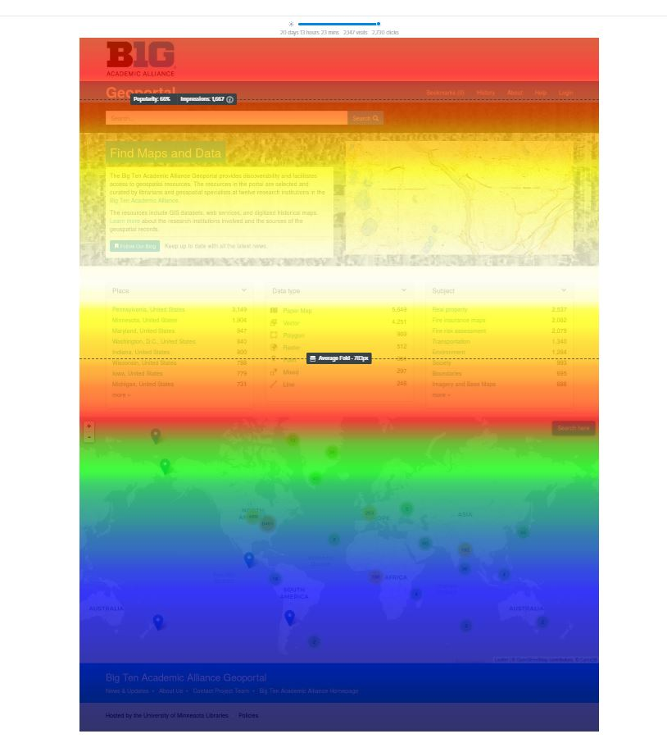
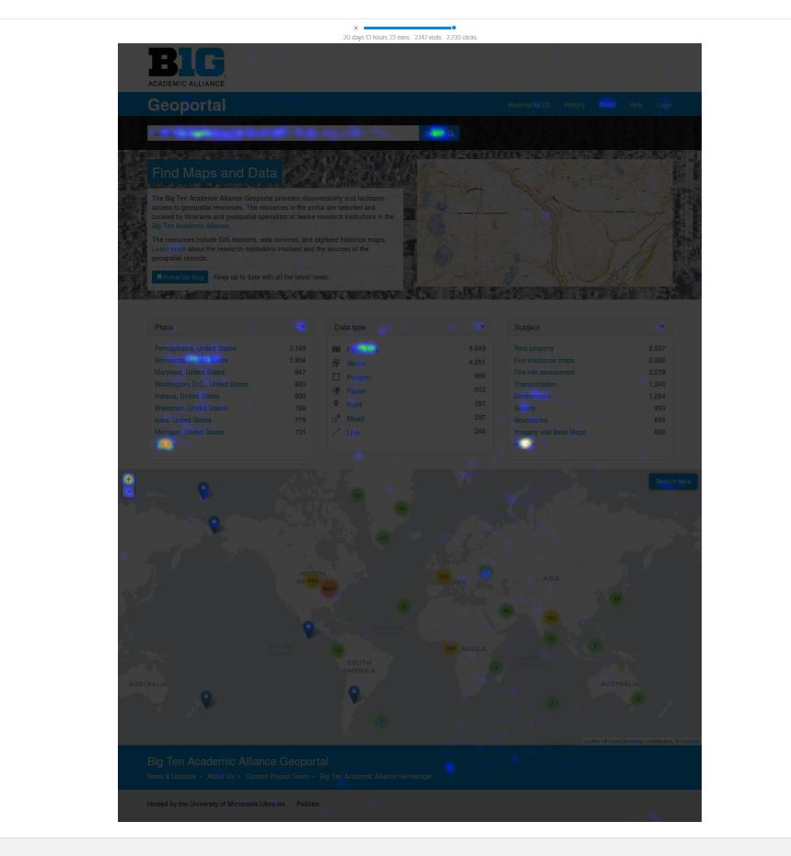
The Future: Click tracking with Crazyegg
Notes:
Follow up study – smaller number of interviews over a larger number of interviewers, hopefully more often to test changes
Activity tracking with crazy egg

Slide 43
Describing scanned maps for the geoportal
using paper map catalog records
as a starting point
Tim Kiser and Nicole Smeltekop
MSU Libraries
Notes:
Nicole Smeltekop and I will be focusing on a particular aspect of supplying metadata to the geoportal, namely metadata for scanned maps, primarily pre-1923 historic maps that are out of U.S. copyright. As Kathleen mentioned, this content accounts for about half of the records in the geoportal.
Nicole and I are both catalog librarians at MSU. I mostly catalog cartographic materials, and Nicole catalogs an array of special materials including maps, and is also a part of the team building MSU’s digital repository.
I’ll be talking about our process for describing scanned maps in the geoportal using the existing catalog records — MARC records — for the corresponding paper maps as a starting point.
Nicole will be talking about the recent introduction of maps to our digital repository, and how that process interacts with supplying metadata to the geoportal.

Slide 44
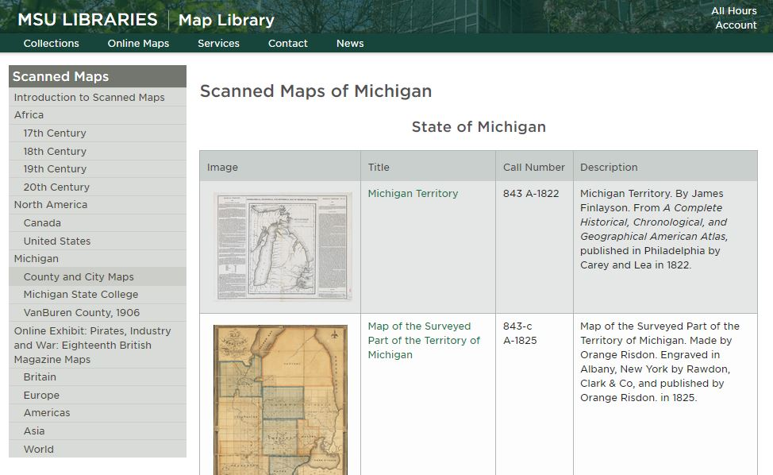
Notes:
I’ll start with a bit of background:
Past practice for serving scanned maps at the MSU Libraries has been via Drupal pages on the Map Library website, an example of which can be seen here — and this is also part of the current practice, although we think we’re in the waning days of that.
These webpages have not contained formatted description of the maps, nor have they had links to formatted description.
Over the years the scans been added to the website without particular attention to whether the corresponding paper maps were cataloged or not —
the motivation was primarily just to make them available, because a description on a Drupal page is better than no description anywhere.

Slide 45
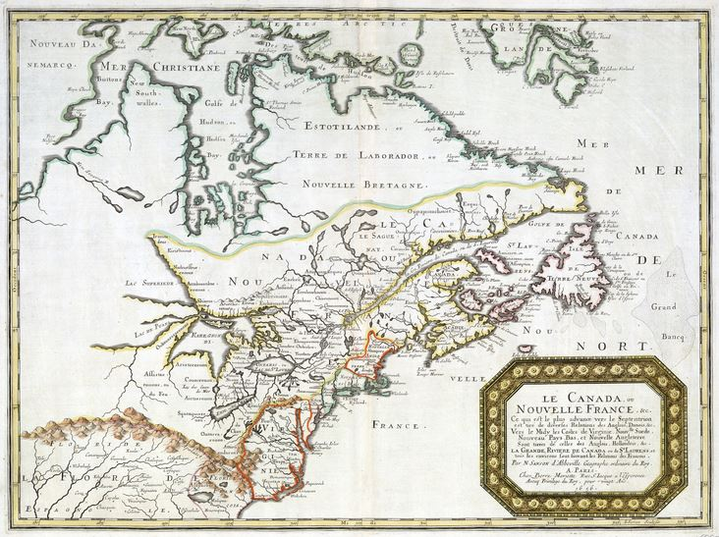
Le Canada, ou Nouvelle France, &c : ce qui est le plus advance vers le Septentrion est tiré de diverfes Relations des Anglois, Danois, &c. ... / par N. Sanson d'Abbeville, geographe ordinaire du Roy. 1656.
Notes:
Which leads me to another aspect of our circumstance, which is that at MSU we have a massive backlog of uncataloged maps, in the tens of thousands, including some of our most important historic maps,
although happily the map I’m showing you here is cataloged.
Unfortunate as it is in many ways to be faced with that backlog, it does afford us an opportunity to be thinking about ways we might incorporate the creation of records for scanned maps — with those all-important formatted descriptions that we can use in the geoportal — into the workflow of cataloging the paper maps from which the scans are derived.
But first, Nicole and I designed and tested a process whereby we started with old, pre-existing MARC records for paper maps...

Slide 46
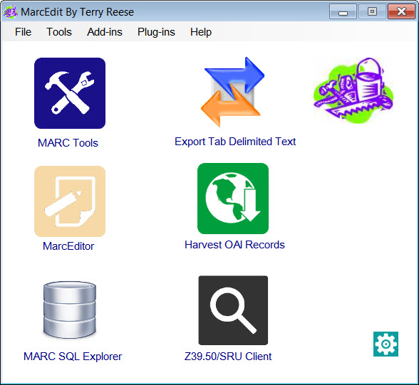
MarcEdit
Freely available software for manipulating MARC data
Extremely powerful and easy to use
Allows for batch editing large numbers of records
For this project, we made use of add/delete, swap, and edit functions
http://marcedit.reeset.net/
Notes:
And then used the software MarcEdit to generate metadata for scans of those maps in a couple of different formats.
A couple of things to mention about MarcEdit:
It’s freely available (although not open-source), and it’s powerful and easy to use
There is lots of documentation online (including youtube tutorials, an active listserv, and the creator, Terry Reese at Ohio State University, has a blog and website.)

Slide 47
Some considerations
Project requires both map cataloging knowledge and MarcEdit knowledge
We opted to create MARC and MarcXML records, rather than trying to create Dublin Core (DC) metadata ready-made for the geoportal, because:
This would mean new RDA-compliant MARC records in our catalog for the scanned maps
The geoportal’s metadata staff had a MarcXML-to-DC transformation available
Notes:
A few considerations we had in coming up with our workflow:
The project requires both a working knowledge MarcEdit, obviously, and a fairly in-depth knowledge of MARC cataloging standards for maps, and between the two of us we had these covered.
We opted to create MARC and MarcXML records (rather than the Dublin Core metadata used in the geoportal) for a couple of reasons:
MARC would allow us to create new standalone RDA-compliant bibliographic records for the scans in our catalog and WorldCat
And because a workflow had already been established by the Big Ten Geoportal team for converting MARC to Dublin Core

Slide 48
Workflow
Start with a file of existing paper map records (exported from Connexion)
MarcEdit: Programmatic changes to those records → new records for scans
OCLC Connexion: Manual edits to the newly created records
Upload the new digital map records to OCLC/WorldCat and our local catalog
MarcEdit: Convert the new MARC files to MarcXML files
Send MarcXML files to geoportal staff for Dublin Core conversion and upload
Notes:
Here is the workflow we came up with.
We started with the OCLC versions of the MARC records of paper maps that were already present in our catalog.
And those had been identified via a spreadsheet that was created by the staff and student workers in the Map Library over the course of a few months.
The staff and student workers went through the Drupal pages and cross-checked the scans against the library catalog, and copy-pasted the catalog records’ OCLC control numbers field into a spreadsheet, for Nicole and I to use
Then we put the corresponding OCLC records into an OCLC Connexion save file.

Slide 49
Workflow
Start with a file of existing paper map records (exported from Connexion)
MarcEdit: Programmatic changes to those records → new records for scans
OCLC Connexion: Manual edits to the newly created records
Upload the new digital map records to OCLC/WorldCat and our local catalog
MarcEdit: Convert the new MARC files to MarcXML files
Send MarcXML files to geoportal staff for Dublin Core conversion and upload
Notes:
We brought those records into MarcEdit and applied a series of programmatic changes to them, thereby creating new records

Slide 50
Workflow
Start with a file of existing paper map records (exported from Connexion)
MarcEdit: Programmatic changes to those records → new records for scans
OCLC Connexion: Manual edits to the newly created records
Upload the new digital map records to OCLC/WorldCat and our local catalog
MarcEdit: Convert the new MARC files to MarcXML files
Send MarcXML files to geoportal staff for Dublin Core conversion and upload
Notes:
We brought those new records back into OCLC Connexion and made various manual edits that we had not been able to do programmatically in the MarcEdit software

Slide 51
Workflow
Start with a file of existing paper map records (exported from Connexion)
MarcEdit: Programmatic changes to those records → new records for scans
OCLC Connexion: Manual edits to the newly created records
Upload the new digital map records to OCLC/WorldCat and our local catalog
MarcEdit: Convert the new MARC files to MarcXML files
Send MarcXML files to geoportal staff for Dublin Core conversion and upload
Notes:
We uploaded the new records for the digital maps into OCLC/Worldcat and brought them into our local catalog

Slide 52
Workflow
Start with a file of existing paper map records (exported from Connexion)
MarcEdit: Programmatic changes to those records → new records for scans
OCLC Connexion: Manual edits to the newly created records
Upload the new digital map records to OCLC/WorldCat and our local catalog
MarcEdit: Convert the new MARC records to a MarcXML file
Send MarcXML files to geoportal staff for Dublin Core conversion and upload
Notes:
We brought the records, with their manual edits, back into MarcEdit and converted them to MarcXML

Slide 53
Workflow
Start with a file of existing paper map records (exported from Connexion)
MarcEdit: Programmatic changes to those records → new records for scans
OCLC Connexion: Manual edits to the newly created records
Upload the new digital map records to OCLC/WorldCat and our local catalog
MarcEdit: Convert the new MARC files to MarcXML files
Send MarcXML files to geoportal staff for Dublin Core conversion and upload
Notes:
We sent a file of MarcXML records to the geoportal’s metadata coordinator, Karen, based at the University of Minnesota, who then selectively transformed the content into Dublin Core/Geoblacklight metadata, which was uploaded into the geoportal.

Slide 54
Selected MARC fields changed (mix of RDA/non-RDA) (Round 1)
Srce | d
001 | Remove field (but not until 776 is created)
003 | Remove field
005 | Remove field
007 | Create new: cr cn||||a|ada
008 position 29 | o
016 | Remove field
049 | QEMP
050 | Change second indicator to 4
260 | Remove (but not until 264_1 is created)
264_1 | If 260 is present, create 264_1 using 260abc content
300$a | Change to: 1 online resource (1 map)
300$b | Add if not present: color
300$c | Remove
336 | $a cartographic image $b cri $2 rdacontent
337 | $a unmediated $b n $2 rdamedia
338 | $a Online resource $b cr $2 rdacarrier
347 | $a image file $b JPEG $2 rda
541 | Remove
561 | Remove
655_7 | $a Digital maps. $2 lcgft
776_08 | $i Print version: $a [copy 1xx $a if present] $t [copy 245$a] $w (OCoLC)[copy 001]
Link to all fields changed
Notes:
This is an excerpt from a list we created, planning out the programmatic changes we wanted to make in our first round of edits.
Because the records were of varying quality, and because some were RDA and some were not, our edits reflected that:
Some of the changes included:
We partially converted the 260 field to its RDA equivalent, field 264 (and I say partial because it required manual editing later, since those two fields often don’t have a 1:1 relationship)
We changed the 049 and 300 fields to reflect the presence of digital content
We added the genre/form term “digital maps”
And we used the content in the 245 to generate a 776 linking field, which is used to link back to the original paper record

Slide 55
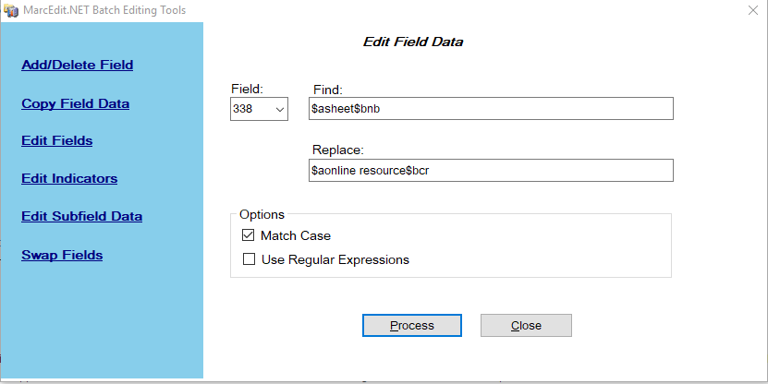
MarcEdit: “Add/Delete”, “Swap”, and “Edit”
Notes:
In terms of actually working with MarcEdit, I won’t go into much detail but the fields we relied on most were:
“Add/delete” meaning adding and deleting MARC fields
“Swap,” meaning moving content from one MARC field to another MARC field
And “Edit,” which includes doing things like find-and-replace as we see here, changing the carrier type from “sheet” to “online resource”

Slide 56
Manual edits
050 | Misc cleanup
090 | Create new 090 conforming to our library's house style
300 | If 490 is present, a full stop should be added at end of 300
533 | $a Electronic reproduction. $b [East Lansing, Michigan] : $c [Michigan State University Map Library], ǂd [2010-2016]. (add locally only)
6xx | Remove all FAST headings, where present
655_7 | Remove instances of 655_7 $a Maps. $2 lcgft
710_2 | $a Michigan State University. $b Libraries. $b Map Library. (add locally only)
776 | Change commas closing $a to periods; remove initial articles from $t; remove closing ISBD punctuation from end of $t
Misc RDA changes | spell out abbreviations; add relationship designators; directly transcribe 245s including replacing ellipses with transcribed text; remove brackets from map scale statements and replace "ca." with "approximately"
Various manual edits were required:
If a human eye was required (e.g., date of situation for call number)
Expertise in creating regular expressions (which we do not have )
Notes:
As I mentioned, there were various edits we had to make manually. Here’s an excerpt from that list.
There are some cases in which human attention is unavoidably required, for instance in identifying the “date of situation” of the map in order to create a Library of Congress call number.
But a lot of the edits were fussy and annoying things having to do with punctuation.
We could have tackled some of these programmatically in MarcEdit if we had had more experience in creating regular expressions.
But since our experience was somewhat lacking, the work involved in creating regular expressions would have taken longer than simply manually editing the records, particularly since we were working with dozens of records and not hundreds or records, or thousands.

Slide 57
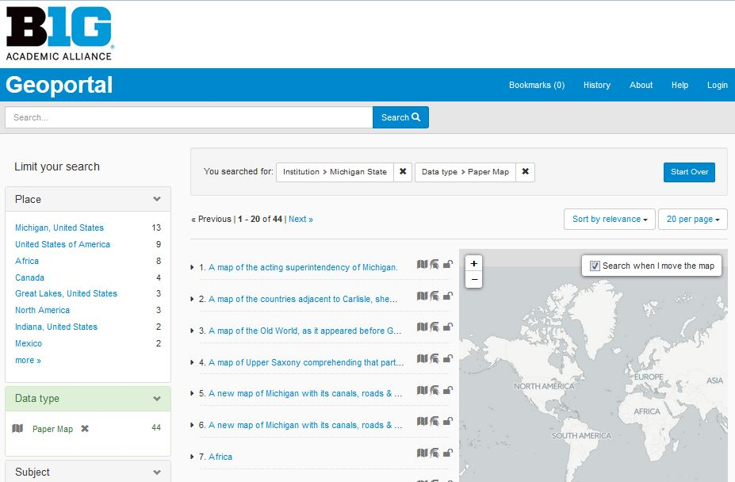
First results and lessons learned
At first we did not adhere to PCC provider neutral guidelines:
“The provider-neutral model (in contrast to RDA) specifies that if the e-resource being cataloged is an online reproduction of a tangible resource, usually the Production, Publication, Distribution, Manufacture and Copyright notice information will come from the original tangible source record”
Identified several additional changes we could have made programmatically
Notes:
We were happy with our first batch of results, consisting of 44 new records for scanned historic maps in the geoportal, along with MARC records for those scans available via Worldcat and the library catalog.
We’re confident that this represents the beginnings of a sustainable workflow that we can repeat at MSU, maybe on a semiannual or annual basis.
We did keep track of a number of changes we wanted to make for our next round.
In particular, we neglected to follow the Program for Cooperative Cataloging’s provider neutral guidelines, which cover how the publication information is handled for online reproductions. Those guidelines are intended to avoid proliferation of multiple Worldcat records for different scans of the same resource.
Also, as we were making all of those time-consuming manual edits, we discovered some additional things we could have edited programmatically, so we added those into our table of changes...

Slide 58
Selected MARC fields changed (all RDA) (Round 2)
001 | Remove ‘ocn’ and ‘on’ and ‘ocm’ prefixes, remove slashes at end. Later, remove field entirely (but not until 776 is created)
006 | Create new: m o c (18 spaces at end)
007 | Retain existing and create new: cr cn||||a|ada
042 | Remove field
050 | Change first indicator to 0, second indicator to 4
300$a | Change to: 1 online resource (1 map)
300$b | Add if not present: color
300$c | Remove
336 | $a cartographic image $b cri $2 rdacontent
337 | $a unmediated $b n $2 rdamedia
338 | $a online resource $b cr $2 rdacarrier
347 | $a image file $2 rdaft
347 | $b JPEG
655_7 | $a Digital maps. $2 lcgft
773 and 774 | Change to 787 where present
776_08 | $i Print version: $a [copy 1xx $a if present] $t [copy 245$a] $w (OCoLC)[copy 001]
856 | Delete where present, and add: 856 40$zConnect to online resource - All users
949 | *ov=.o;i= /loc=wbmap/ty=0/sta=e/w=cmsorigmapsngs;
Link to all fields changed
Notes:
...which we’ve again excerpted here.
This past fall we did a second batch of about two dozen records in which we applied the lessons learned from our first batch.
While the first batch had been focused on scans of paper maps that had already been cataloged at various times in the past
... with the original cataloging done by various institutions,
… sometimes cataloging in RDA, sometimes in older standards,
this second batch was put together from records that I had identified as I was cataloging some of our previously uncataloged paper maps.
So these were quite a bit easier to work with--
in particular, because this time they were all in RDA,
but also because as I was handling each paper map record, I was anticipating their eventual conversion to a record for a scan, and was able to do a bit of prep work, and get a few of the manual edits done ahead of time, at the point when I was saving each record to a separate file for conversion.

Slide 59
Future metadata reuse and refinement
Nicole Smeltekop and Tim Kiser
MSU Libraries
Notes:
Now I will turn things over to Nicole, who will talk about some next steps.

Slide 60
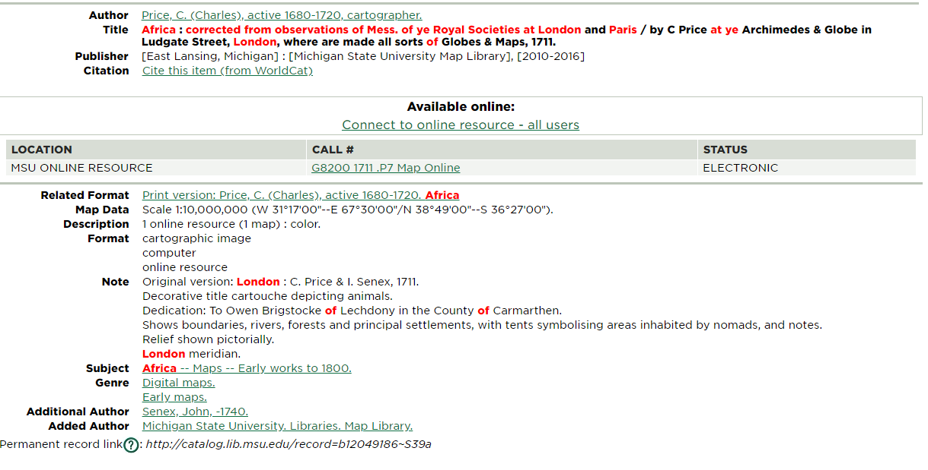
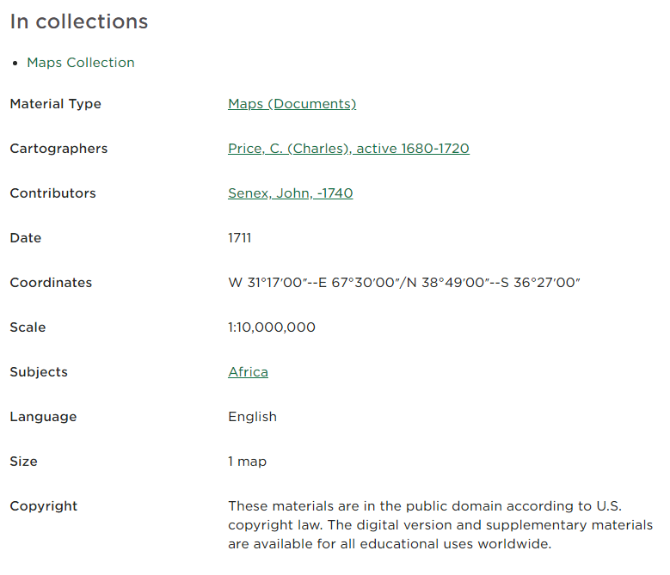
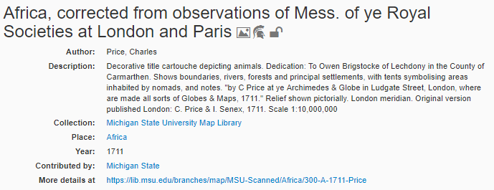
Future reuse and refinement
Notes:
One of the most exciting part of this process is that we’re creating a workflow that results in high-quality metadata that can be reused for new batches of records added to the geoportal.
It also allows us some new opportunities to repurpose the metadata we created. Our first project in that vein is adding maps to our digital repository.
We’re excited that this results in our map metadata being findable in five locations - the library catalog, the geoportal, the digital repository, Worldcat, and soon, the DPLA.
All of these places are using the same structured metadata - keeping our descriptions consistent and allowing for reuse in ways we haven’t thought of yet.
As you can see, all of these sites are displaying the metadata a bit differently - that’s one of the benefits of structured data - they all have the same underlying file, but display can change based on the needs or desires of different sites.

Slide 61
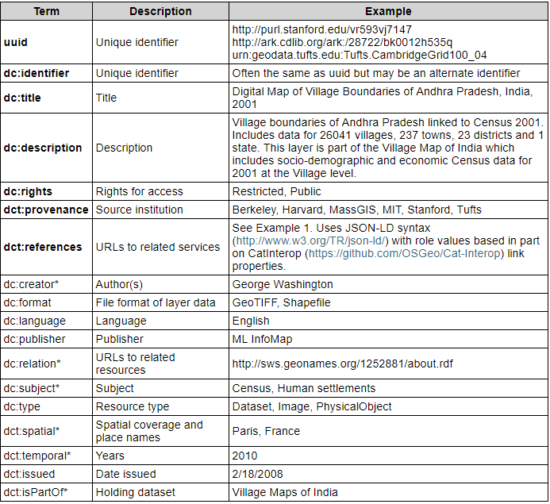
New batches added to geoportal
22 new records added 5/2018
May change process to convert to DC before sending
Source: http://journal.code4lib.org/articles/9710
Notes:
Last fall, we added a second batch of mapsto the geoportal.
When this batch was added, we noticed that there were a number of strange formatting and punctuation issues.
These oddities stemmed from the MARC punctuation not getting stripped out of the records.
We emailed the metadata coordinator, and she adjusted her stylesheet, but it made Tim and I question the process.
It turns out, she converts our MARC files to a spreadsheet and then maps that to Dublin Core/Geoblacklight.
In this process, some fields get merged into a single DC field.
An example is the description field. This field combines the summary note and scale information.
In the future, we may work with her to develop a better XSL stylesheet that works directly on the MARC file to convert it to the flavor of Dublin Core she uses.
This will require us to discuss where MARC fields currently map to in the MARC to DC crosswalk.

Slide 62
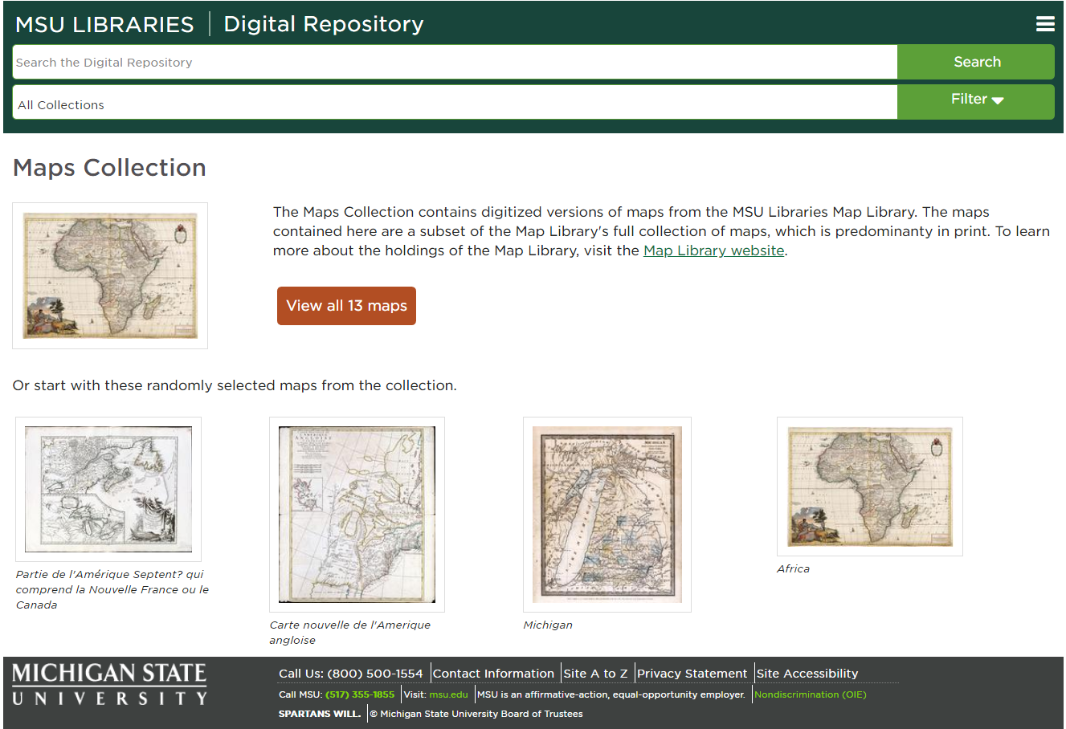
Digital repository
Notes:
Last semester, the map library started adding maps to the digital repository.
The repository ingests MODS and DC metadata, and has existing templates to crosswalk MARC to MODS and MODS to DC.
Thus, with the MARC records we created as part of the geoportal project, we could easily create and ingest MODS for the digital repository.
A bit of background about our digital repository:
The digital repository runs on Islandora, which is an open-source combination of Fedora for storing digital objects and Drupal for creating a front-end interface.
The repository is run by a team of librarians, system administrators, and web developers that goes by the name ‘RepoTeam.’
As part of my secondary assignment at the library, I create and manage metadata for the digital repository.
The digital repository offers a number of benefits for the maps library.
First, using Fedora, the digital scans are preserved up to national preservation standards.
Second, the digital repository uses persistent identifiers for all their objects, so if an update happens, the URL should stay stable.
It also has some additional functionality that allows users to zoom in and will soon include an option for users to download a JPEG for their own use.
The repository also uses OMI-PMH, a metadata exchange standard used the DPLA. Our initial map collection should be harvested into DPLA this July.
The repository does not have the capability to search by view by coordinates, so the geoportal is a valuable complement to the repository.

Slide 63
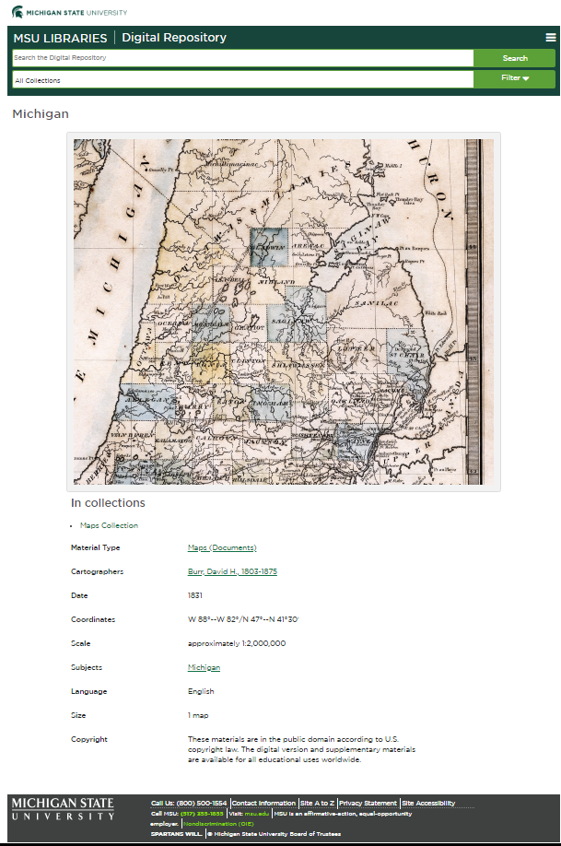
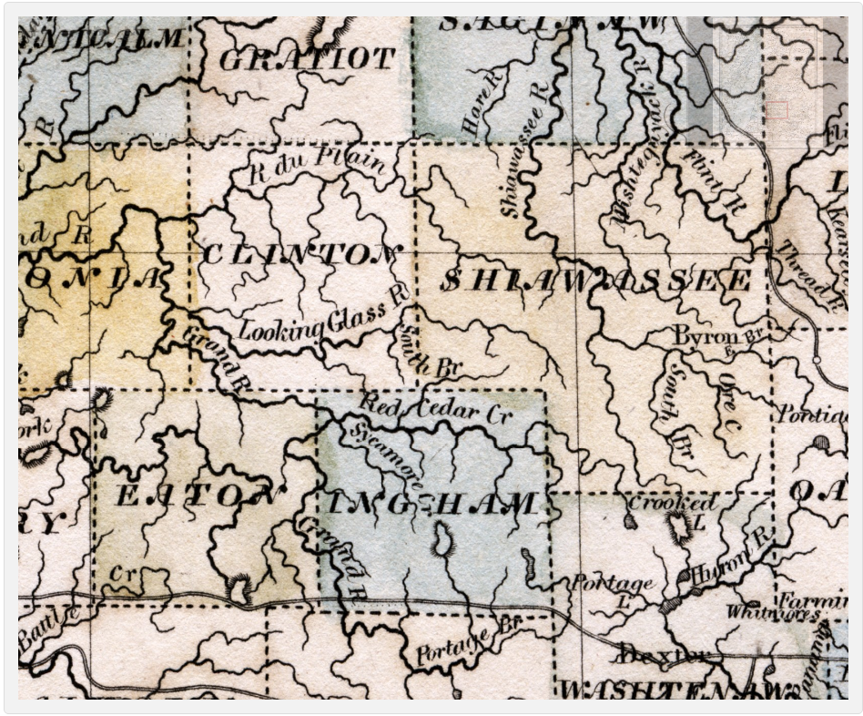
Digital repository - cont.
Notes:
For our first bath of maps, we identified maps that had both a MARC record and a high-quality TIFF file.
In working with the metadata, we tweaked our MARC to MODS XSL stylesheet for use with the maps collection.
We also had to adjust our SOLR settings to display creator information to include the label ‘cartographer.’ (You can see this on the metadata display in this item level page.)
For the summer, my project will be comparing spreadsheets to find more high resolution images that have MARC metadata and adding those maps into our digital repository.
Another part of the project is streamlining the scanning process for the map library.
In the past, maps were scanned on an ‘as needed by researcher’ basis with varying scanning specs ranging from 200 dpi to 600 dpi.
The scanning location also has varied; some were scanned internally in the map library while others were sent to our Digital Media Center two floors above depending on size and fragility.
This resulted in different file formats - the Digital Media Center always outputs TIFFS, while reference copy scans of maps were often JPEGS.
As we transition to using the digital repository to present our digitized maps, we’re taking the opportunity to rescan the JPEG maps to create TIFFS to add to the respiratory. This way, the digital repository has consistent high quality scans.

Slide 64
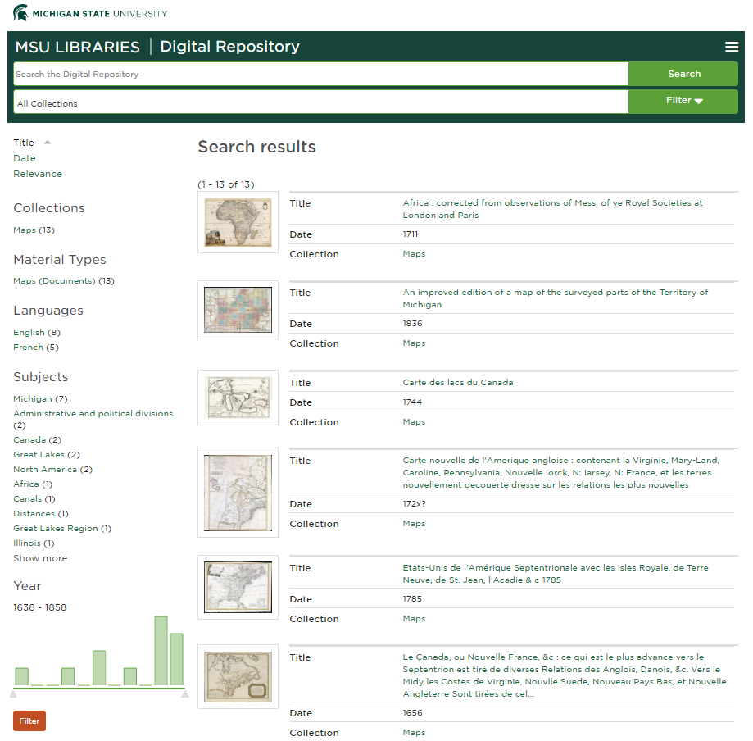
Digital repository
Notes:
On the search interface of the digital repository, we’ve included a few facets for narrowing searching.
For now, you can narrow your search by language, subject, and year.
In the future, we plan to add faceting by location using the Getty Thesaurus of Geographic Names (TGN for short). We can map from the LCSH subject headings in the catalog record.
Using TGN allows us to group regions together. This is particularly important, since it’s the main way users search for maps on the current Map Libraries webpage.

Slide 65
Future work
Change link in geoportal to the digital repository version of the map
Workflow to add non-MARC cataloged map records to the geoportal and the digital repository
Prioritize cataloging of already scanned maps
Scan more maps!
Notes:
As with most projects, our work to create metadata for the geoportal created many new project opportunities!
First on the list is working with the geoportal metadata coordinator to change the links over to our digital repository version of the map for all our records in the geoportal.
Going forward, we’d have the digital repository link in any new records destined for the geoportal.
We would also like to investigate creating a workflow for adding maps to the geoportal and repository without a MARC record.
Although MARC data is very detailed and clean, it takes a long time to create, and it doesn’t always make sense to create it.
Individual pages from atlases are an example of maps that we may like to add to the geoportal and repository without creating MARC records.
We also anticipate the need to publish our maps in both the geoportal and digital repository will eventually get ahead of our cataloging capacity.
Our current plan is to create a spreadsheet that could be mapped to MODS that students could fill out.
When the map did eventually got cataloged, we could replace the student created metadata with the cleaner, MARC records.
A related idea is to realign cataloging priorities to prioritize scanned maps destined to the geoportal and the digital repository.
We are fortunate to have flexibility in creating our cataloging queue, so the cataloging staff could adjust their cataloging priority to queue pretty easily.
We plan to do this for the backlog, but going forward, we’re going to have to assess cataloging capacity against the desire to get our maps into the geoportal and digital repository.
And lastly, we are so excited to get our maps out there - and we want to do more!
Once we establish a workflow for scanning more maps to consistent standards, we’ll want to add more of our collections to the geoportal and the digital repository.

Slide 66
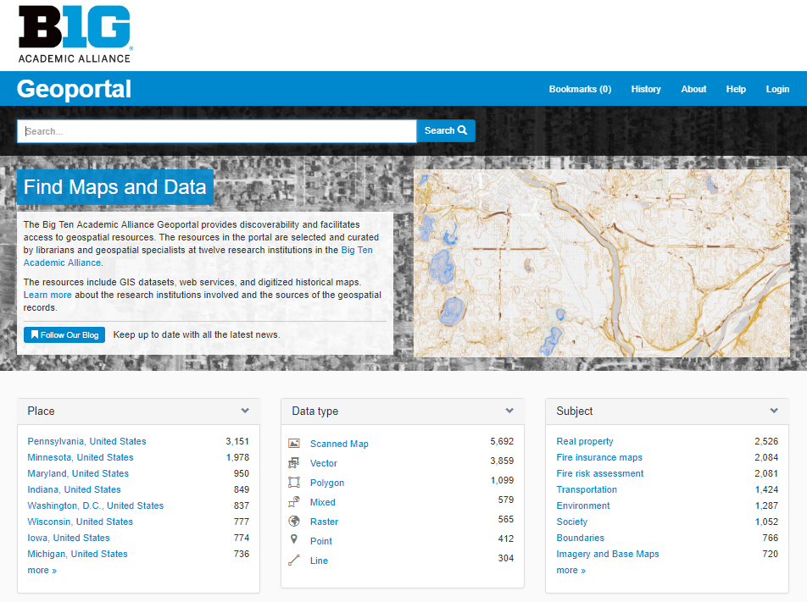
Show and tell
Notes:
Using the previous example, we’ll walk through the final product of our work.
Besides using the search box at the top that Amanda discussed, you can also search using the facets below.
To find the collection of maps we worked on, click on ‘scanned map’ in the data type facet.

Slide 67
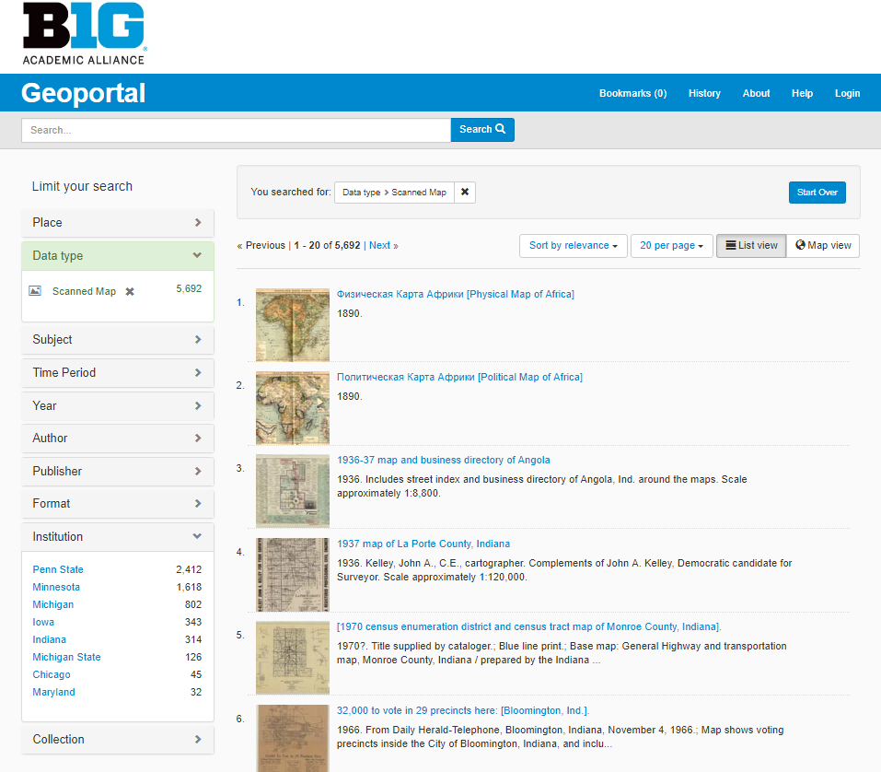
Show and tell
Notes:
Once you select ‘scanned map’, you are redirected to the search results page, where you can further facet your search. As you can see, if you look under institution, MSU has contributed 126 maps.

Slide 68
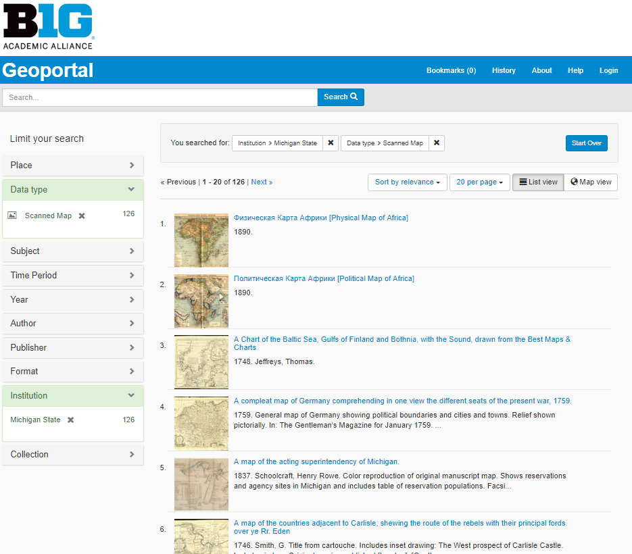
Show and tell
Notes:
Once you click on ‘Michigan State,’ the search narrows to just the 126 maps

Slide 69
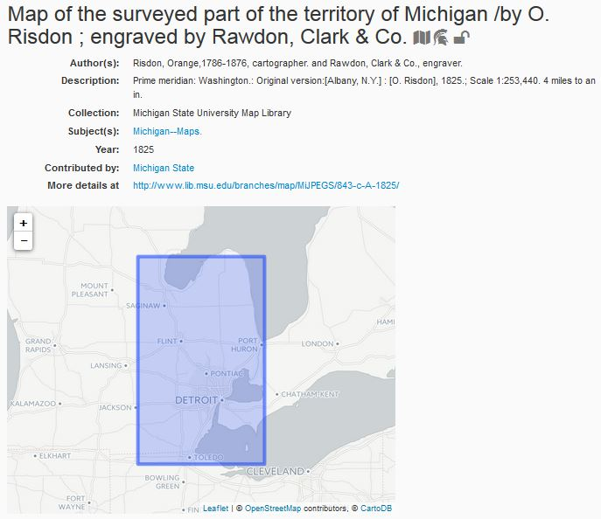
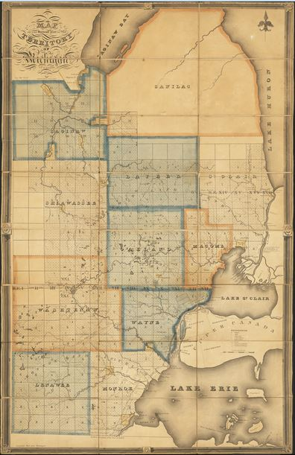
Notes:
This is a sample record of one of our map records in the geoportal. As you can see, the geoportal includes brief metadata with a map interface showing the bounding coordinates of the map. The portal also includes a link back to the Map Library website, where users can see the original map described in the geoportal.
One of the gratifying things about this project is seeing the latitude and longitude data that catalogers record in MARC records finally being put to use in map-based search and display interfaces where it can really come to life and be a useful part of the discovery experience.

Slide 70
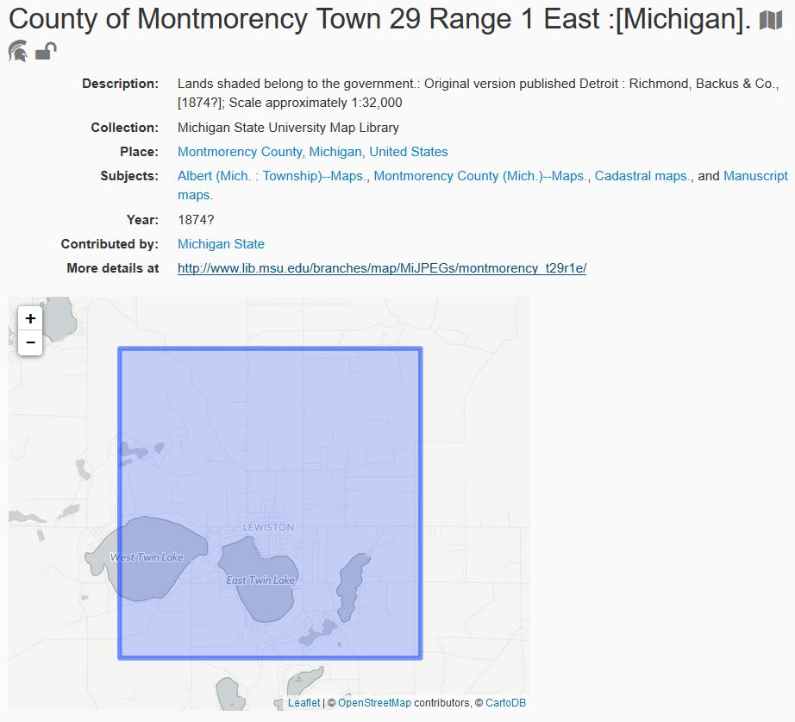
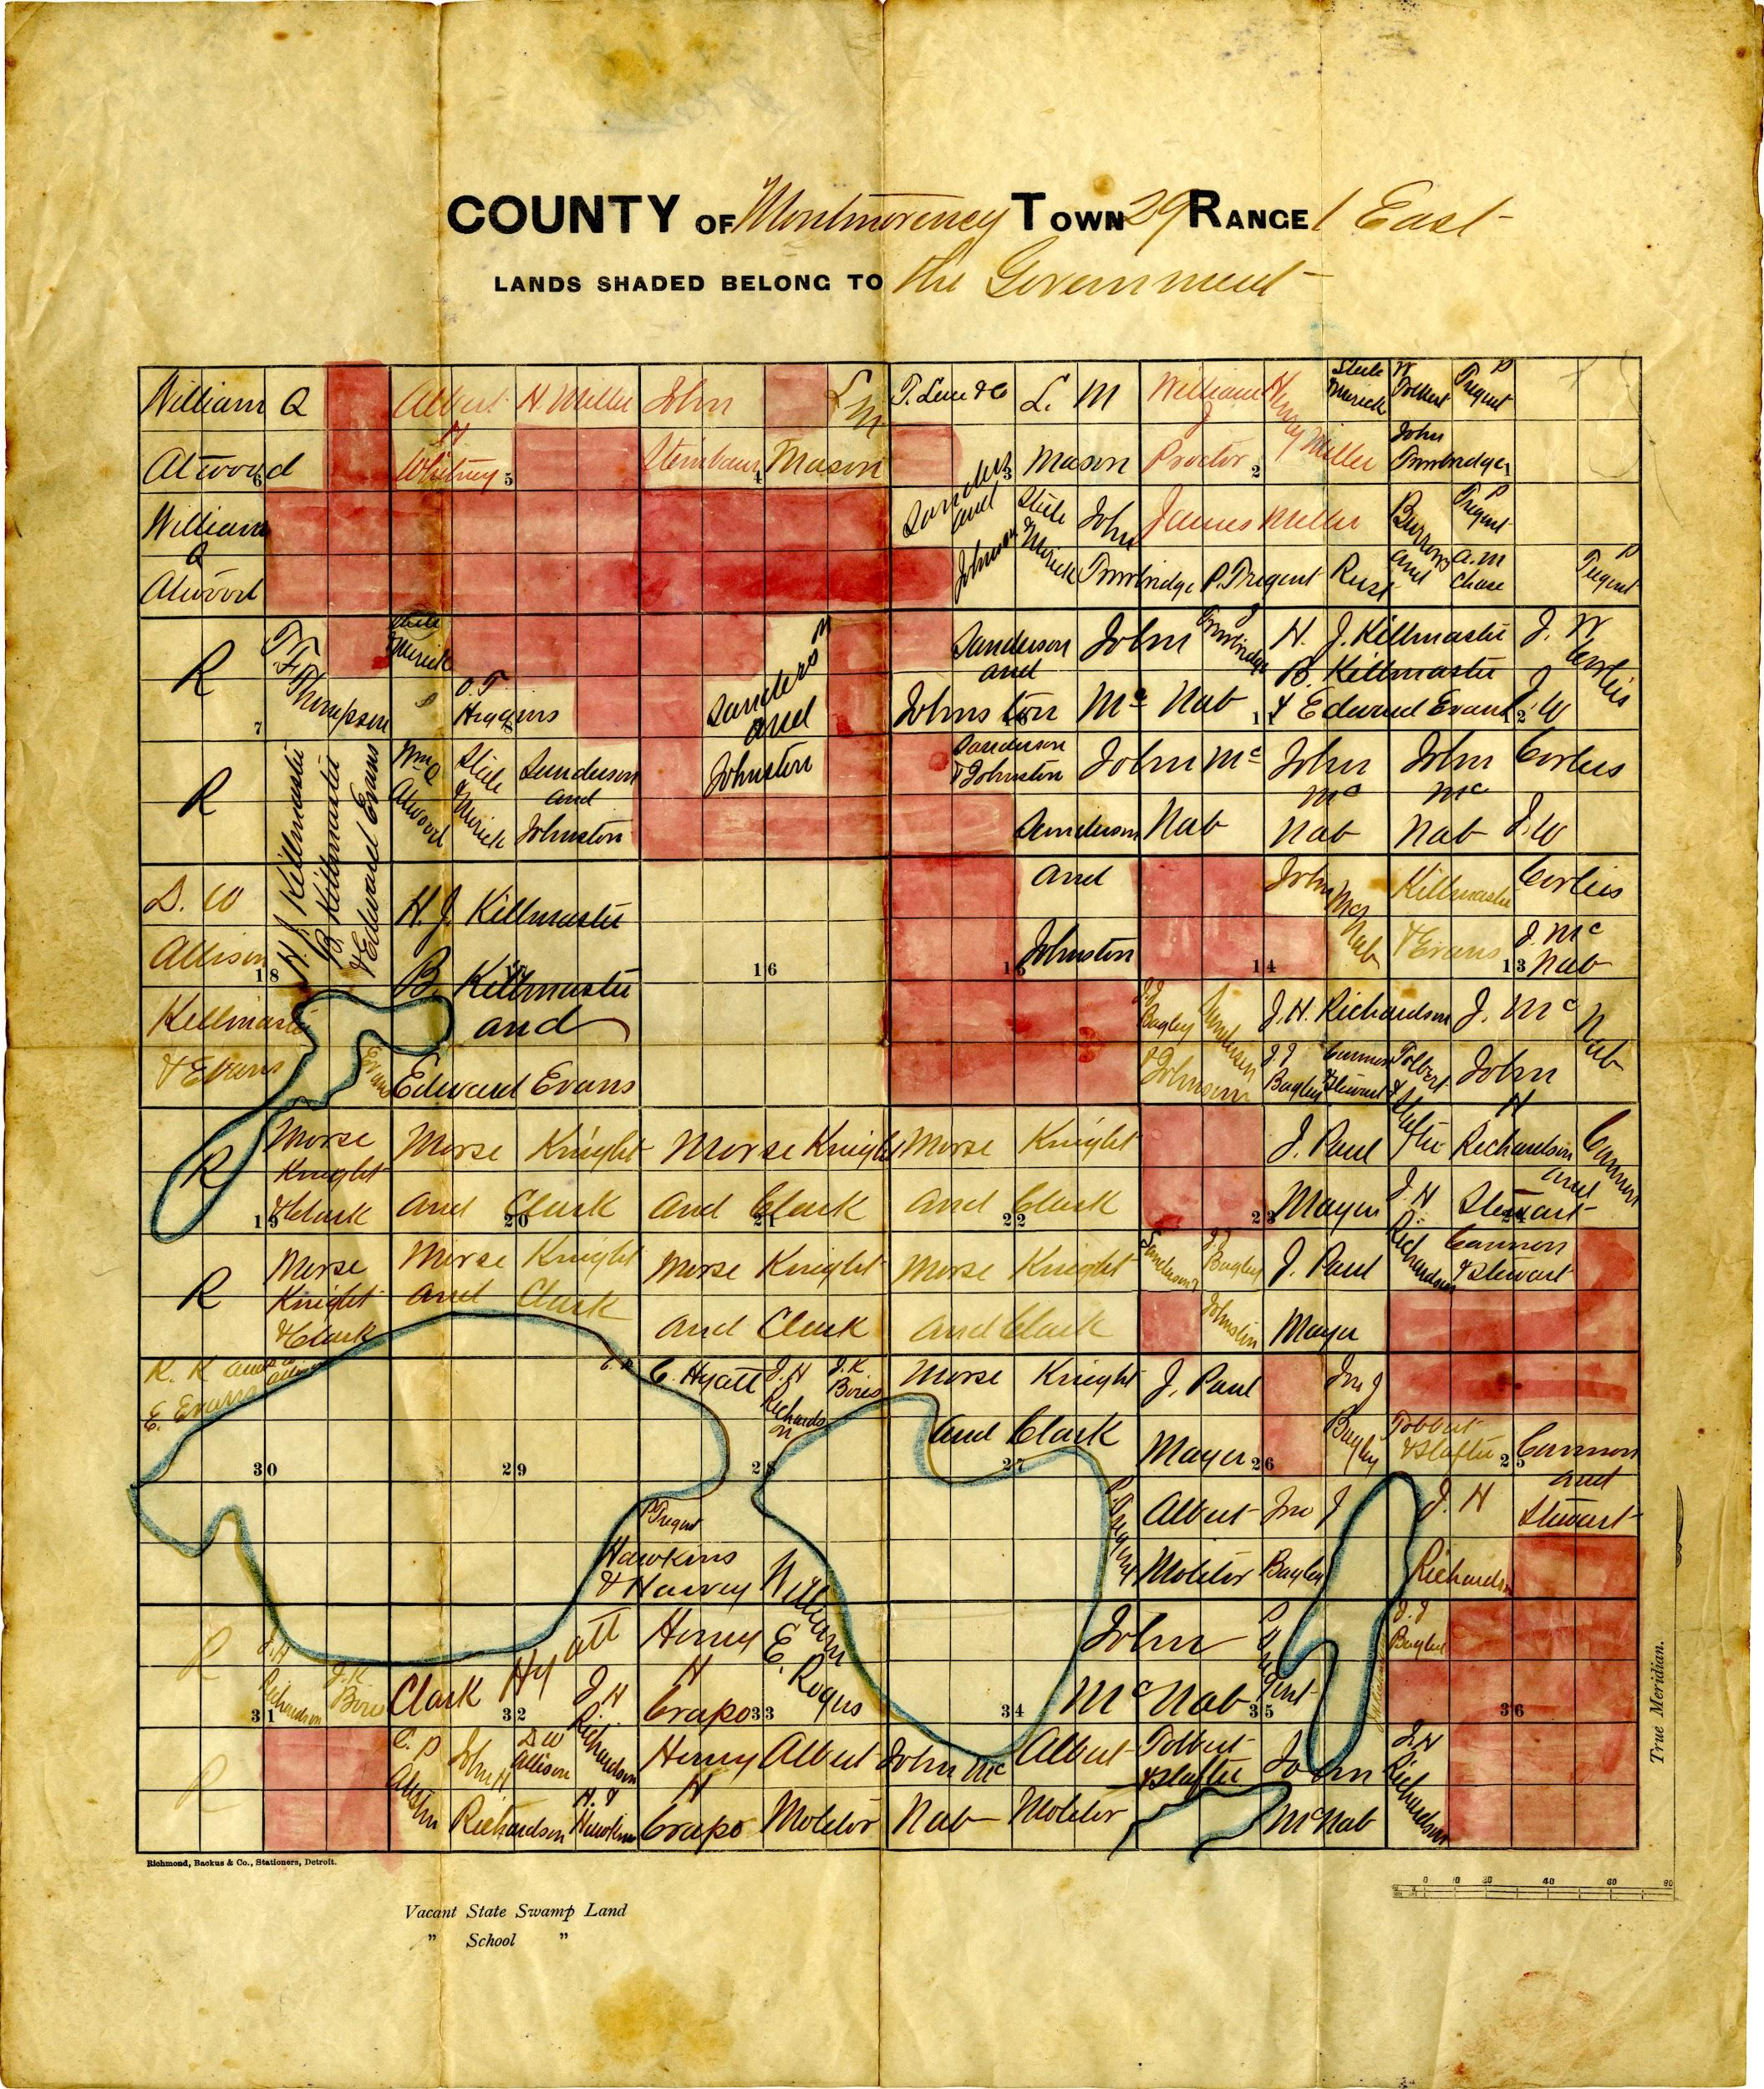
Notes:
Here we have a cadastral map of a survey township in Montmorency County

Slide 71
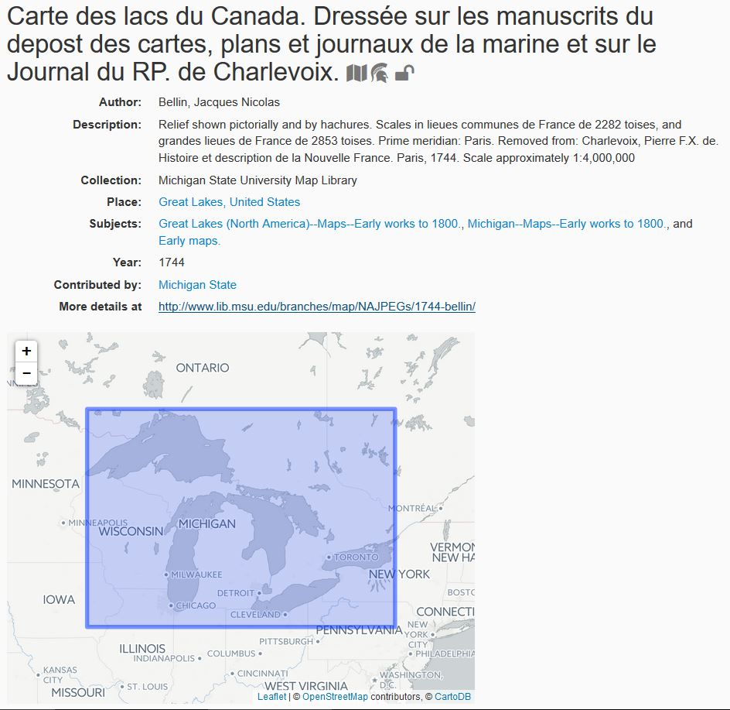
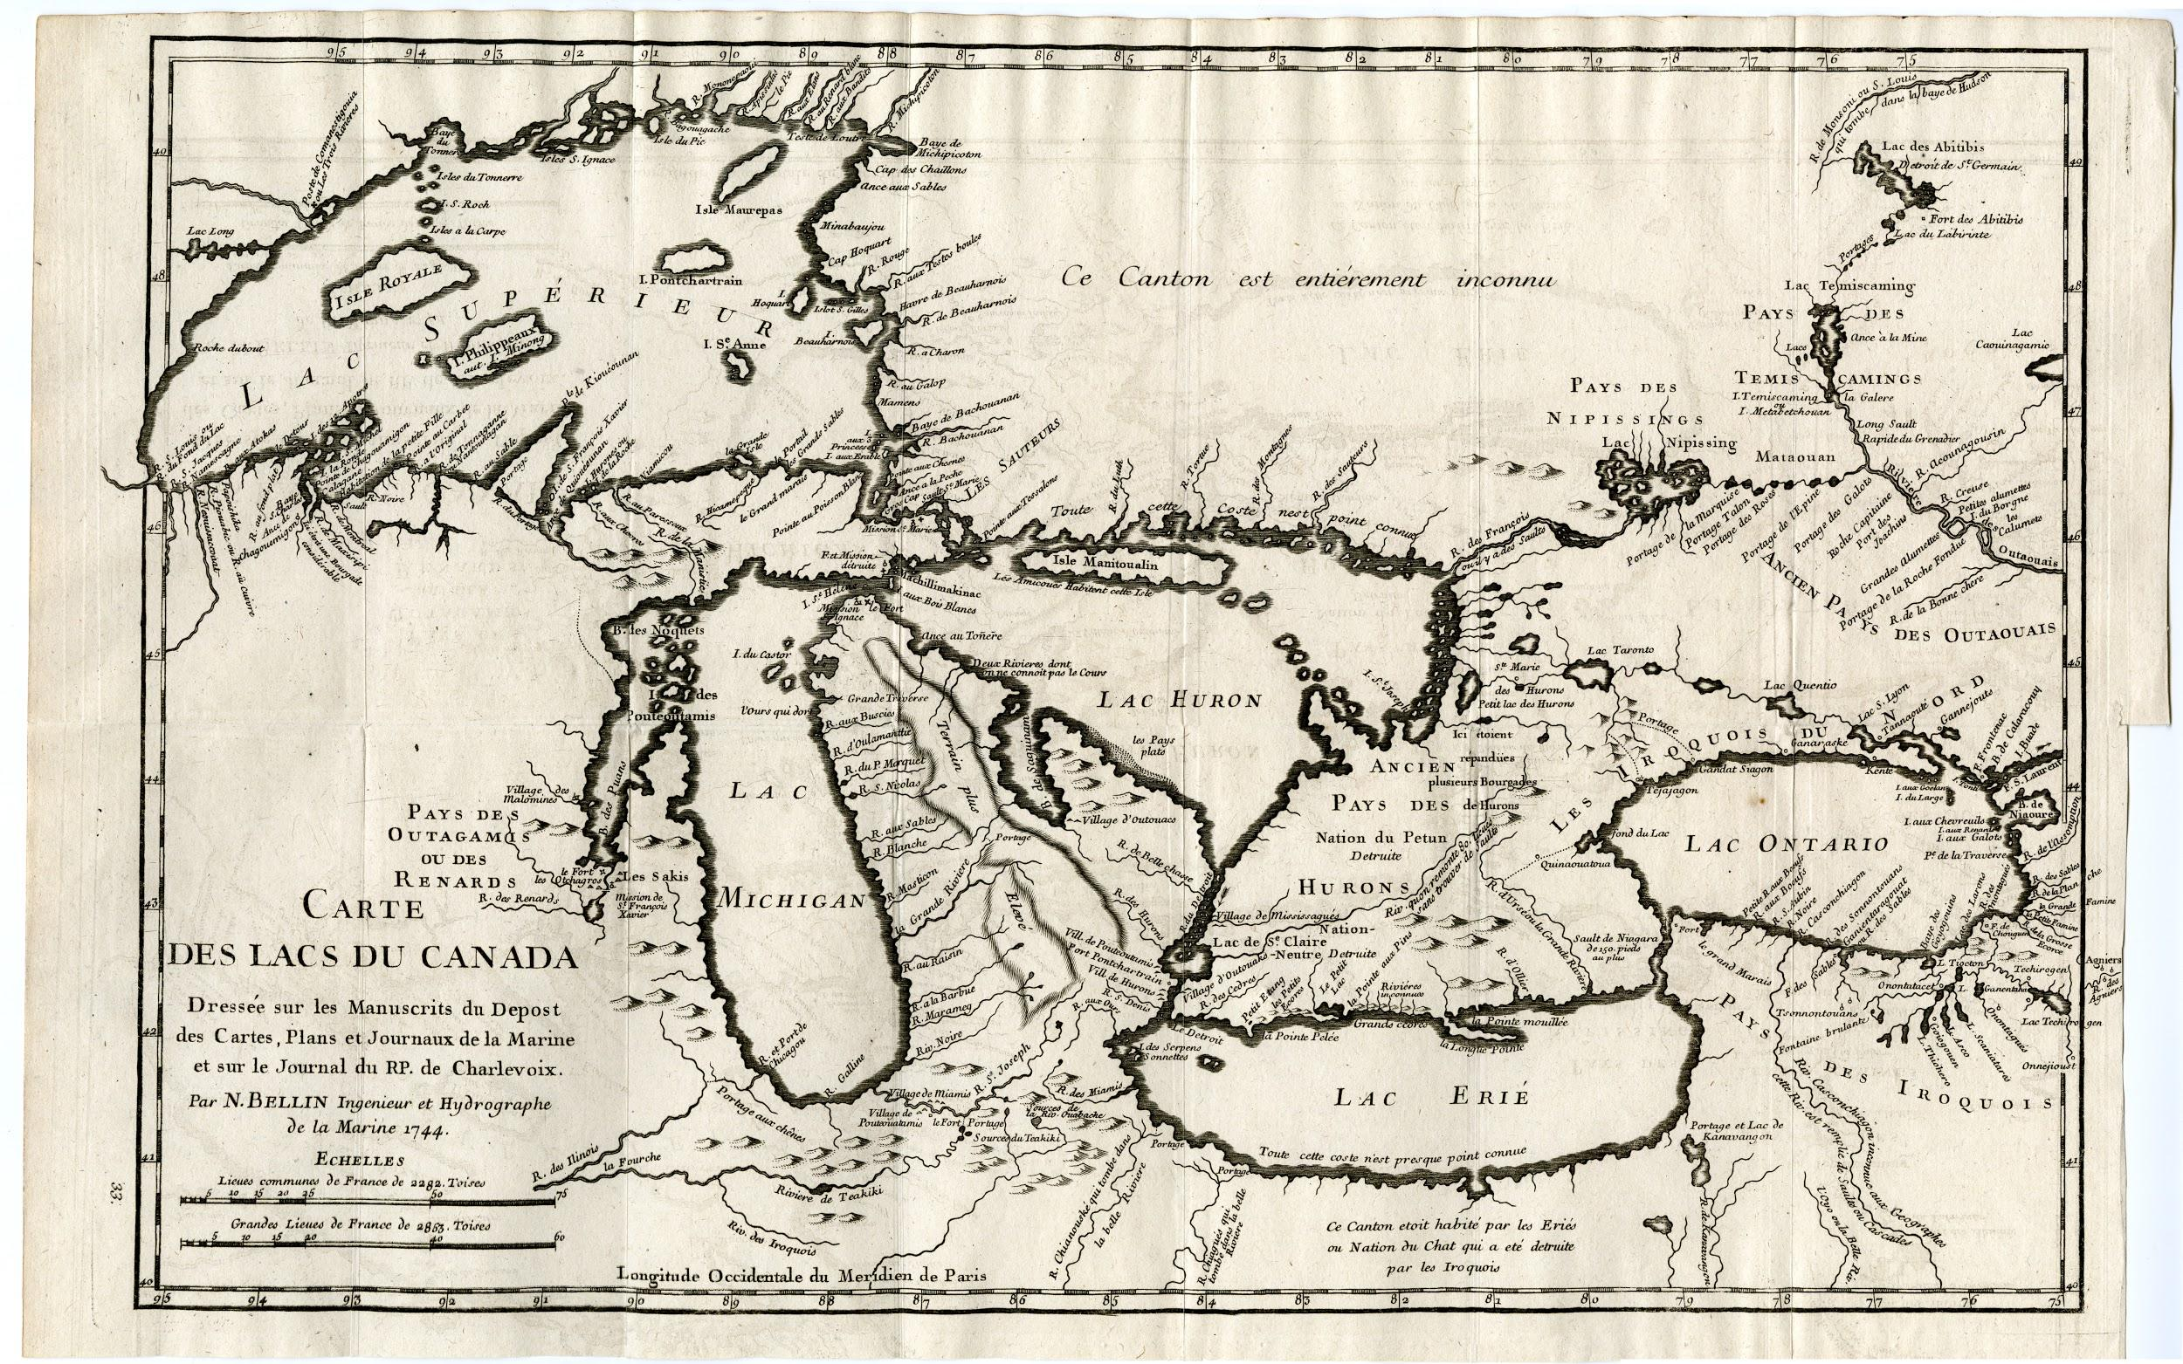
Notes:
And here is a 1744 map of the Great Lakes.

Slide 72
Tim Kiser Catalog Librarian for Maps tkiser@msu.edu
Nicole Smeltekop Special Materials Catalog Librarian nicole@msu.edu
Amanda Tickner GIS Librarian atickner@msu.edu
Kathleen Weessies Head, Map Library weessie2@msu.edu
Thank you!

