Slide 1
3D Printing and Modelling For Beginners
Hollander MakeCentral: Makerspace
Facilitated By:
Amanda Tickner
GIS Librarian
Notes:
Hello Everyone and welcome to the intro to 3d printing workshop here in Make Central: MSU Libraries’ Makerspace
I’m and the Make Central Coordinator Erica Ervin, here with Amanda Tickner our GIS/Makerspace librarian and we have a member our the make central staff here to help out as well. So let’s get started.

Slide 2
Agenda
What is 3D Printing? Why use it?
  Examples
Tour of Make Central 3D Printing Services: 3D printing in the library
Making a bird house with TinkerCad
Notes:
Here is an overview of how we will spend the hours. Starting with a quick look at our printers, followed by a breif overview of 3d printing the process, file types and how to submit to us when you’re ready. Then we go into the modeling portion and using Tinkercad a novice 3D modeling program.
So let’s get up, and we’ll walk over to look at the machines which are located in the copy center. You can leave your belongings here, our staff will stay in the room to watch them.

Slide 3
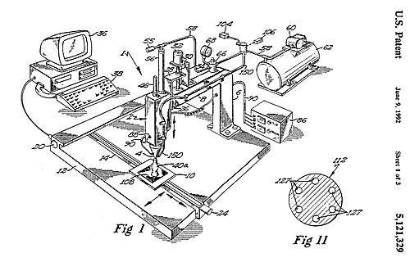
What is 3D Printing?
CAD file ⇒ Physical Object
Also called additive manufacturing Adding material layer by layer
Dates back to 1980s
Term is applied across materials and processes
Notes:
Let’s start by talking about what 3d printing is.
Well 3D printing is smiply taking a Computer Aided Design file, more commonly refered to as a CAD file and making a physical object from it.
3D printing is also, or more historically, called Additive Manufacturing because the physical object is created by putting matreial together as opposed to subtractive manufucating, like carving, cutting or milling where material is removed.
3D printing dates back to the 1980s, but only recently gaing popularity in the late 2000s due to the development of lower cost desktop machines with affordable materials. Currently there are many different types of 3d printing but the term applies across all processes and materials.

Slide 4
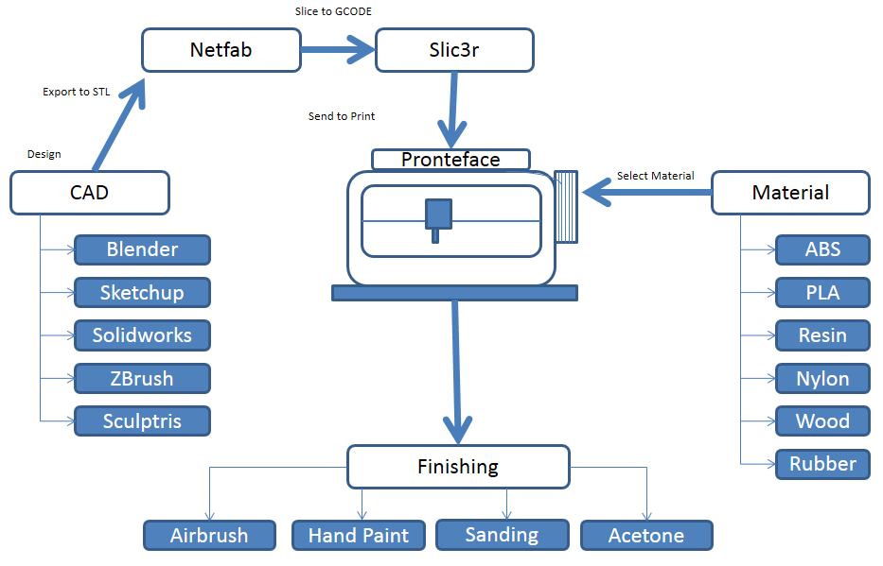
Outline of the Process
CAD file
Check & Repair file
Slice file
Choose Material
Print file
Clean up & Finish object (optional)
Check & Repair
Slicer
3D Printer
Notes:
Here is an overview of the whole 3d printing process.
First you start with a CAD file and it can be something you download from an online repository or create yourself using any of a number of 3D modeling programs. Listed here are just a few. You don’t have to start with a CAD file to 3d print, such as if you were using an MRI or scan image, but for this basics this is where we will start.
From there you save your file as an .STL file. An STL is the standard type of file used for 3d printing and it basically makes your file into a locked format like a PDF document would be for text. When you save as an STL it converts that object you created an converts it into lots of tiny interconnected triangles that can be read by 3d printing software.
Sometimes when you convert to STL there may be one or two issues so you want to check and repair the file, and there are a number of programs that do this as well. And it will make sure none of those little triangles are missing or flipped in the wrong direction for printing and make sure your object is solid which is key for 3d printing!
Once your .STL is file looking good, you will need to prepare it for printing which means slicing into the tiny layers that that the machine can print. This is called the g-code, or machine redable format of your object for the printer.
Then you choose your material. Most printers can only handle a specific type of material so that will determine what you are using but the most common types are Plastics like PLA, ABS, Resin, and Gypsum Powder. But also there are specialized printers for metals, foods like chocolate, and even organic tissues.
Once you’ve selected and loaded the material you send your file to the printer. Printing can be anywhere from 20 minutes to days, but on average most prints take a few hours so you just sit back and wait and soon you will have a completed object.
You then remove the part and clean up any support material if it was used and you’re all set! Some people go on to finish the object by painting or sanding as well.

Slide 5
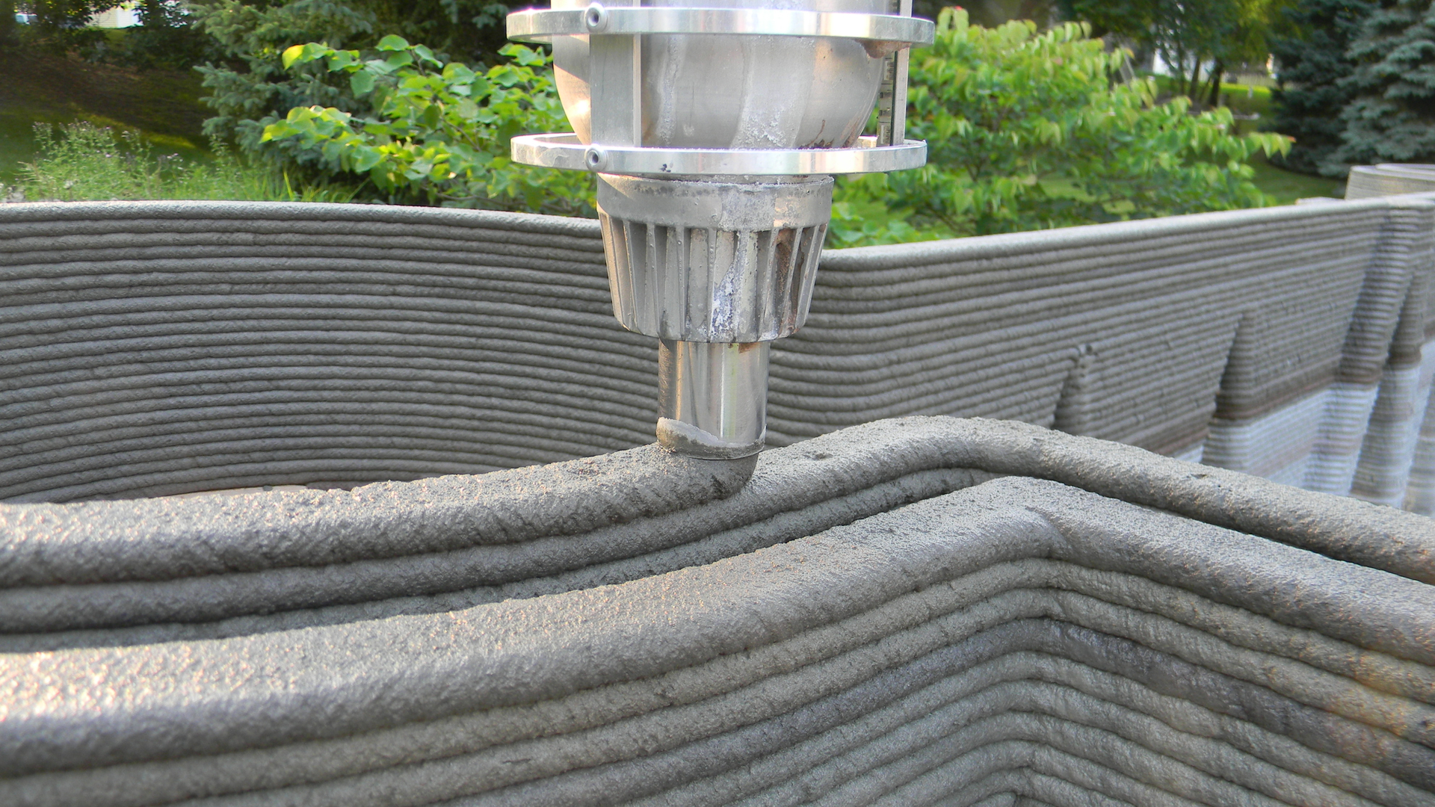
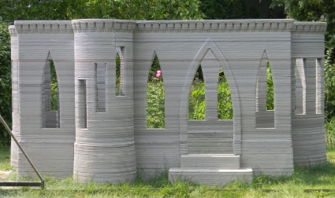
3D Printing often works in layers

Slide 6
Rapid prototyping
“Rather than using custom machine tools to build early prototypes of new parts, Ford is now using 3-D printing technology to design and test its engineers’ latest ideas…in as little as a week after they create a new design—compared with a previous wait time of three to four months”-USA Today
“in some cases tripling the number of iterations of a new product that can be refined before being mass-produced”
Notes:
Read this, put picture

Slide 7
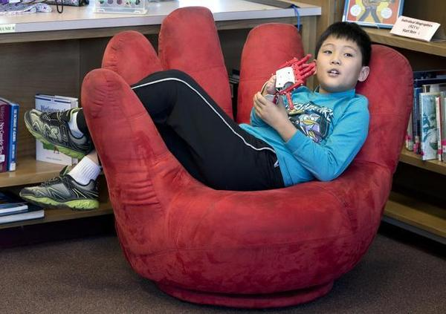
Artificial Hand

Slide 8
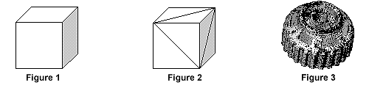
.STL Files
STL has several after-the-fact backronyms (because it didn’t initially stand for anything) such as "Standard Triangle Language" and "Standard Tessellation Language".
Industry standard for 3D files
Created by 3D Systems
Supported by many design packages
Surfaces—no color
What is an .STL File? (n.d.). Retrieved January 8, 2014, from http://www.quickparts.com/LearningCenter/WhatIsAnSTLFile.aspx
Notes:
So what’s a .STL file. Well it stands for Standard Tessellation Language
“The STL file format has become the Rapid Prototyping industry's defacto standard data transmission format. STL format approximates the surfaces of a solid model with triangles. For a simple model such as the box shown in figure 1, its surfaces can be approximated with twelve triangles, as shown in figure 2. The more complex the surface, the more triangles produced, as shown in figure 3.” (Quickparts, 2013, para. 1)

Slide 9
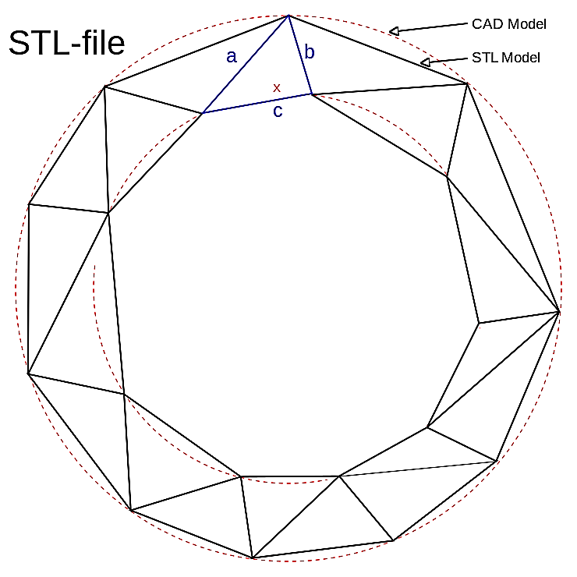

Slide 10
Printers Print Files
Option One: Find a File Online
Thingiverse http://Thingiverse.com
Sketchfab https://sketchfab.com/
NIH http://3dprint.nih.gov/
NASA http://nasa3d.arc.nasa.gov/
Smithsonian http://3d.si.edu/
Notes:
Now on to the fun stuff of getting a CAD file. You have a few different options. The first is to find a file online and there are many online repositories. Listed here are just a few. You can go to these sites like Thingiverse and type in what you are looking for like.

Slide 11
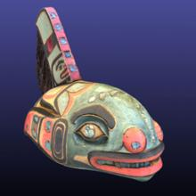
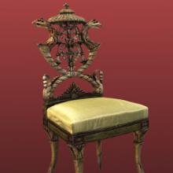
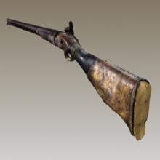
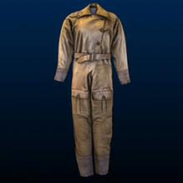
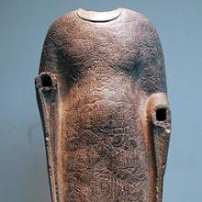
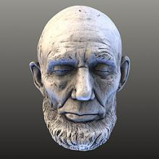
Smithsonian 3D Models: http://3d.si.edu/browser

Slide 12
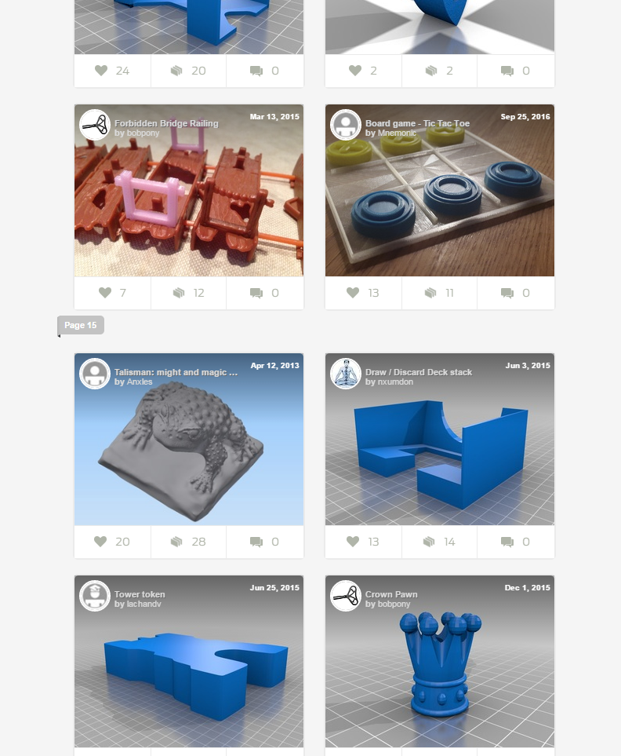
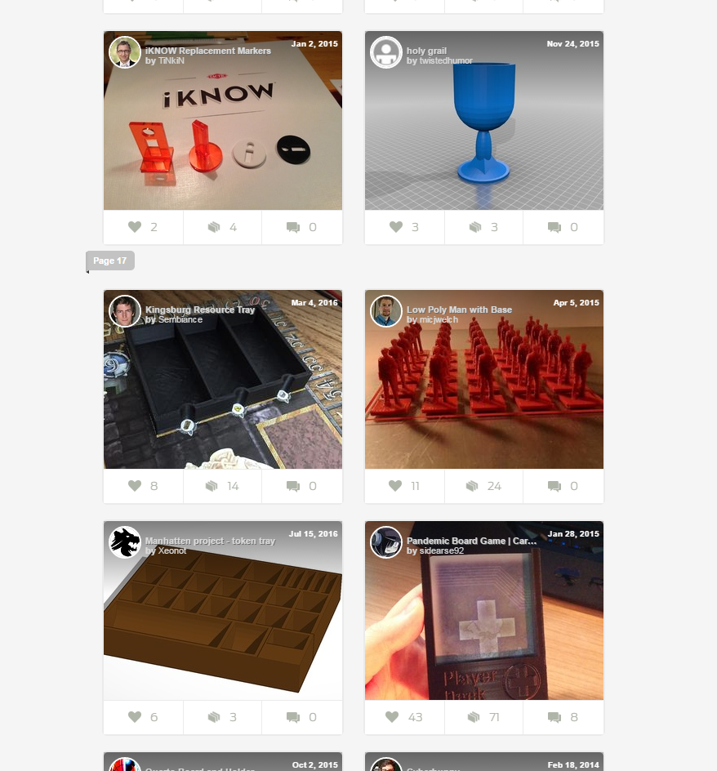
thingaverse.com

Slide 13
3D Terrain Models
Instructions:
http://libguides.lib.msu.edu/3DTerrain
App:
http://jthatch.com/terrain2stl/

Slide 14
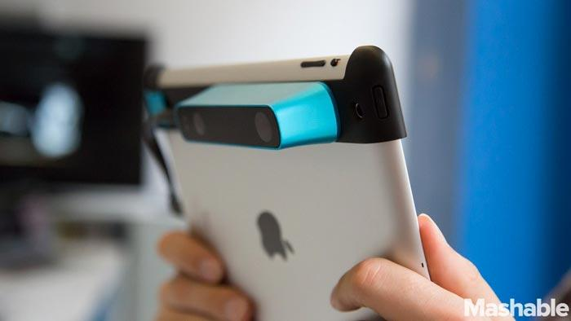
Making models: Scan them
Option Two: Scan an object
3D ojbect scanners
Photogrammetry: 123D Catch http://www.123dapp.com/catch
Other Scanners:
  MRI or CT scan data
Notes:
There are a few different ways to get scan data that can be used for 3d printing like: designated 3d object scanners which can be stand alone or you can get some that attach to tablets
You can use photogrammetry which is taking lots of pictures from different angles of an object and merge them together to see it all in one 3d image.
And you can use other 3d image data like MRI or CT scans and make the printable files.

Slide 15
What’s Used on Campus?
AutoCAD
Available in Specialized Labs
  SolidWorks
  Rhino 3D
  Photoshop
Free Programs
  123D Design
  Sketchup
  Blender
  Meshmixer
Extracting files from CAT/MRI scans
Notes:
There are hundreds of 3D design programs out there, so of which are more suited than others for 3D printing. Here on campus alone I there are various different programs that patrons are using to get created their objects and send to us for printing. Which is why we only accept .STL file types.

Slide 16
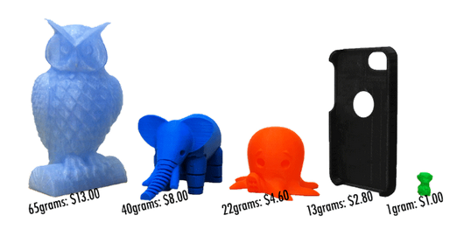
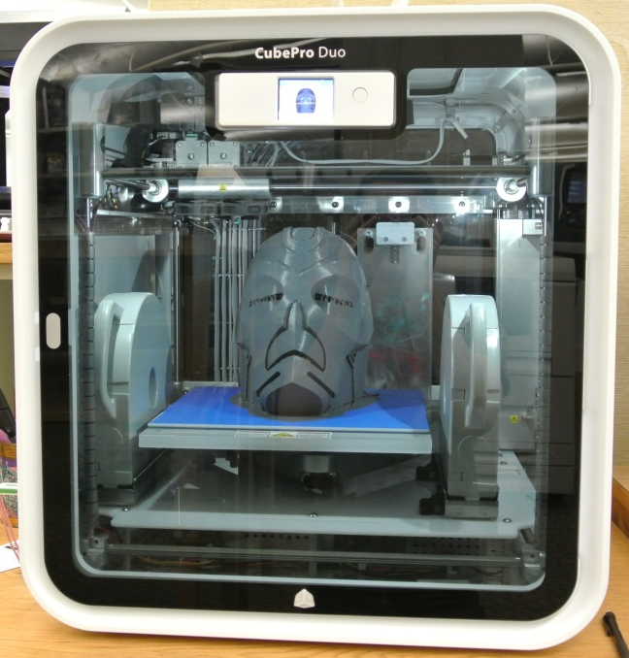
3D Printing at the Library
Mediated services
Hobbyist-level prototyping machines
20 - 25¢ per gram
User-friendly process!
Accessible to model-makers and novices using community files

