Slide 1
Basic GIS Concepts
Introduction to QGIS Workshop

Slide 2
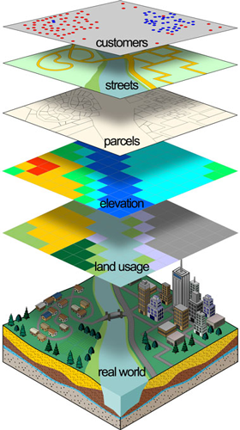
What is GIS?
Geographic Information System
Works in layers
Used for:
Database
Data visualization
Analysis

Slide 3
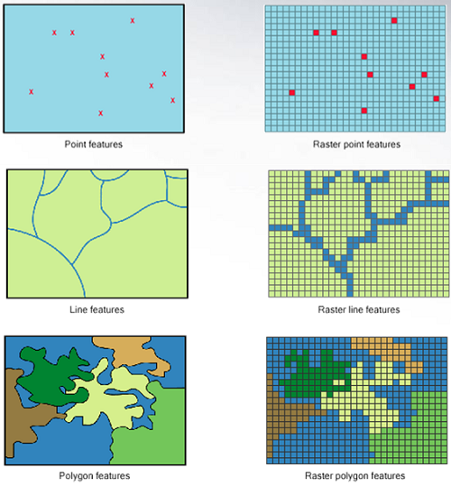
Types of Data

Slide 4
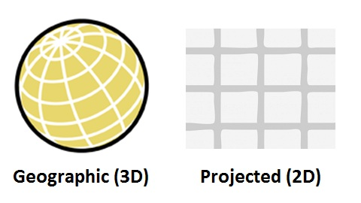
Types of Projections
Notes:
Inevitable error – The Map Will Never Be The Territory

Slide 5
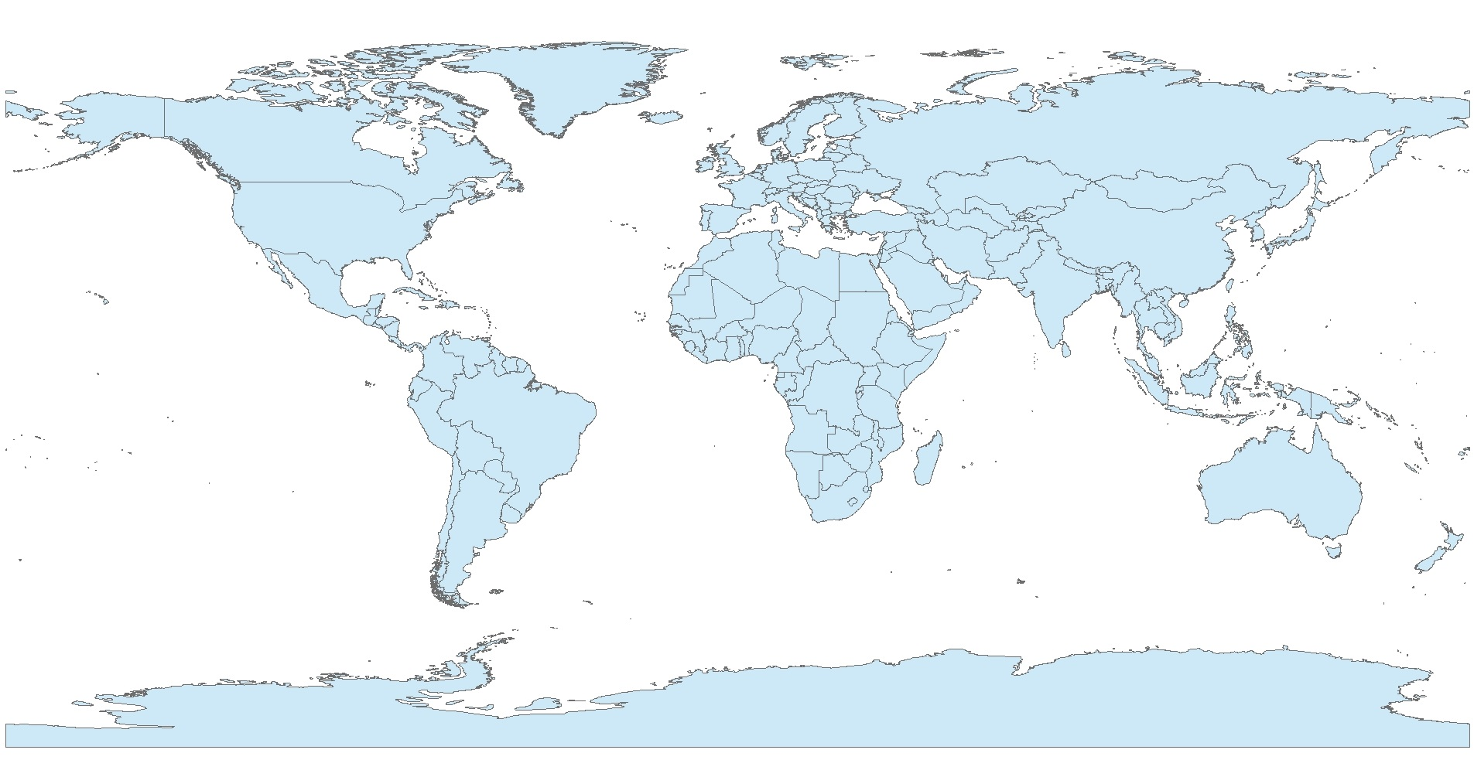
Example of Projections
World countries shapefile in WGS 84 projection

Slide 6
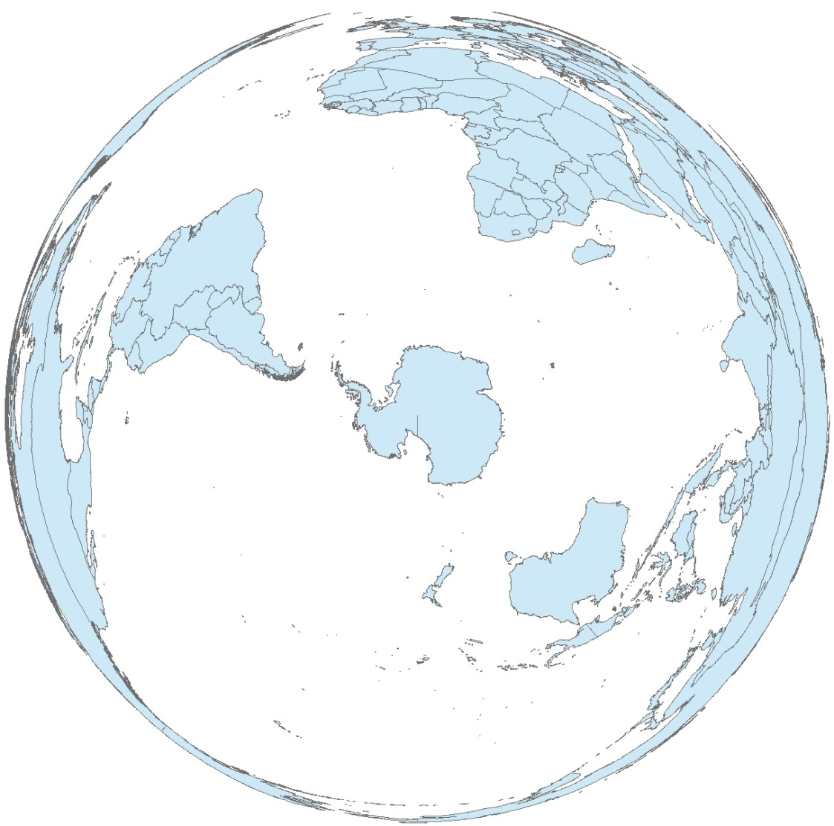
Example of Projections
World shapefile in polar projection

Slide 7
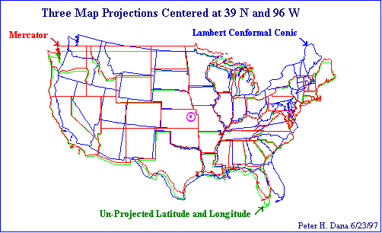
Projections matter for analysis

