Slide 1
Census Data: Access, Importance, and the Future
Presented by
Julia Frankosky
Amanda Tickner
March 2, 2018

Slide 2
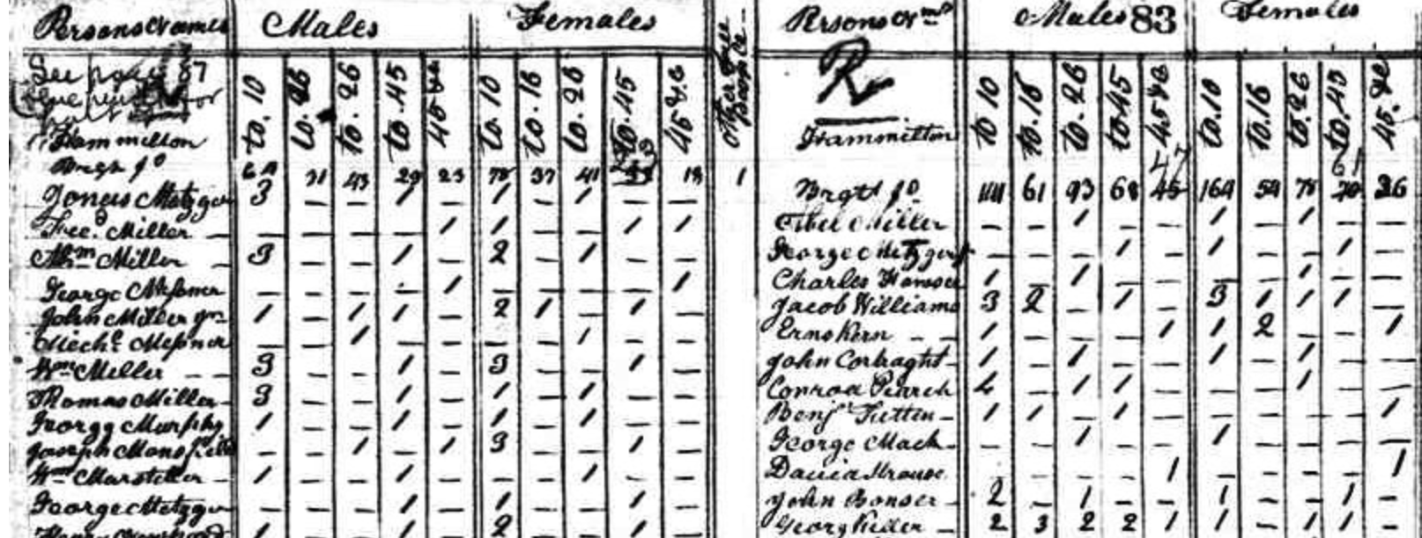
A Walk Through Time
Notes:
The first U.S. Census was collected in 1790 and has been conducted every ten years since then. The first few iterations of the Census asked a few, very basic demographic questions. In 1790 for example the only questions asked were The number of free White males aged: under 16 years , of 16 years and upward Number of free White females, Number of other free persons Number of slaves. This data was hand collected by Census workers going door to door and tabulated locally. Actual publications of the results was very limited and much data is missing for the older Censuses, such as micro level data for some areas.

Slide 3
1860 Census Questions
Number of dwelling in order of visitation by the enumerator
Number of family in order of visitation by the enumerator
Name
Age
Sex
Color
  Enumerators could mark "W" for Whites, "B" for Blacks, or "M" for Mulattos.
Profession, Occupation, or Trade of each person, male and female, over 15 years of age
Value of person's real estate
Value of person's personal estate
Place of birth
Enumerator could list the state, territory, or country of the person's birth
Was the person was married within the last year?
Did the person attend school within the last year?
If the person was over 20 years of age, could he not read or write?
Was the person deaf and dumb, blind, idiotic, pauper, or convict?
Notes:
With time and the growth of our country, it became clear to the government (both local and federal) that the Census was a valuable resource and the amount and types of questions asked expanded. Here are some of the questions asked in one of the Census questionnaires for 1860. There were several questionnaires this year such as one for slaves. As you cam see the questions have expanded beyond the basics asked in 1790.

Slide 4
2010 Census Questions
Number of household residents
Did anyone else live here during the year not included in first count
Rent, mortgage, or own the house outright
Telephone number
For each person in the house:
      Sex
  Age and date of birth
  Hispanic or Spanish origin
  Race
  Do they live anywhere else
Notes:
The Census is an evolving questionnaire. Questions have not been asked continuously over time, they may have altered in their wording or the options one can choose from, or the question may have been deleted. Additionally for those studying race and ethnicity, the way these categories are broken down has also changed. These factors make using the Census for historical comparison tricky For example, in 2000, the Census asked 52 questions, while in 2010 only 10 questions were asked.

Slide 5
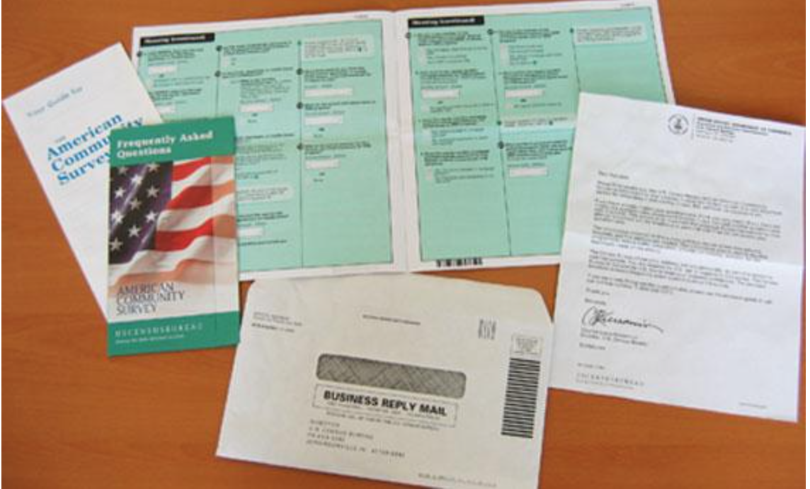
American Community Survey (ACS)
Notes:
The key reason for this drastic shift was because of the introduction of the American Community Survey or ACS. The ACS replaced the long form of the Census (which only was sent to 1 in 6 households), so now the Decennial Census, which surveys the entire population, is much shorter. The ACS goes out to a subset of the population and is collected far more frequently than once every 10 years – instead it’s collected yearly and data sets are released in groups of 1 year, 3 year, and 5 year groups. By increasing the frequency of data collection and distribution, federal and state governmental bodies are able to make appropriate budgetary changes based on more accurate data. The increased frequency of data collection and release because of the ACS provides better insight into our communities such as jobs and occupations, educational attainment and enrollment, the number of home owners or renters, the usage of social welfare programs such as SNAP, and many other important household and demographic aspects.

Slide 6
Census 2020
Operational plan and will provide the planned 2020 Census questionnaire wording to Congress by March 31, 2018
Two-question format for capturing race and ethnicity
DOJ requested adding a question about citizenship
Notes:
We are fast approaching the next Census. The plan for the Census and proposed questions will be submitted to Congress for approval by March 31, 2018.
Two-question format for capturing race and ethnicity. will not include a combined question format for collecting Hispanic origin and race, or a separate Middle Eastern or North African category on the census form. Categories used for race and ethnicity will remain the same as the 2010 Census. There had been discussions regarding new categories, but more research needs to be conducted into this aspect.
A citizenship question was first asked on the 1870 census and was asked continuously from 1890-1950, on the 2000 long from census which was filled out by 1 in 6 households, and on the American Community Survey. While immigrants have been willing to answer such questions in the past as they see the benefit to their community by answering truthfully, the political climate and anti-immigrant rhetoric has caused distrust in the current data collection. Fear of retaliation could lead to lower response rates or inaccurate responses.

Slide 7
Current Issues
A citizenship question on the Census may be bad for your health
  https://www.nytimes.com/2018/02/14/us/politics/citizenship-question-census-public-health.html
Will the Census Bureau’s IT systems be ready for 2020?
  https://fcw.com/articles/2018/02/21/census-cedcap-ready-2020.aspx
Currently there is no director of the Census Bureau
Notes:
If fewer immigrants feel comfortable answering questions related to citizenship, this could affect social services offered in communities. Census data is used to determine not just congressional districts, but more importantly social services, such as hospitals, schools, etc. With a lower response rate caused by fear of retaliation or deportation, funding could be cut in areas that need it most. Not only that, but public health officials use this data to model neighborhoods before launching preventative programs. With inaccurate data, public health officials are at a disadvantage and areas that have large immigrant populations may underreport population counts on the Census, causing those areas to be neglected by public health officials when it comes time to develop preventative health services and the appropriation of federal funding for these programs.
Budgetary constraints (and the fact that the budget has been severely underestimated) and tight deadlines could mean that the centralized IT system that the Census Bureau is hoping to utilize for 2020 might not be up to the challenge. These systems need to be ready by a date in 2018 to ensure they are tested and ready for use, but as of January this year only 24 out of the 44 systems are ready for use and the Government Accountability Office doesn’t agree with what the Census Bureau has deemed ’ready.’ Budget increases have been requested and the Census Bureau is focusing on IT infrastructure and data security, but there are concerns that other aspects such as education and outreach are being ignored.
In June 2017, the director of the Census Bureau stepped down and no new director has yet to be named. This leadership vacuum is happening during a crucial time for the Census, not only are we nearing the next decennial census but it is one that will rely more heavily on technology than any census in the past.

Slide 8
Data Usage
Reapportion the 435 seats in the House of Representatives
Realign the boundaries of legislative districts in every state
Determine the number of Electoral College votes that each state receives
Distribution of over $400 billion/year in state and federal funds
  Add hospitals, schools, transit systems and transportation infrastructure, elder care
  Provide funding for social welfare programs (SNAP, reduced school lunches, Medicaid, etc.)
Measuring migration
Employment information, including potential for growth
Provide invaluable social, demographic and economic profiles of the country essential in developing public policy and conducting research

Slide 9
Accessing census data/statistics

Slide 10
The Census provides great spatial data
Census Blocks are at a neighborhood scale
TIGER files = shapefiles of census blocks
TIGER = Topologically Integrated Geographic Encoding and Referencing
Organized by FIPS (Federal Information Processing Standards) codes
Where on the web:
https://www.census.gov/geo/maps-data/data/tiger.html

Slide 11
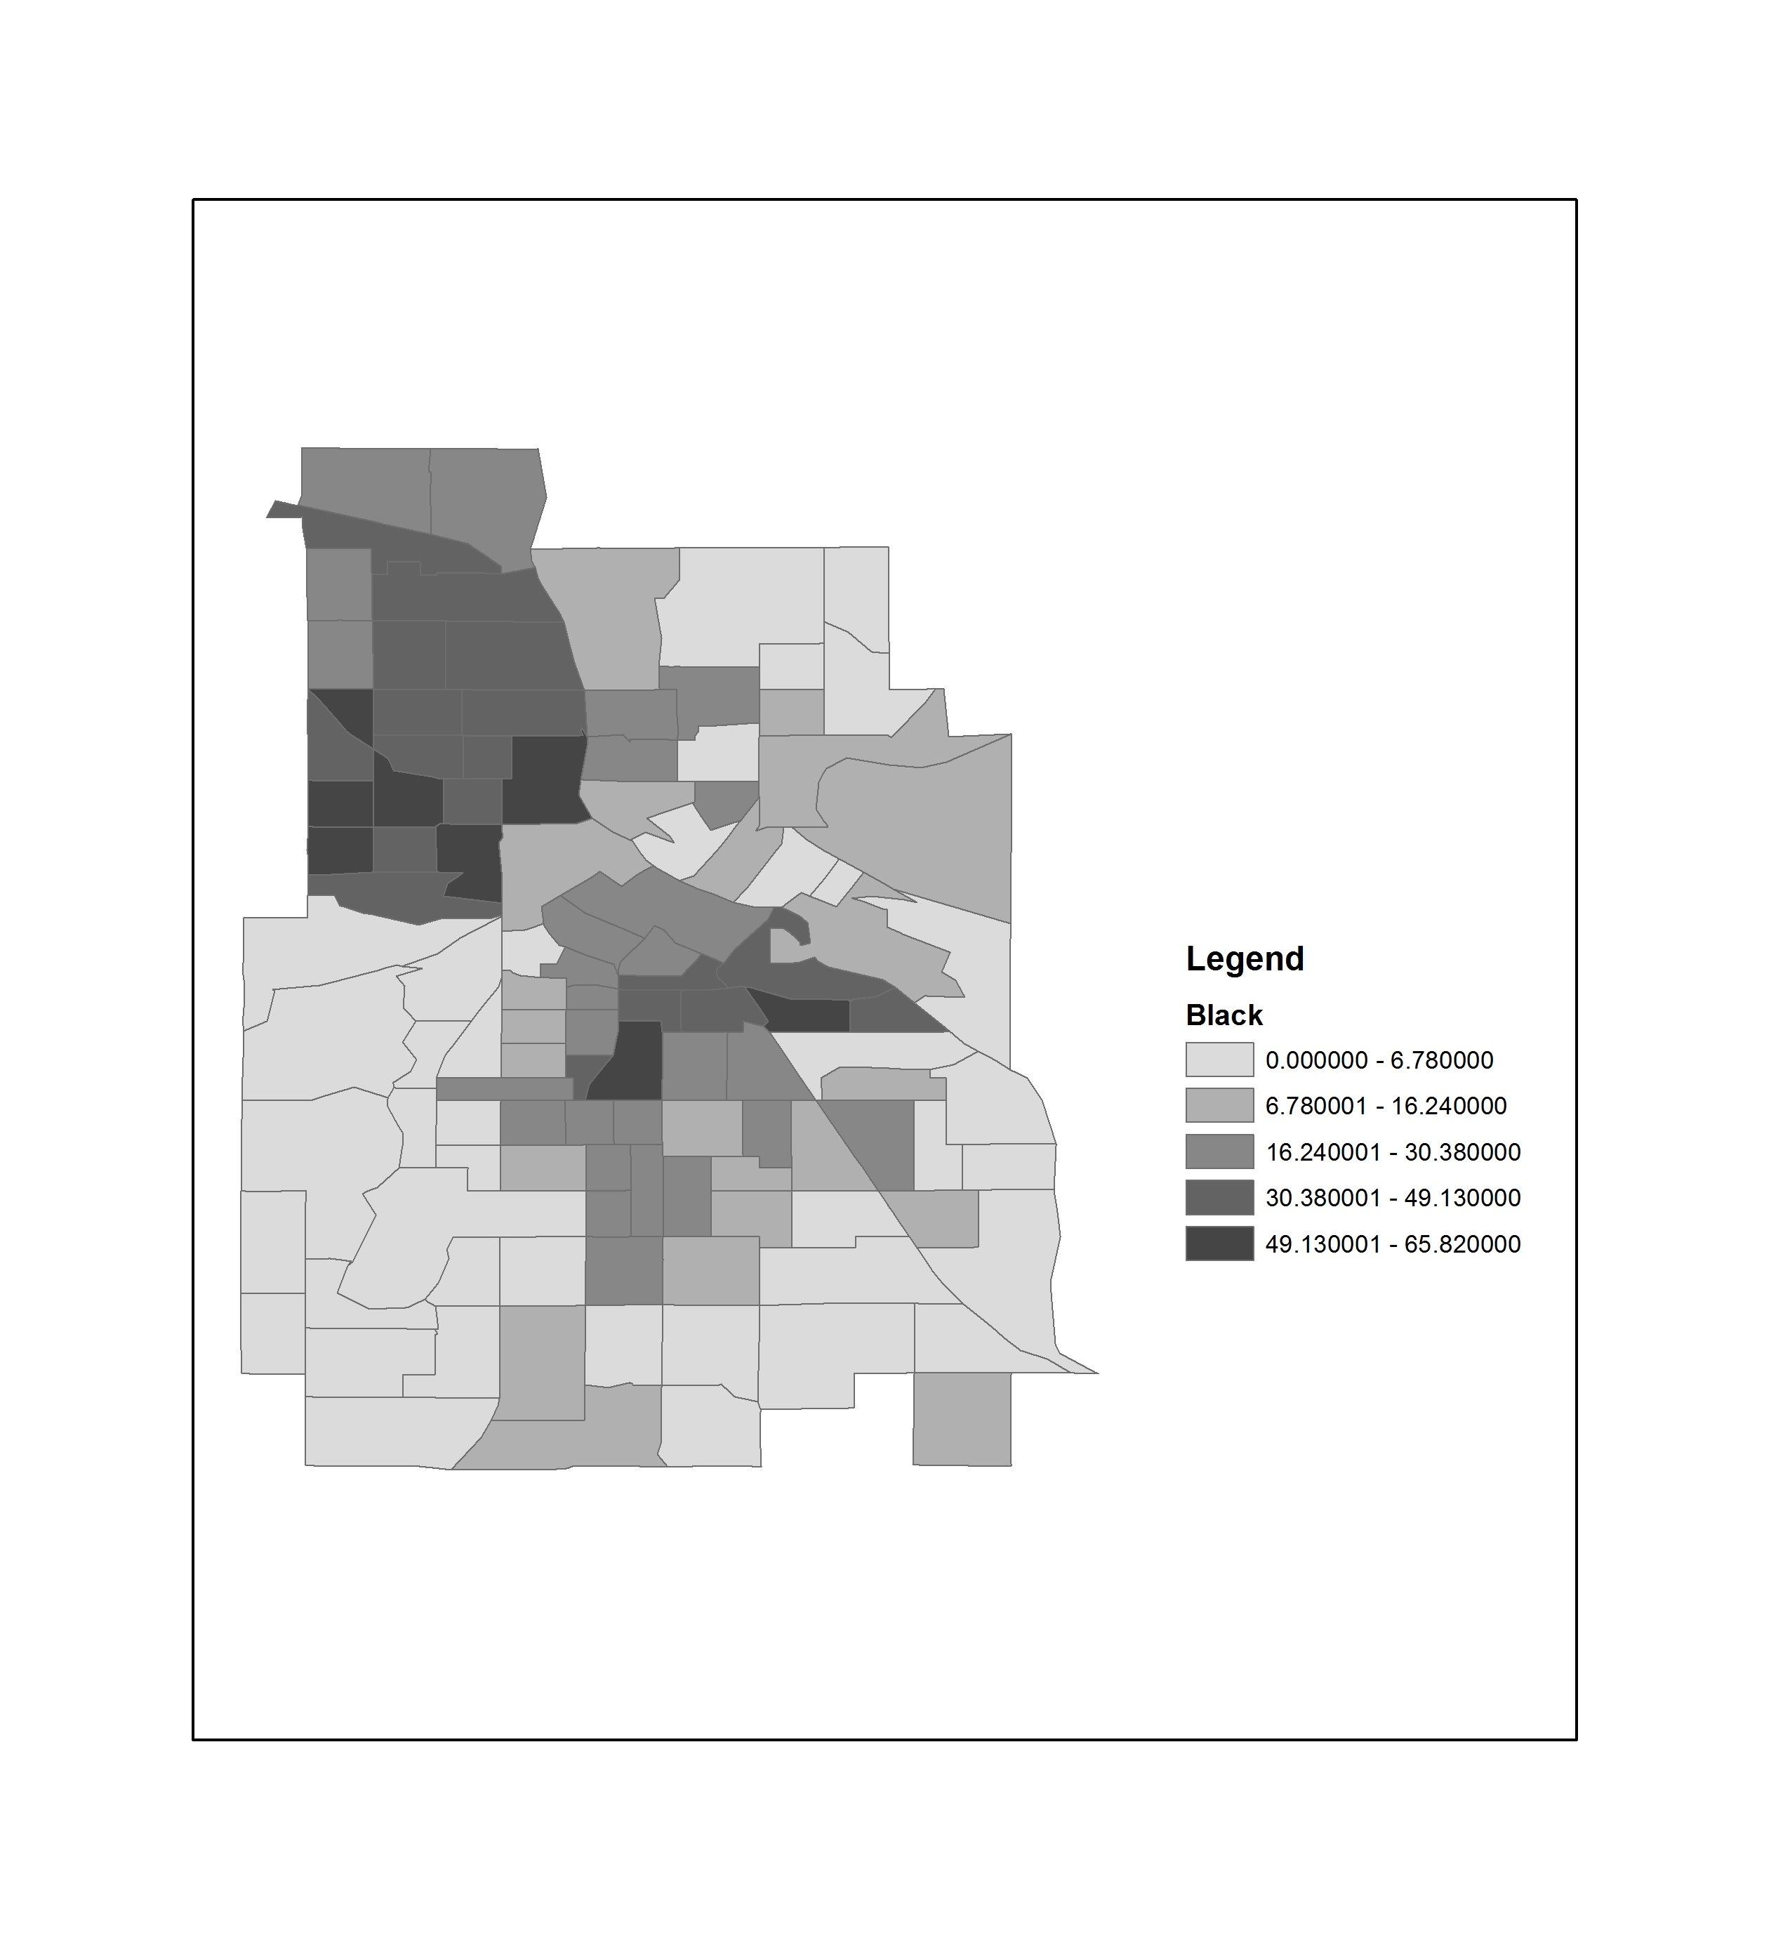
In the 2010 Census there were…
74,134 Census Tracts
220,742 Block Groups
11,166,336 Blocks (545,653 were water only)

Slide 12
American FactFinder
https://factfinder.census.gov
Developed by the Census Bureau
Freely accessible to all (so long as the government isn’t shut down)
Does not include access to historic data, only the most recent surveys

Slide 13
Mapping the Census
https://www.census.gov/geo/maps-data/
Census Data Mapper (county level only)
https://www.census.gov/geo/maps-data/maps/datamapper.html
American Fact Finder (only 2000 and 2010)
https://factfinder.census.gov/faces/nav/jsf/pages/index.xhtml

Slide 14
What is included
American Community Survey
American Housing Survey
Annual Economic Surveys
Annual Surveys of Governments
Census of Governments
Decennial Census (2000 & 2010 only)
Economic Census
Equal Employment Opportunity (EEO) Tabulation
Population Estimates Program
Puerto Rico Community Survey

Slide 15
iPums
https://www.ipums.org
Part of the Minnesota Population Center at the University of Minnesota
Provides census and survey data from around the world integrated across time and space
IPUMS integration and documentation makes it easy to study change, conduct comparative research, merge information across data types, and analyze individuals within family and community context
Data and services available free of charge

Slide 16
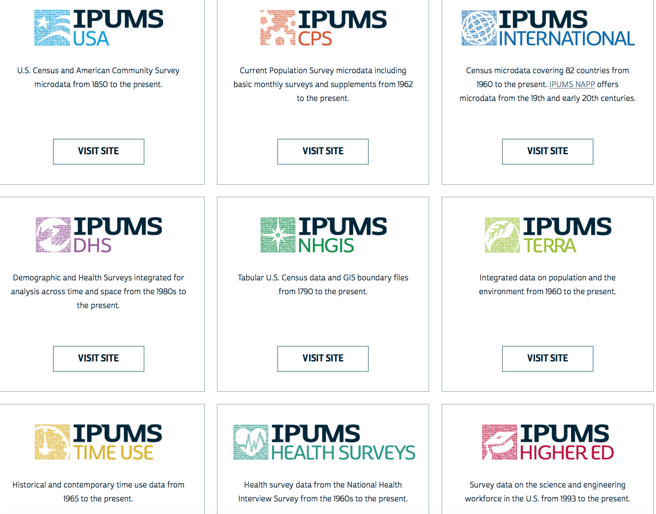

Slide 17
Social Explorer
http://ezproxy.msu.edu/login?url=http://www.socialexplorer.com
Subscription provided by the MSU Libraries
Create maps and reports from selected census statistics. 1790 to 1930: County, state and national data. 1940-2000: Census tract, county, state and national data. 2006- : ACS
Generate thematic maps for census tracts.

Slide 18
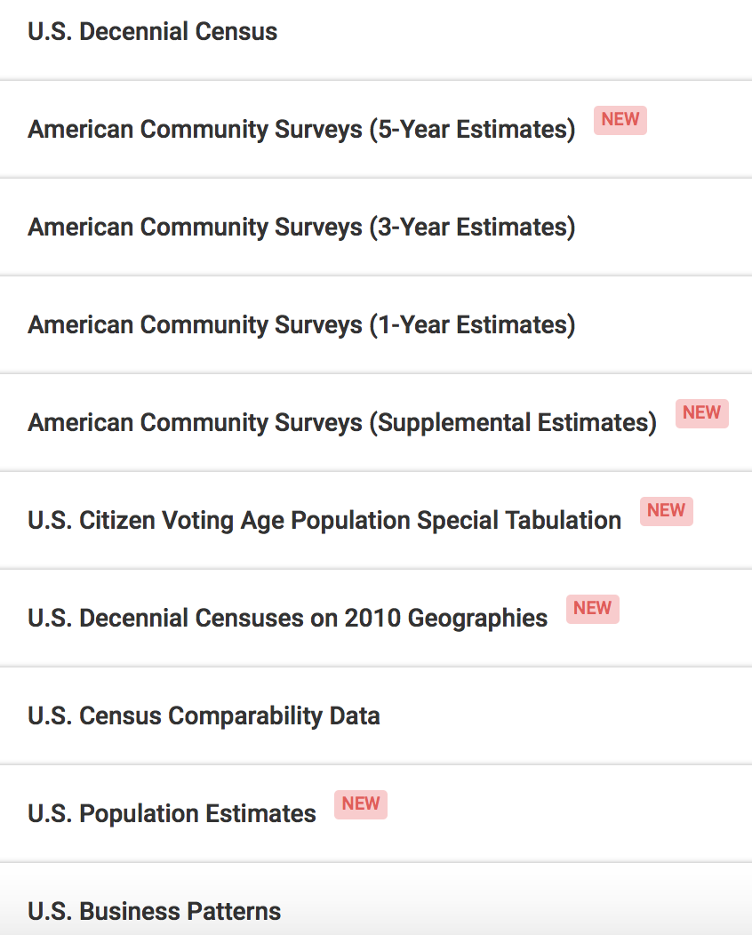
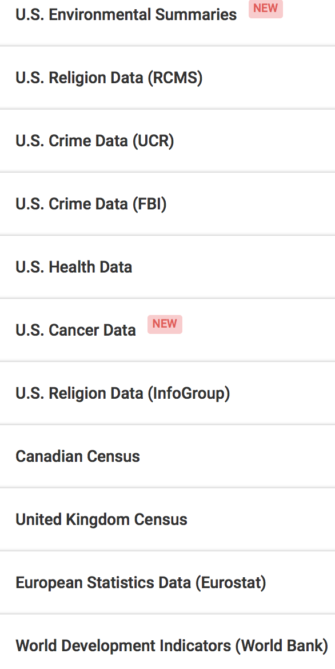

Slide 19
SimplyAnalytics
http://libguides.lib.msu.edu/c.php?g=210008
Subscription provided by the MSU Libraries
Must create a free account
Access limited to 5 users at a time
Create professional quality thematic maps using 100,000+ data variables
View data by state, congressional district, city, county, ZIP Code, census tract, or block group

Slide 20
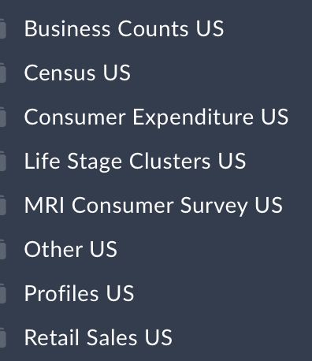
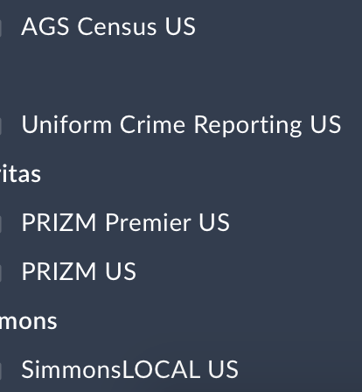
Data Sources

Slide 21
PolicyMap
http://ezproxy.msu.edu/login?url=http://msu.policymap.com/maps
Subscription provided by the MSU Libraries
Data and mapping application that gives access to over 15,000 indicators related to housing, crime, mortgages, health, jobs, demographics and education.
Data are available at all common geographies (address, block group, census tract, zip code, county, city, state, MSA) as well as unique geographies like school districts and political boundaries.
Data come from both public and proprietary sources and many of the public files are available for download
Access all data in interactive maps, tables, charts, reports and through a unique analytic tool.
You may also upload your own address level data and share your data and interactive maps with others.
Includes plumbing and kitchen data from 2011-2015 US Census Annual Community Survey.

Slide 22
