Slide 1
Finding Geospatial Data on the Web
10/2/2017
Amanda B. Tickner
Kathleen W. Weessies

Slide 2
Topics Covered Today
Types of data
Metadata
Places to get data
QGIS Tutorial

Slide 3
Types of data: Raster
Pixel resolution important (how many meters per pixel)
File types include: GEOTIFFs, .gifs, .img
JPEG is smaller, but will lose pixels over time

Slide 4
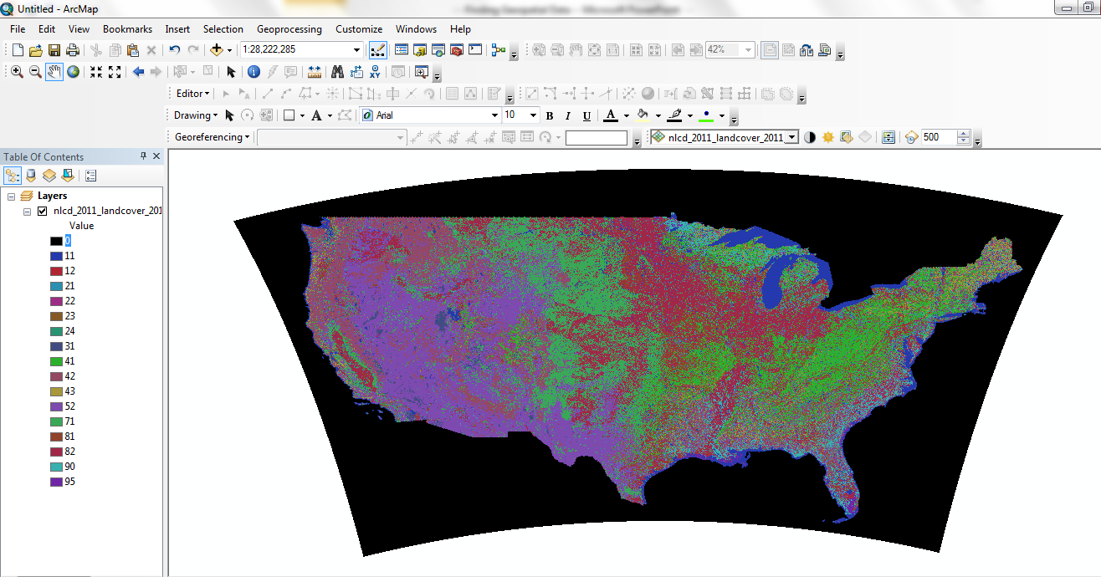
Raster: Land Cover

Slide 5
Raster: Digital Elevation Model (DEM)

Slide 6
Raster: Aerial Imagery and LIDAR

Slide 7
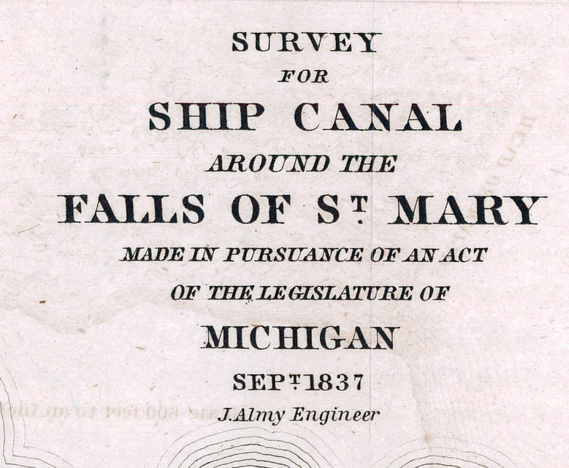
Raster: Scanned Paper Maps

Slide 8
Types of data: Vector
Generally SHAPEFILES, .shp
These usually come in bundles of files:
.shp: shapefile
.xml: metadata
.dbf: attribute table
.prj: projection, spatial information
.shx: shape index file, index of geometry
.sbn and .sbx: spatial index of the features

Slide 9
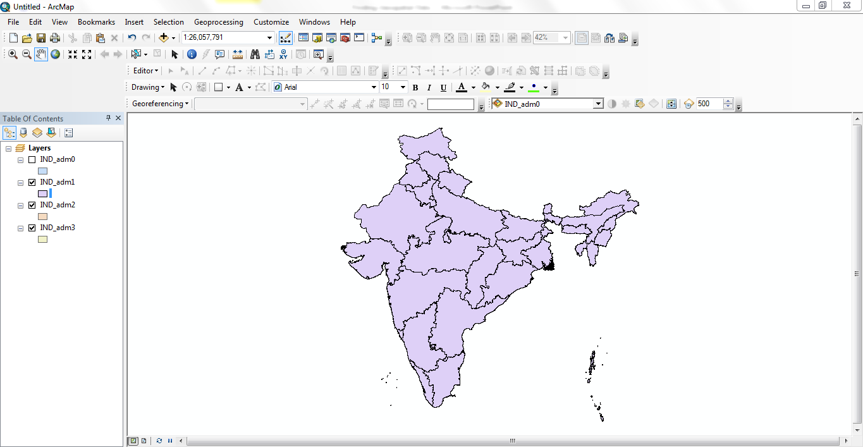
Example of Vector Data 1

Slide 10
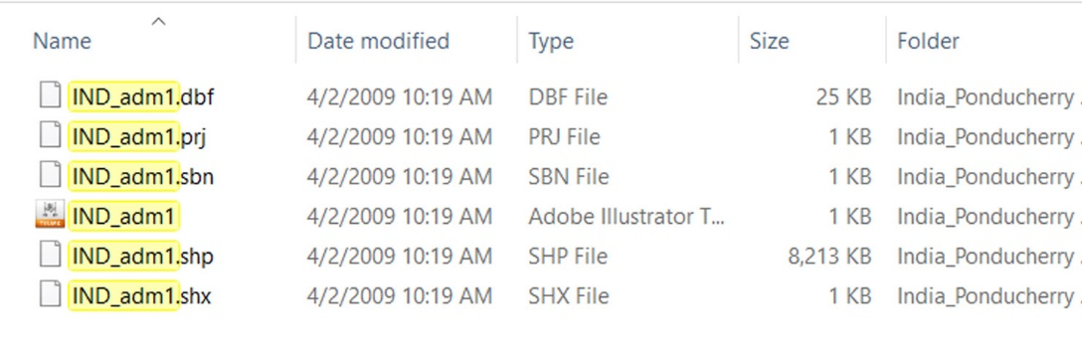
Example of Vector Data 1

Slide 11
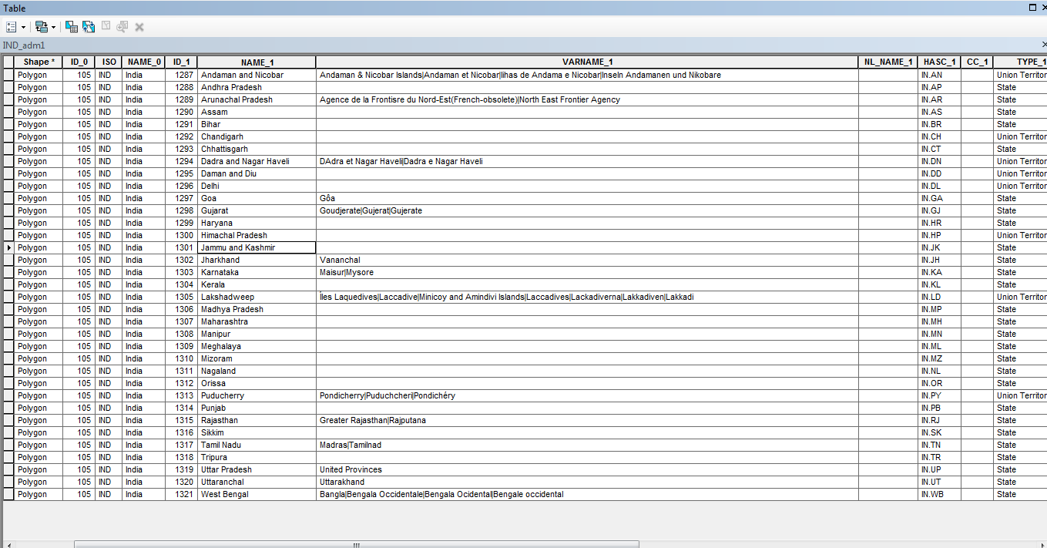
India Shapefile Attribute Table

Slide 12
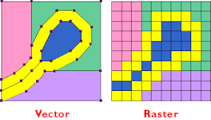
To sum:

Slide 13
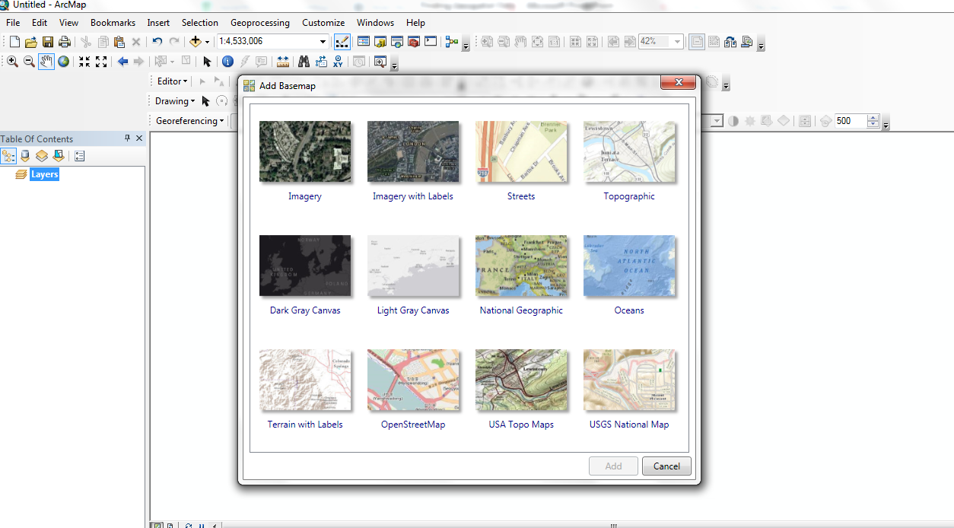
Types of data delivery: Services
Online
Pros/Cons

Slide 14
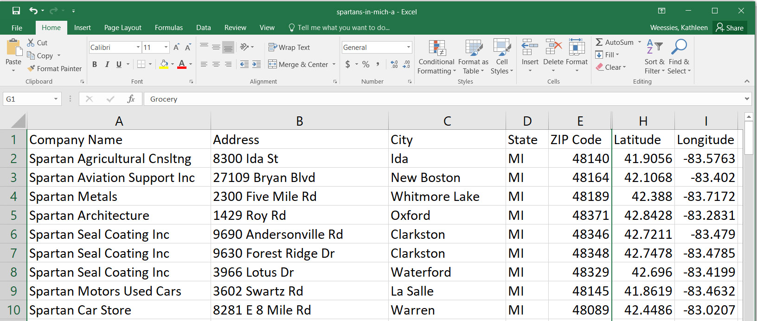
Types of data: Spreadsheets
Linking data via joins
(Show spreadsheet .dbf from earlier vector data of India – good for selection and joining data)
.csv - comma separated values

Slide 15
Projections
Far better if you can get data in all the same projections
You may need to use on the fly projection or re-project the data

Slide 16
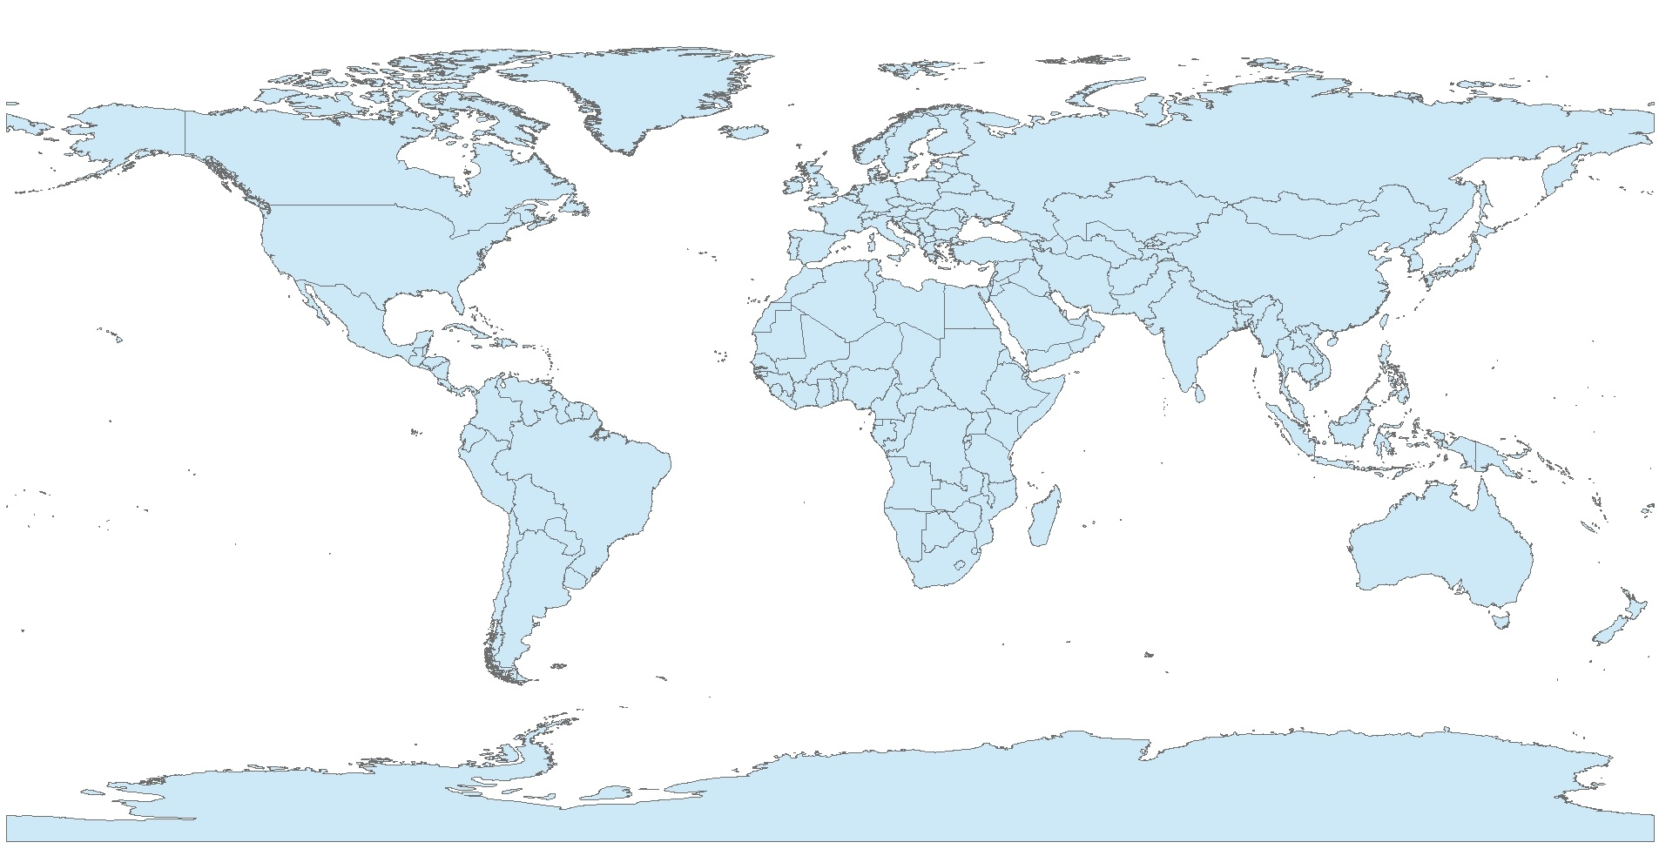
Example of Projections
World countries shapefile in WGS 84 projection

Slide 17
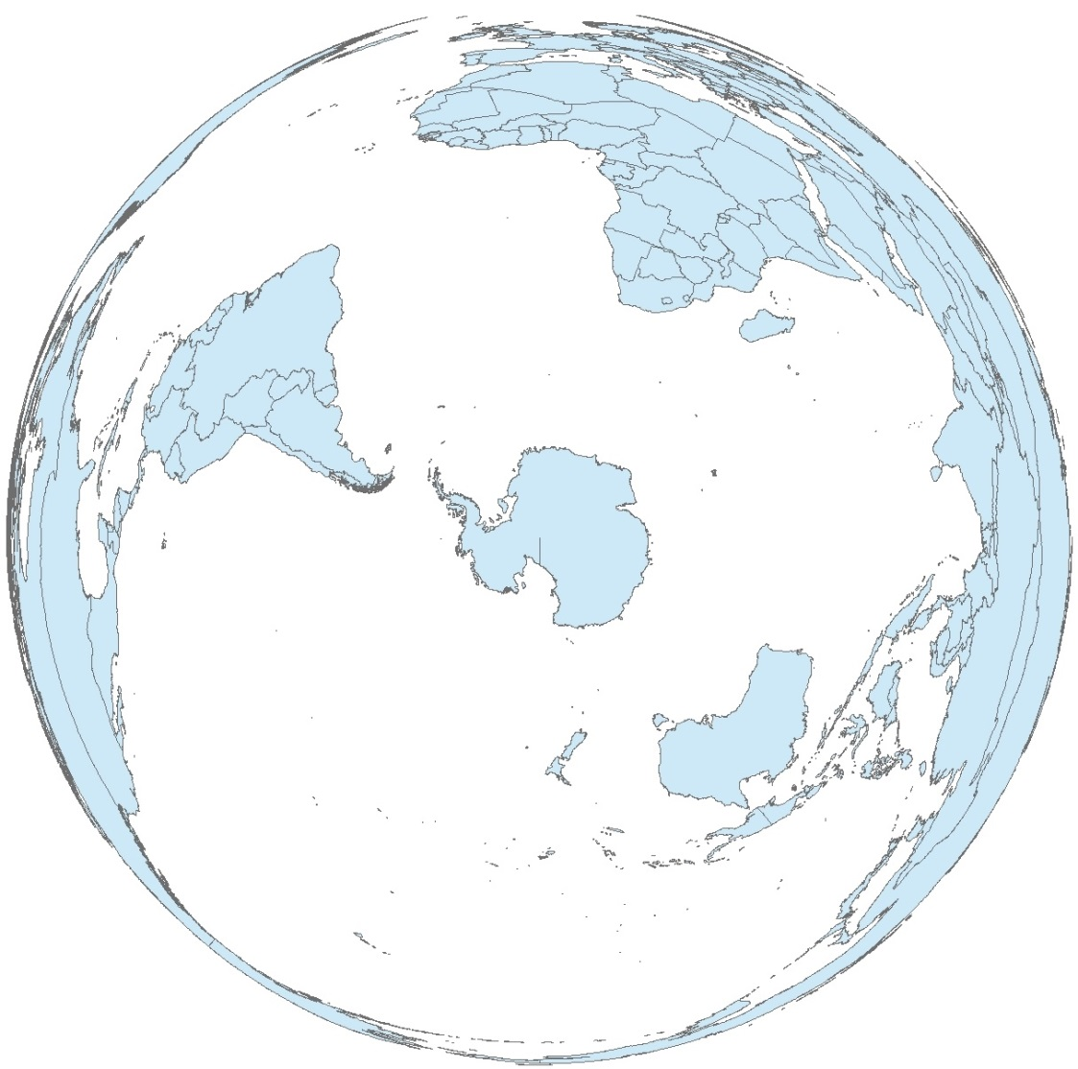
Example of Projections
World shapefile in polar projection

Slide 18
Metadata
Data about data
Data dictionaries are good things

Slide 19
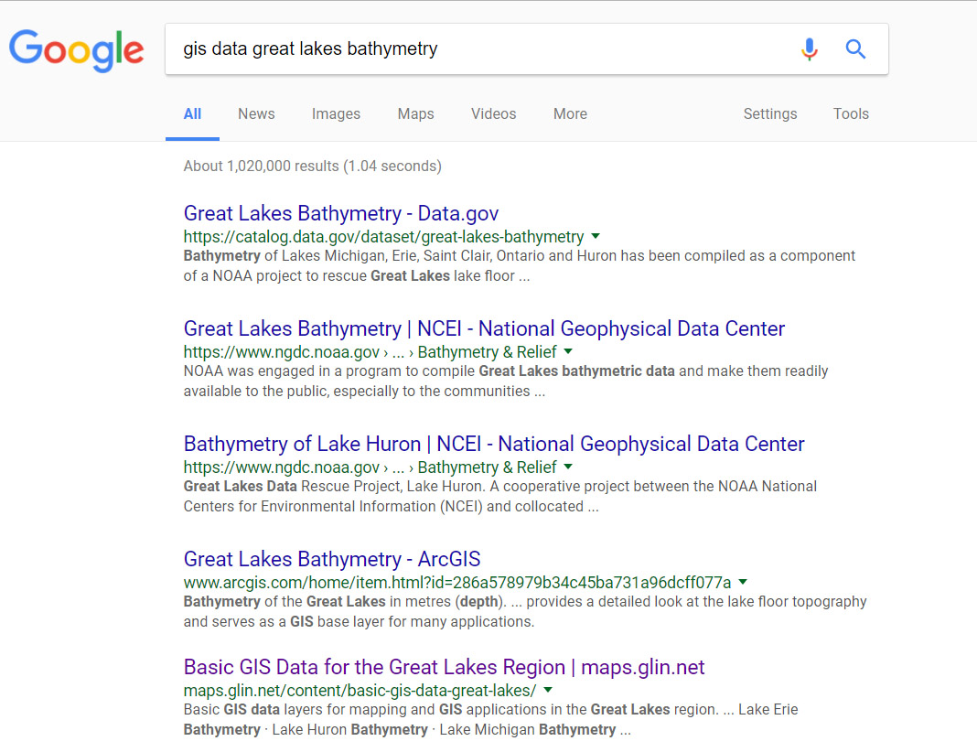
Finding data: May as well Google it
Terms to use: Shapefile, Tiff, file extensions (.shp, .tiff, etc.)
Be specific but not too specific

Slide 20
Finding data: what agency would make this data?
National government agencies
State Government
Local Government
Regional Interest (transportation, planning, GLIN)
Non-profits
For-profit companies

Slide 21
Finding data: International Org or National Government

Slide 22
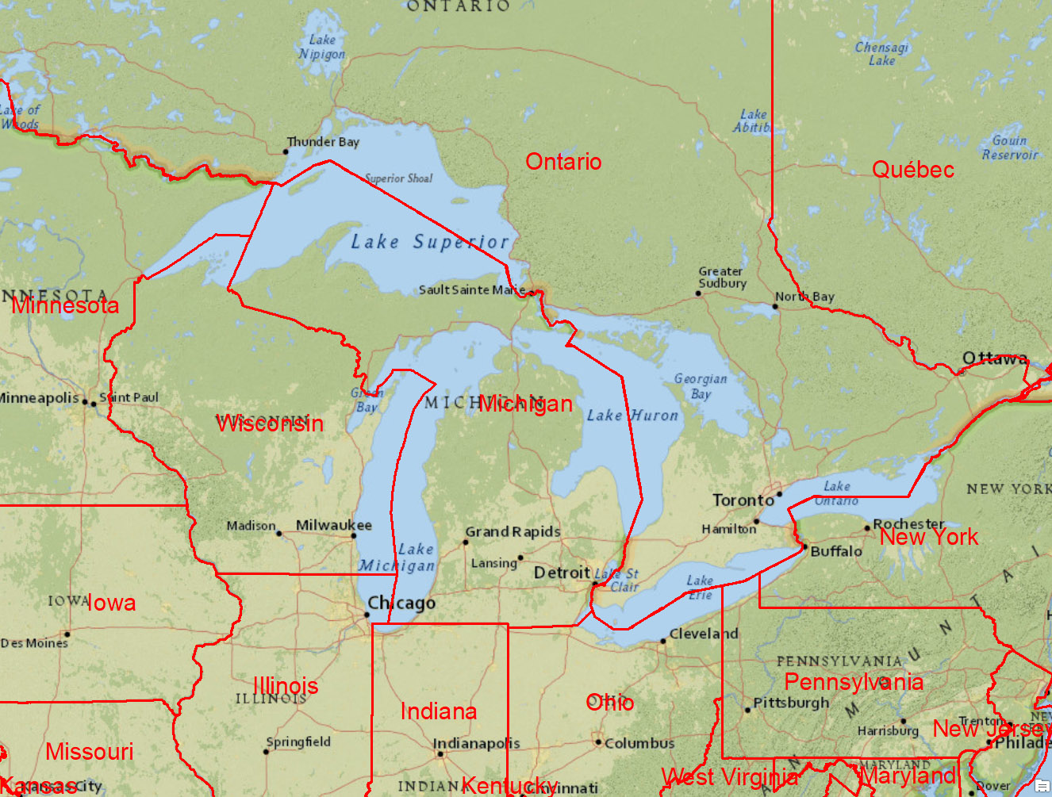
Finding data: State Government

Slide 23
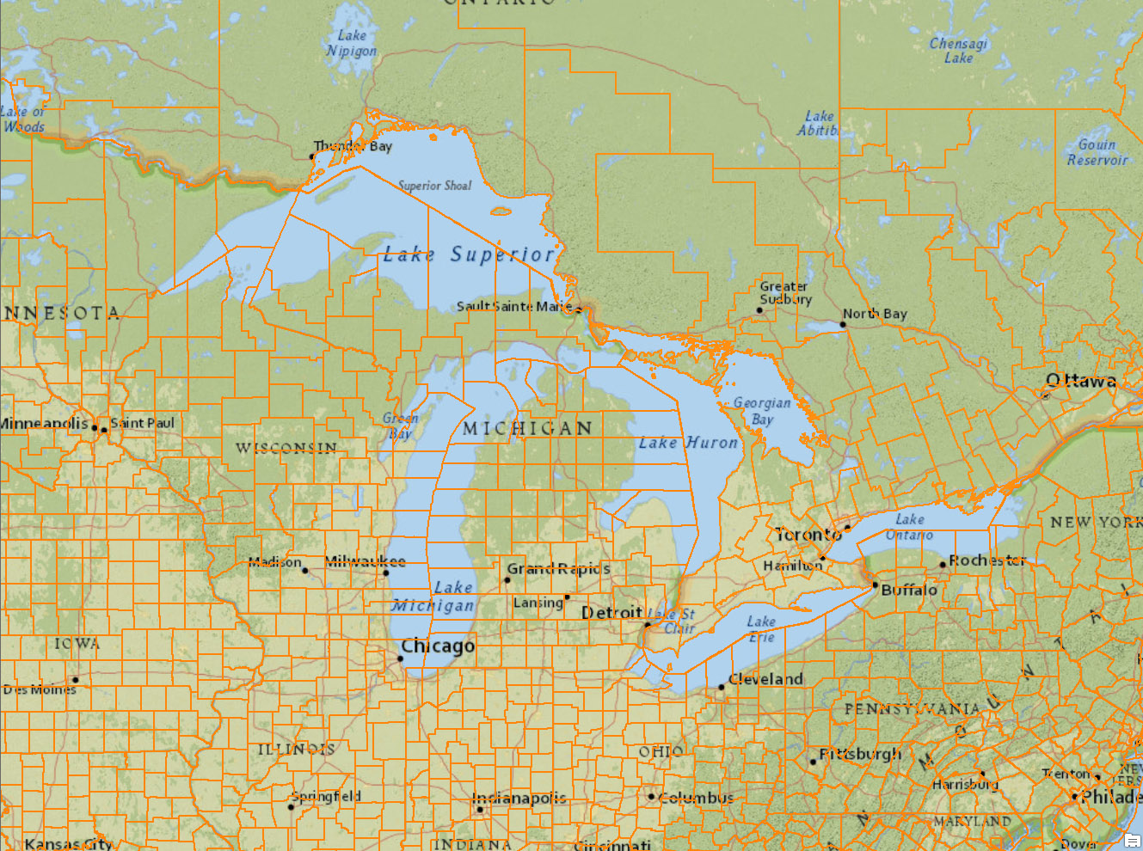
Finding data: county Government

Slide 24
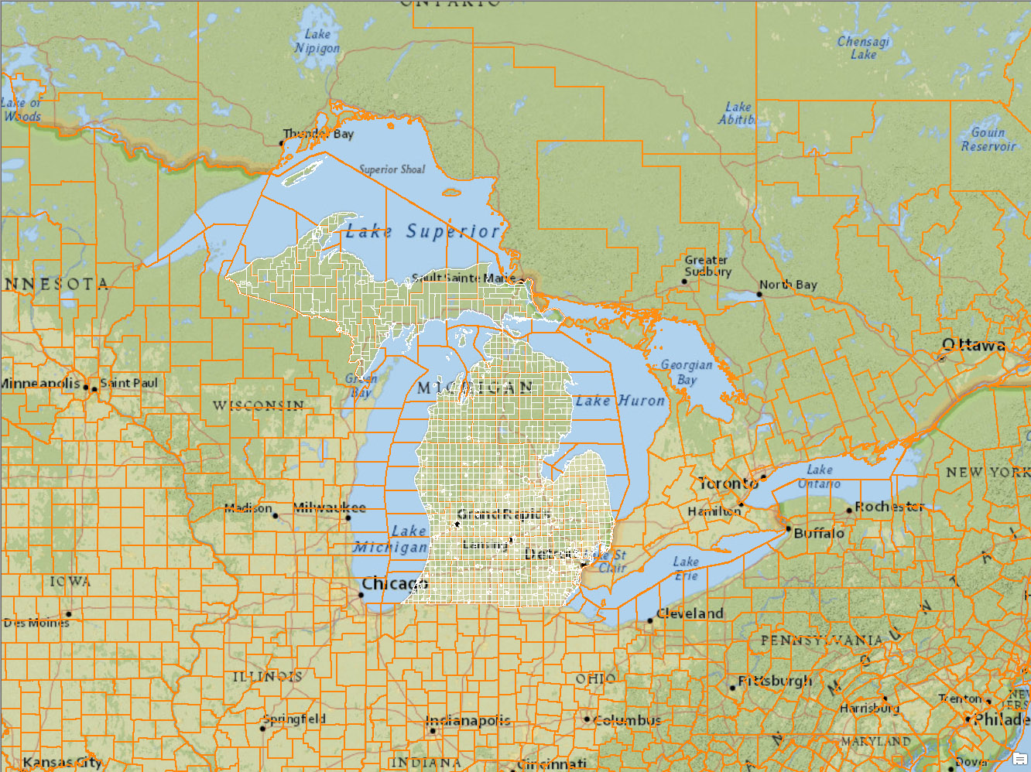
Finding data: local Government

Slide 25
Governments
Canada:
Open Data – Political borders, Roads, Census, etc.
GeoGratis – hydrology, hydrography, Land Cover, Geology, Imagery, etc

Slide 26
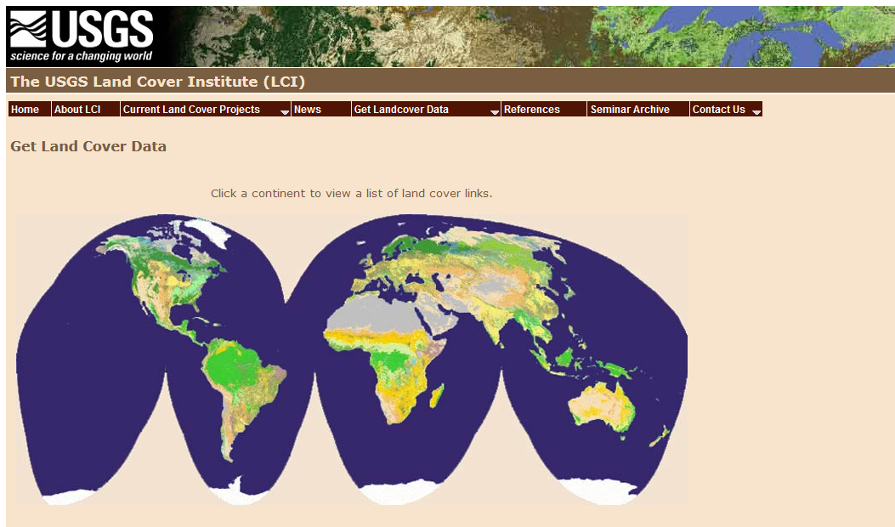
USGS – many flavors
Personal Favorite: Land Cover Institute
http://landcover.usgs.gov/landcoverdata.php
Global data, US Data

Slide 27
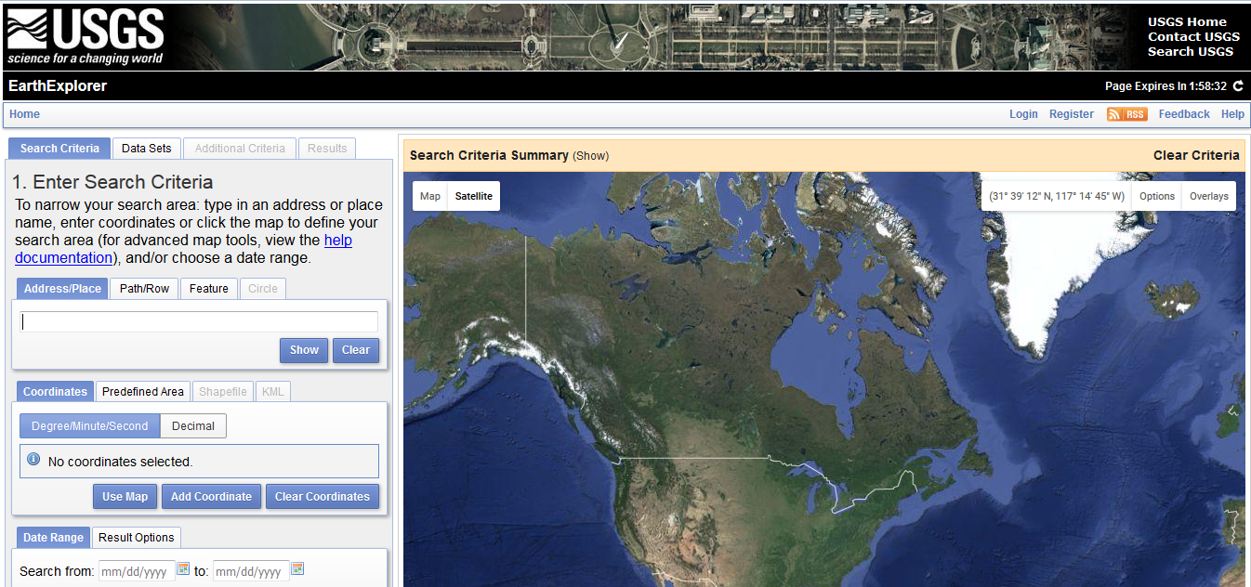
USGS: Earth Explorer
http://earthexplorer.usgs.gov/
Replaces GLOVIS

Slide 28
National Map
http://viewer.nationalmap.gov/launch/
Source for topo maps
Not all items georeferenced

Slide 29
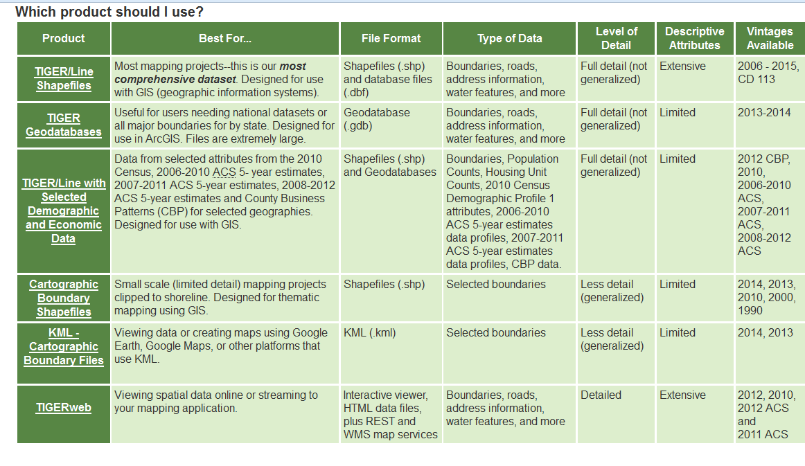
Census Data
https://www.census.gov/geo/maps-data/data/tiger.html

Slide 30
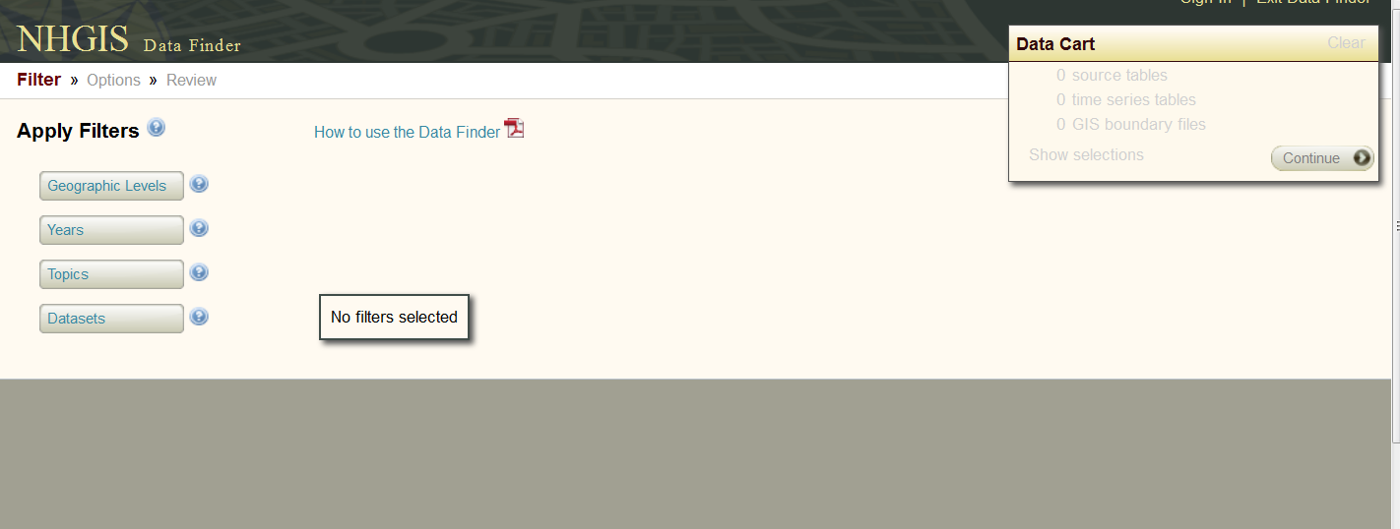
National Historical GIS site (University of MN) https://data2.nhgis.org/main
Shapefiles and data to link – they use unique ID not FIPS
Not all inclusive, can be hit or miss, but earliest data

Slide 31
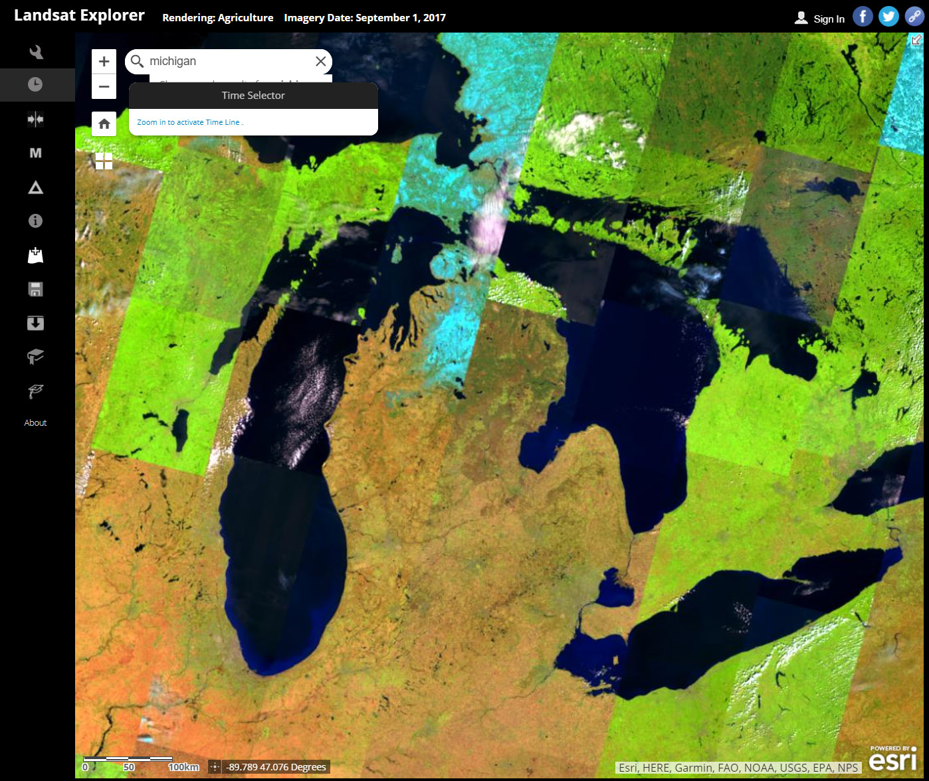
LANDSAT Explorer
http://landsatexplorer.esri.com/

Slide 32
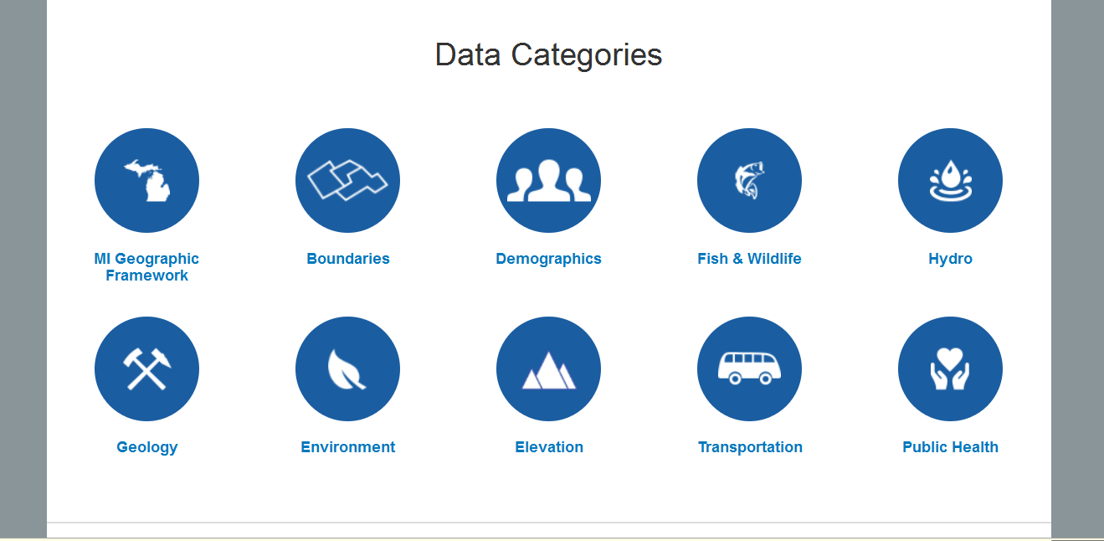
Michigan Geospatial Data site
http://gis.michigan.opendata.arcgis.com/

Slide 33
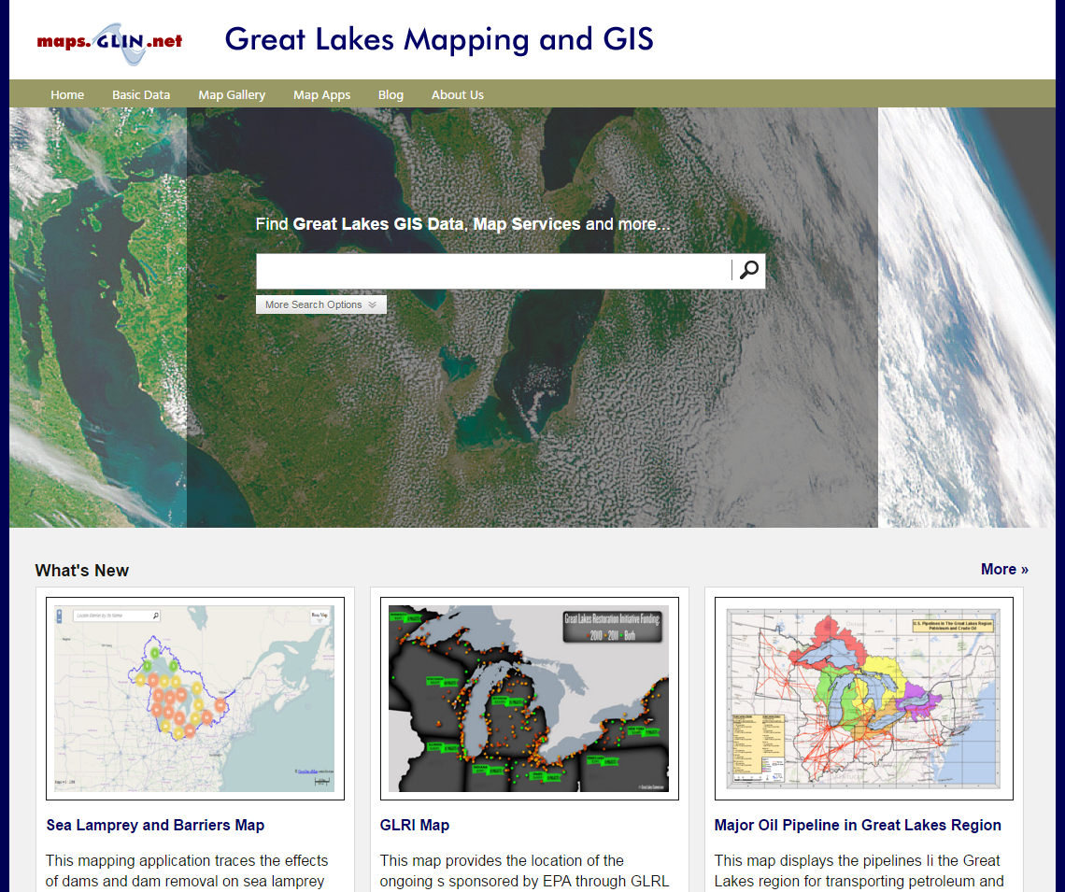
Great Lakes Information Network (GLIN)
http://gis.glin.net
Notes:
This is a service of the Great Lakes Commission, based in Ann Arbor, that provides public access to maps and GIS data for the Great Lakes region.

Slide 34
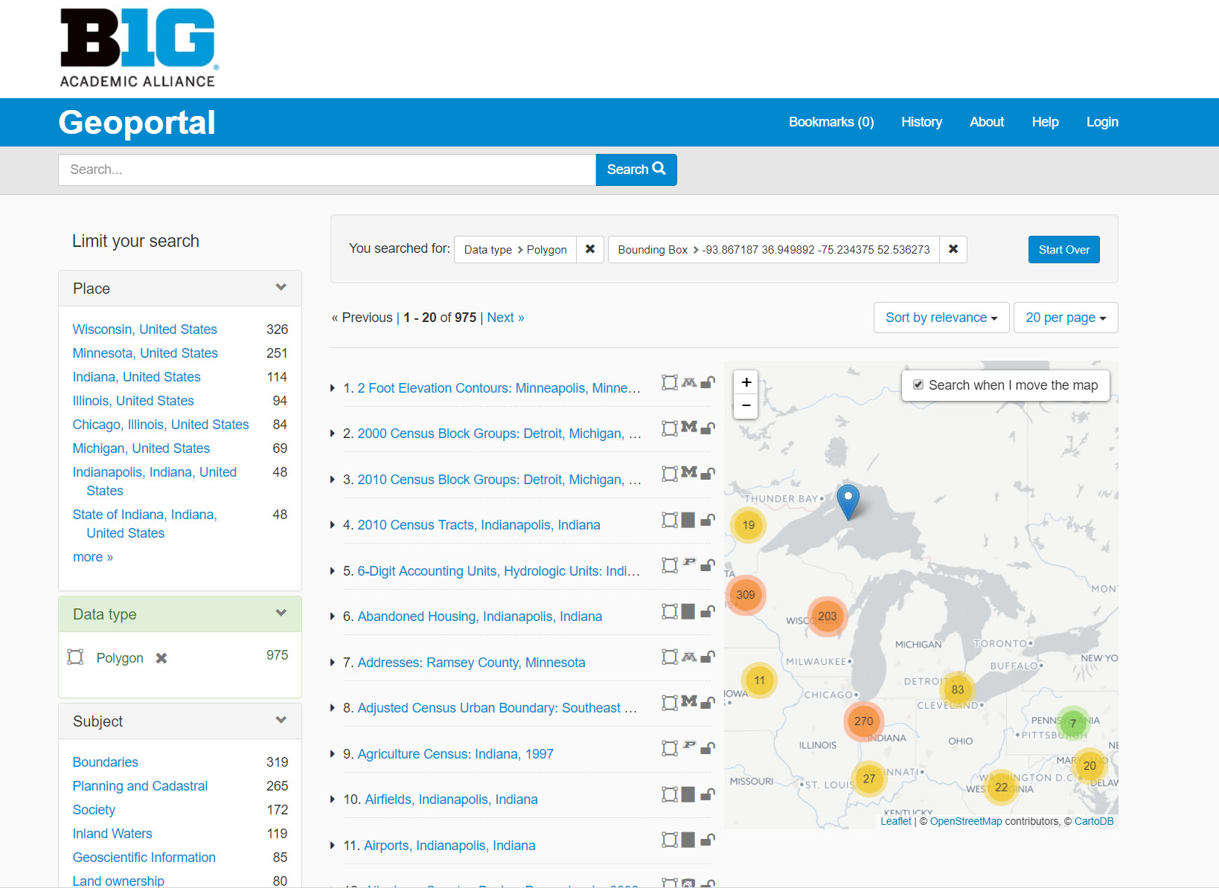
Geo.btaa.org

Slide 35
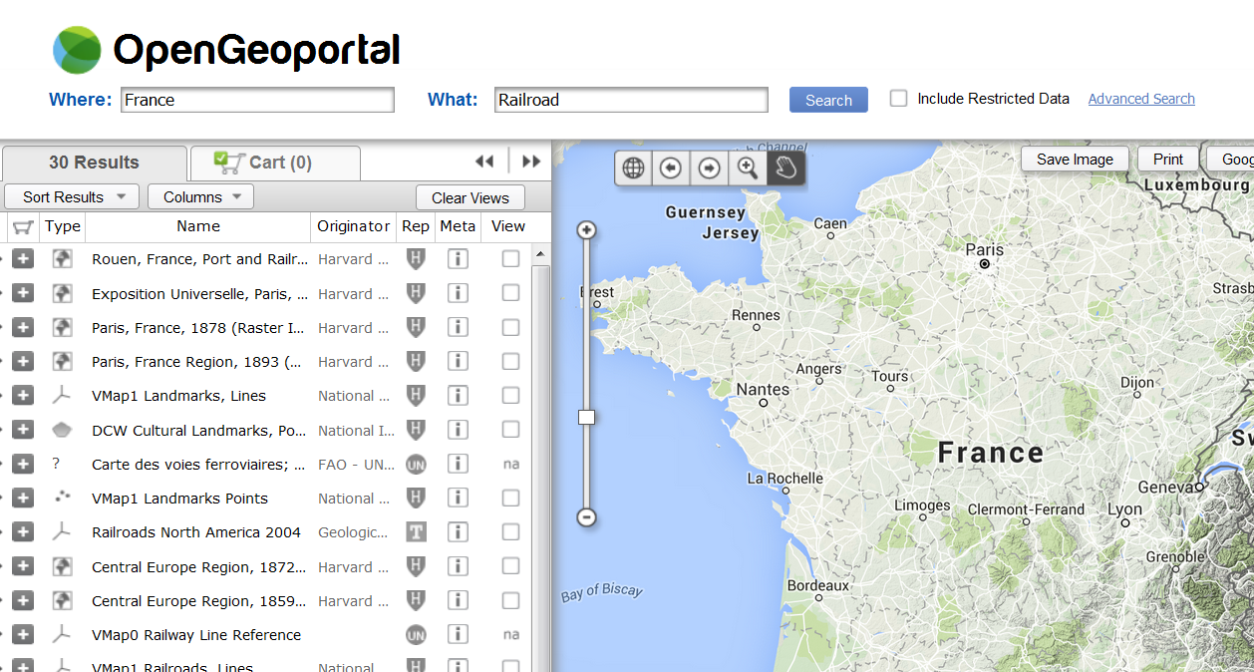
OpenGeoportal
Multi-institution collaboration
http://data.opengeoportal.org/
https://earthworks.stanford.edu/

Slide 36
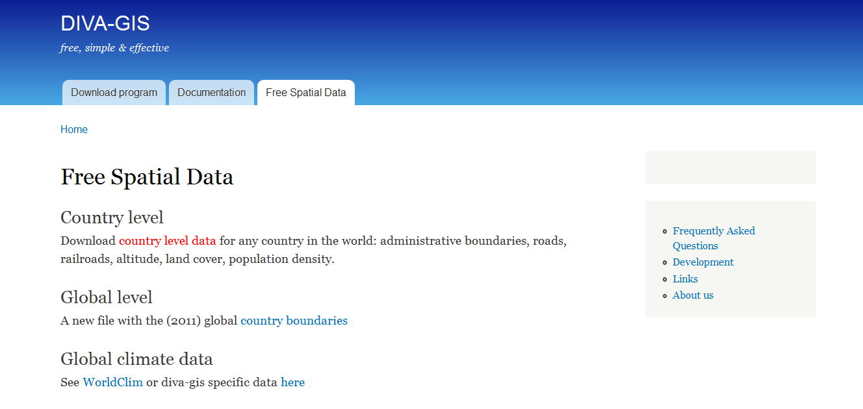
DIVA-GIS http://www.diva-gis.org/Data
Make sure to review metadata…
Clearinghouse, now with rasters (elevation, etc.)

Slide 37
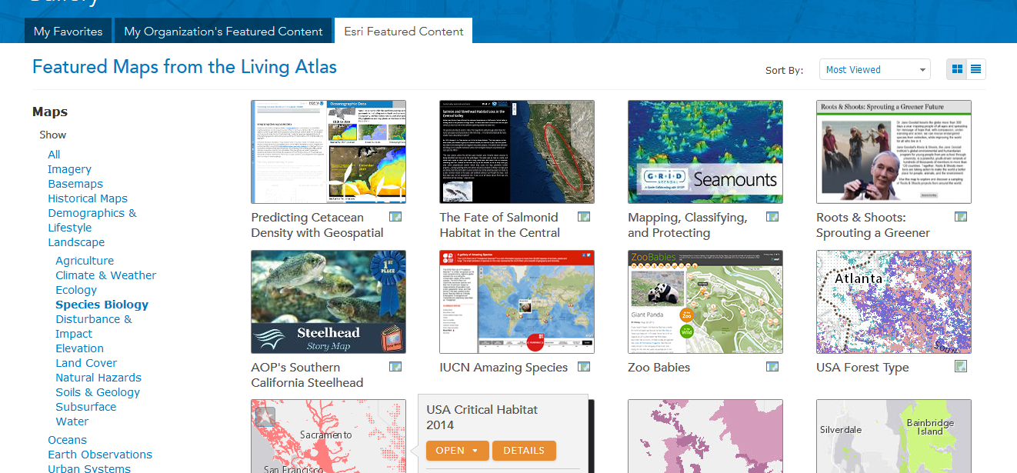
ArcGIS Online
Again, check that metadata

Slide 38
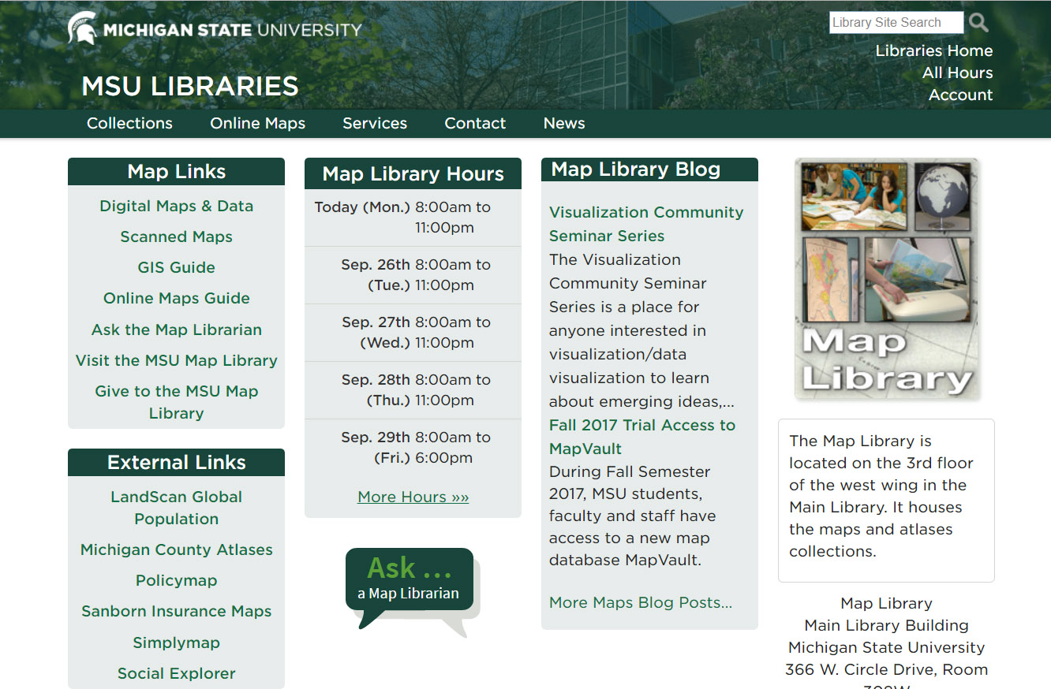
MSU Map Library
http://www.lib.msu.edu/map/

