Slide 1
Survey 123
10/12/16

Slide 2
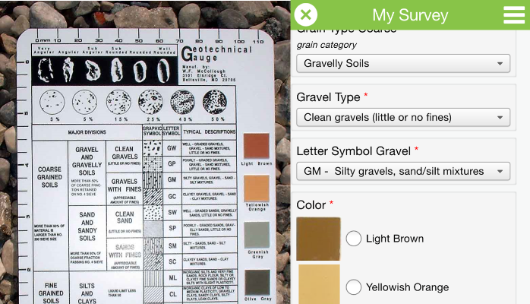
First we will need to sign up for ArcOnline Accounts
www.arcgis.com
Not the free account: the 60 day trial account
Go to your email for activation link

Slide 3
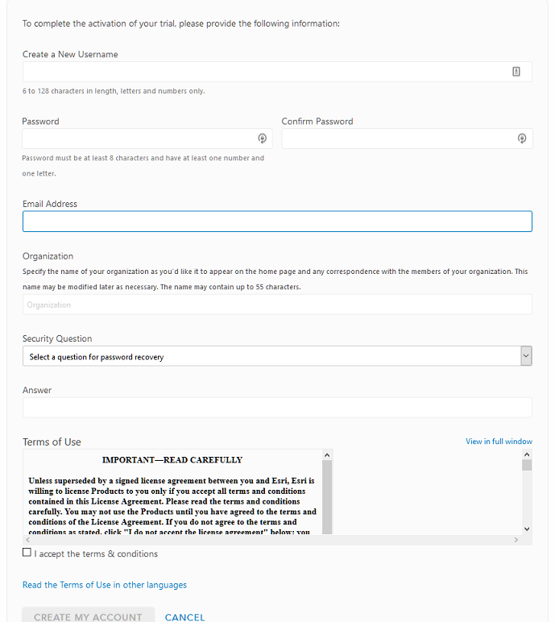
Activate account

Slide 4
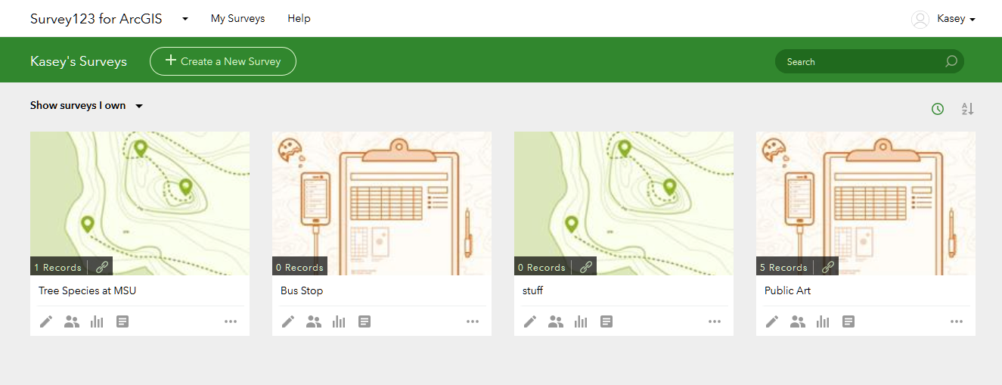
Go to survey123.arcgis.com:
Click My Surveys - Create New Survey

Slide 5
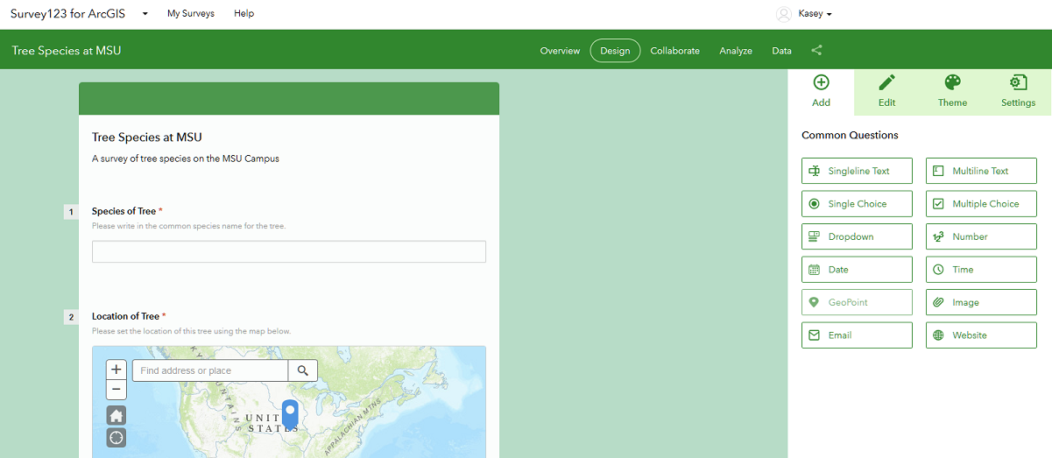
Survey Editor

Slide 6
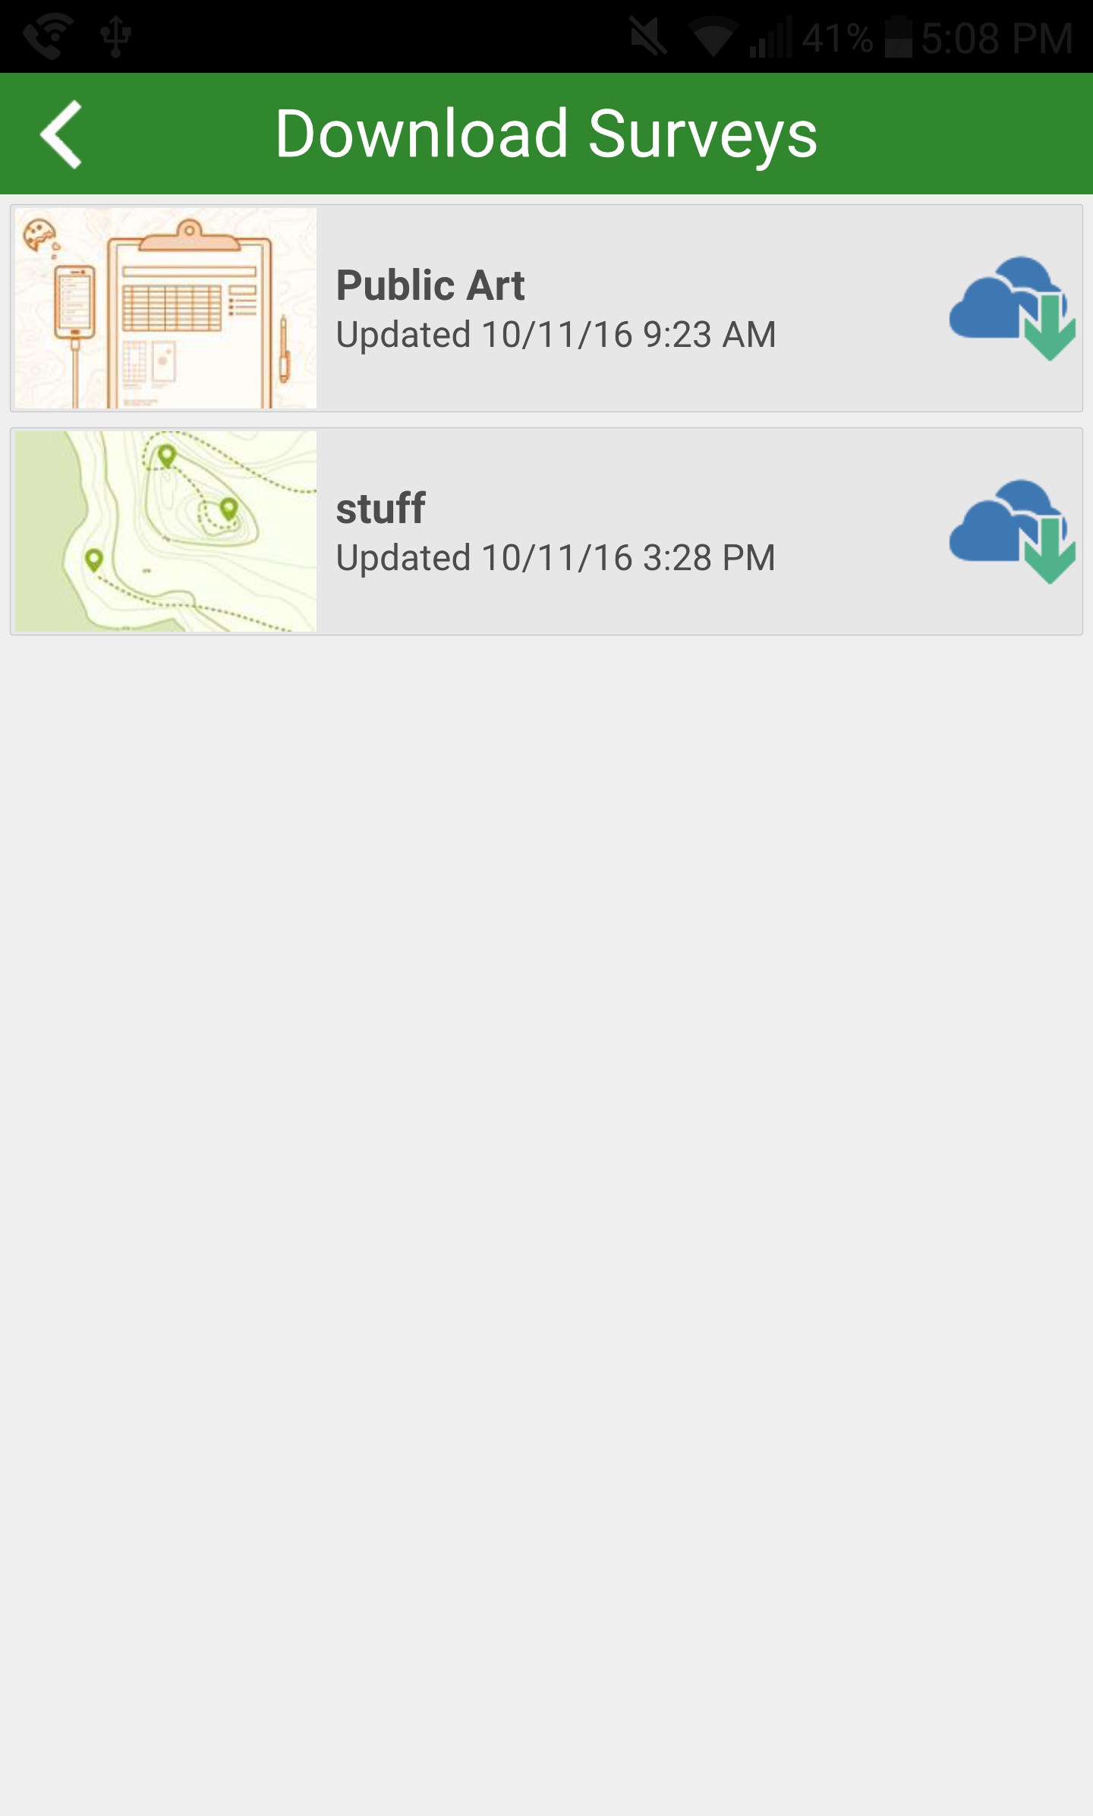
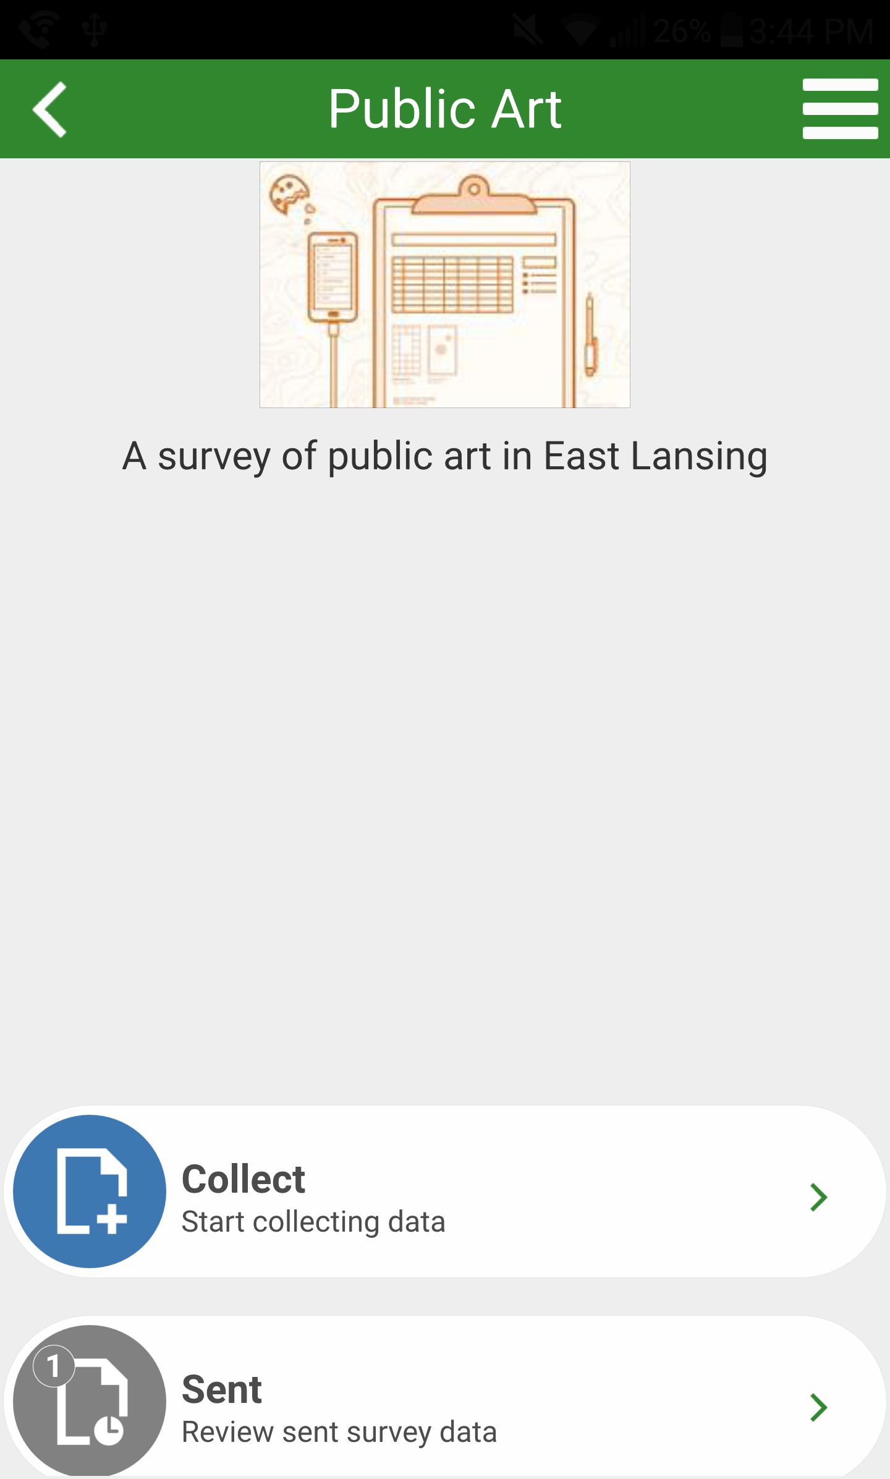
After you make a survey it will appear in your list

Slide 7
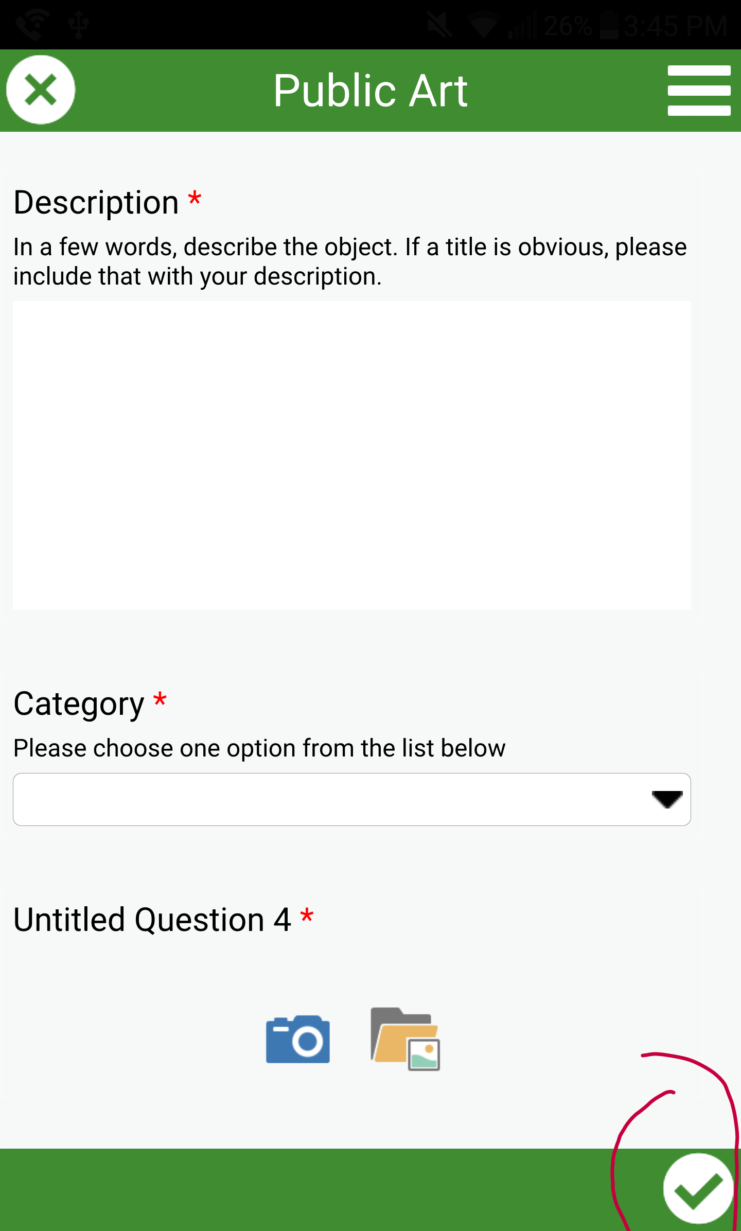
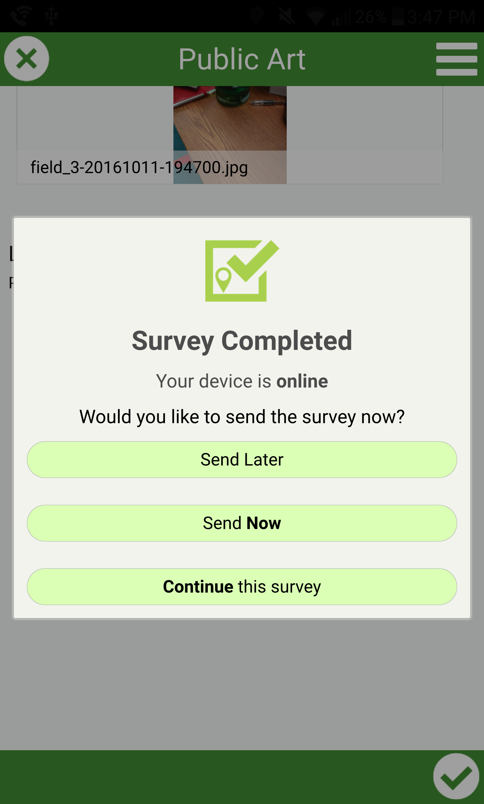
Click Send Now to upload your point

Slide 8
Arc has help files
https://survey123.arcgis.com/help

