Slide 1
GEOCODING
Fall 2016 Library Workshop

Slide 2
Geocoding
Geocoding is the process of converting addresses (like "366 West Circle Drive, East Lansing, MI 48824") into geographic coordinates (such as: latitude 42.731063, longitude -84.483278) which can then be used to place points representing the addresses on maps and create point shapefiles for use in GIS.

Slide 3
What is a geocoder?
A database of addresses and lat/long coordinates
It needs to be built by someone
They are often different from one another in quality and requirements
Geocoders make point type shape files

Slide 4
When to Geocode
When you have a large number of addresses
If you only have a few addresses it may be overkill to automate and batch process the geocoding. You can find coordinate information via Google Maps. Just right click on your result flag and choose “What’s Here?” Click on the Latitude/Longitude link and copy the result in the search box – not the degree/minute/second result (so this: 44.988834,-93.216097 NOT: 44°59'19.8"N 93°12'58.0"W). This lat/long can be copied into an excel spread sheet, where you can use the text to column tool to split the field into Latitude and Longitude fields and then import the sheet into ArcGIS or QGIS to create XY data points.

Slide 5
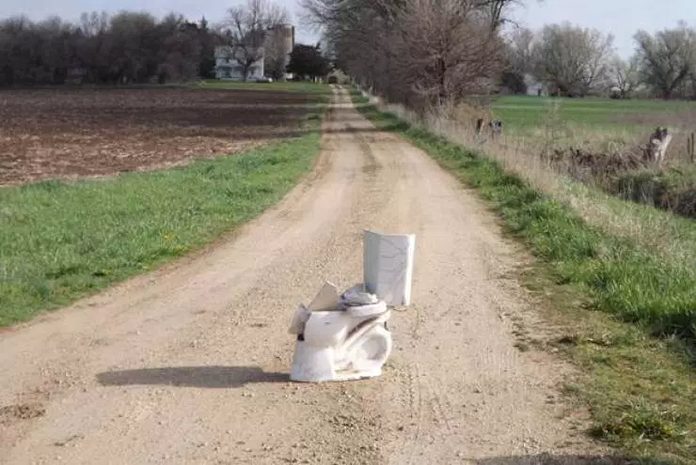
Limitations: geocoding Gone wrong Max Mind Geocoding Ip Addresses
Notes:
http://fusion.net/story/287592/internet-mapping-glitch-kansas-farm/

Slide 6
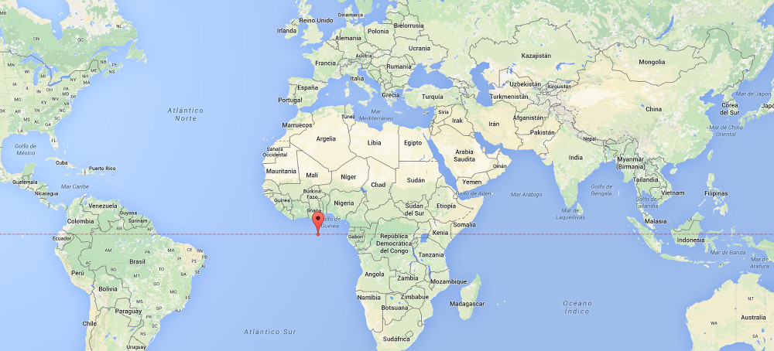
Null Island

Slide 7
Geocoders For Hire: SmartyStreets, GEOCODIA
Up to 250 addresses per month free w/Smarty Streets
https://smartystreets.com/signup
Geocodia – 2,500 free per day, .0005 cents per address after that
https://geocod.io/faq/

Slide 8
TAMU Geoservices
http://geoservices.tamu.edu/Services/Geocode/
They also have batch correction services
And they have details about how their geocoder works

Slide 9
Carto
carto.com
Free webmapping tool
Limited number of addresses per month
You can still make a free account!

Slide 10
QGIS - MMQGIS
QGIS MMQGIS Plugin – uses the Google API. It wants a .csv with an Address field, a city field, a state field, and a county field is optional.
2,500 addresses in a 24 hour period
Will output a shape file and an error .csv
Formatting .csv:
What does your geocoder want?
Notes:
If you want to combine them again: CONCATENATE or CONCAT =CONCATENATE(B3," ",C3," ",D3,” “,E3) – need to redo this and make sure to add , s in all…
Selecting a range to the end – SHIFT, CTRL, DOWN ARROW
Added a comma for both , and space splitting
Added an extra space for “TRIM” function
REMOVING DUPLICATIONS – Show REMOVE DUPLICATES FUNCTION IN DATA – TEXT TO COLLUMNS
http://www.exceltip.com/tips/how-to-select-first-5-characters-from-another-cell.html
Removing Zip Numbers after
=RIGHT(A1,LEN(A1)-[number of characters to remove])
OKAY – THINGS I’M GOING TO SHOW THEM:
Remove duplicates
Split on ,
Grab Right 5 characters – either split again using that tool, OR Right(B2,5) then =Right(B2,LEN(B2)-5)
Trim extra space (SHOW THAT I AM NOTICING THIS BEFORE WE SPLIT THE FIELDS)
(Reverse all this – CONCATENATE)
Save as .csv

